Slide 1
The Perinatal Loss Experience
Sarah Greer RNC-OB, BSN
Laura Wallenfang MSN, RNC-OB, PCCN

Slide 2
Objectives
The learner will have a better understanding and be more prepared to meet the needs of bereaved parents and their family during the initial crisis of the loss of their baby.
The nurse will learn new techniques of memory making through the use of grief photography and keepsakes.

Slide 3
-The presenters today have no conflicts of interest (actual or potential) or bias to disclose.
-No commercial support or sponsorship has been received.

Slide 4
The Perinatal Loss Experience
Miscarriage (<20 weeks gestation)
10-15% of all known pregnancies
Stillbirth (>20 weeks gestation)
24,000-26,000 / year in U.S.
Neonatal Death (within 28 days of birth)
4:1,000 live birth
1 in 4
(CDC/NCHS, National Vital Statistics System)
Notes:
However, these are not just statistics. These are people and their experience.

Slide 5
The Perinatal Loss Experience:
Notes:
If not you, then likely someone at your table…

Slide 6
Early Pregnancy Loss
Important to understand the meaning of this pregnancy before options are offered
75% of women who miscarried felt they had lost a baby; 25% felt the loss was not significant and that it was just another life experience (Limbo & Wheeler)
Factors that influence how a person feels about the pregnancy include:
Length of pregnancy
Planned or not
Wanted or not
Notes:
Let’s start with early pregnancy loss

Slide 7
Early Pregnancy Loss
Women presenting to the ED with pregnancy loss
Do not use terms such as “spontaneous abortion”
Identified a gap in service to the community
“I felt lost and didn’t know what to do next.”
The miscarriage kit is now offered OSF Mission-wide in ED’s
Miscarried remains may be brought to any OSF hospital for burial
Miscarriage Support Folder provided in EDs and ORs
Resources for support, local contact person, information on miscarriage or ectopic loss

Slide 8
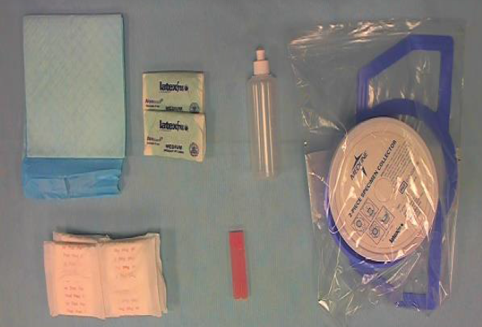
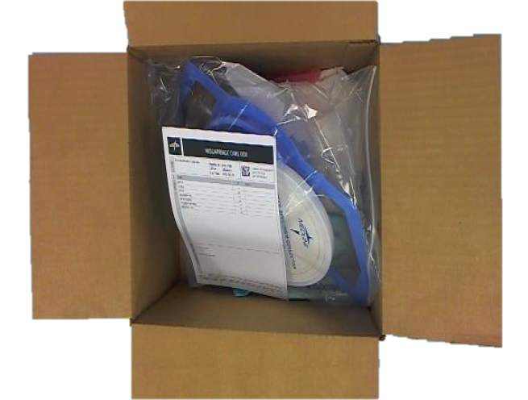
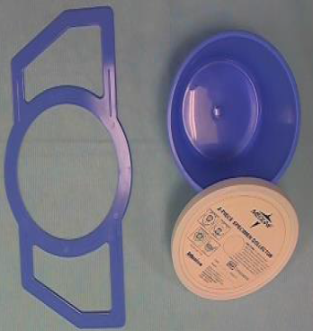
Medline Fetal Loss Kit – Premier #10306171, Medline #DYKL1398

Slide 9
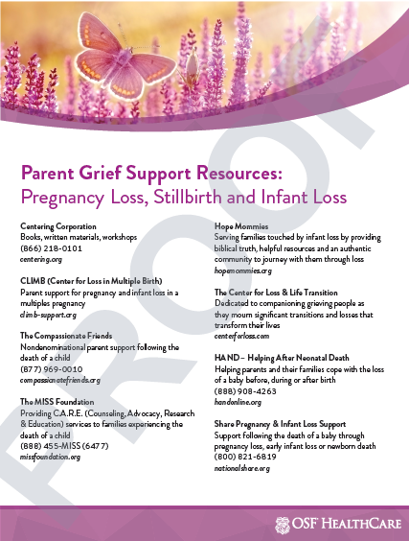
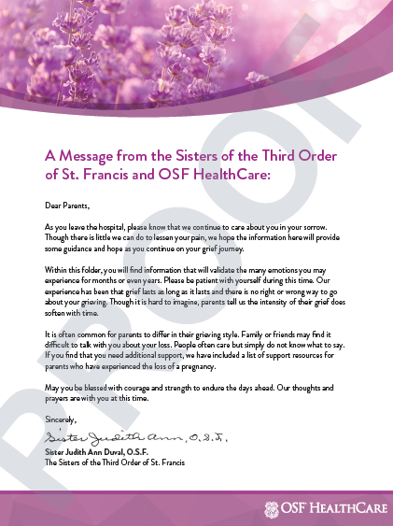
Preassembled Folder SmartWorks Order Item # WHS-0104-OSF
Folder charged to site ordering
Folder
Contents

Slide 10
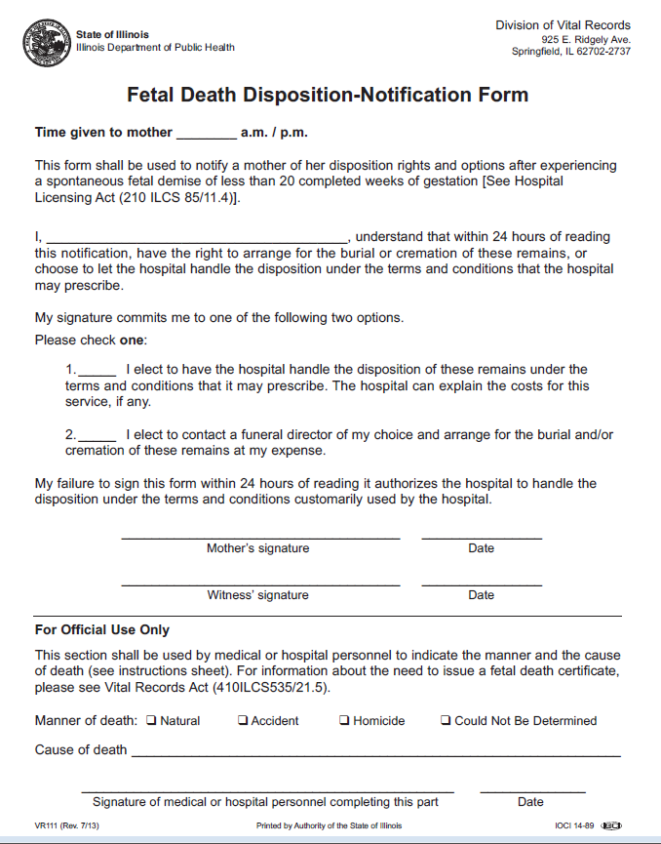
Fetal Death Disposition-Notification Form (VR-111)
Required by the State of Illinois for a pregnancy loss of <20 weeks
Documents that the mother has had her rights & options explained to her
Place a copy with the fetal remains when sending to the lab

Slide 11
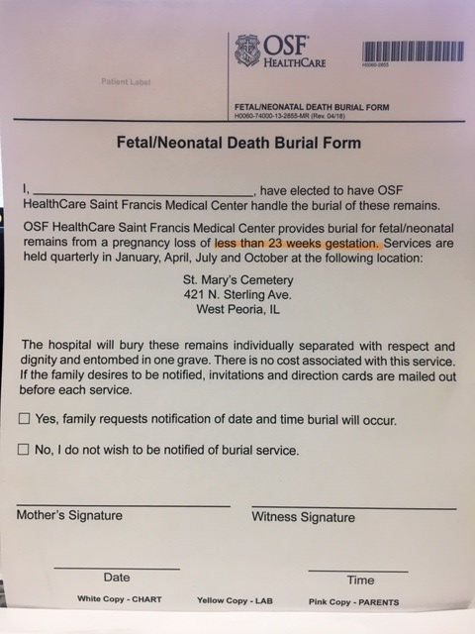
OSF Healthcare Fetal /Neonatal Death Burial Form
Only fill out if the mother wishes to have her baby included in the OSF Burial Service
white copy-Chart, yellow copy-Lab, pink copy-Parents
Offered for a pregnancy loss of <23 weeks
Mother checks the box to indicate if she requests notification of date / time of service

Slide 12
OSF Hospital Burial Service
Services held quarterly: January, April, July, October
St. Mary’s Cemetery in West Peoria
Deacon performs a Christian burial service
Parents are encouraged to invite family / friends
Fetal remains are placed in individual containers with respect and dignity, then placed together in one casket
Gravesite is marked with a metal plaque with date of service
Parents appreciate knowing that their baby was handled in a dignified manner and that there is a location marking the brief existence of their baby

Slide 13
OSF Burial Service

Slide 14
The L&D Experience:
Triage diagnosis??
Do not leave your patient, call for assistance and sono
Do not offer excuses or lie. They know something is wrong and they need to trust you as the care provider

Slide 15
The L&D Experience:
What to say:
Acknowledge what happened
Express your concern
“I’m sorry this happened to you and your family”
Be genuine in your communication
“I’m not sure what to say but I want you to know that I care and am very sorry for your loss.”

Slide 16
The L&D Experience:
What not to say:
He / she is in a better place
You now have an angel in heaven
It’s part of God’s plan
You’re young, you can have another baby
I know how you feel
You’ll get over this
He /she wouldn’t want you to be sad
At least you hadn’t gotten to know them

Slide 17
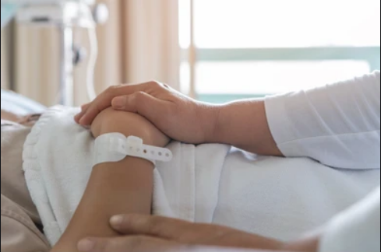
The Perinatal Loss Experience:
They may not always remember your name or what you looked like but they will always remember how you made them feel.

Slide 18
The L&D Experience:
Speaking with Bereaved Parents:
Admission
Before you enter the room…pause. You are about to enter a sacred space.
Find out what place your patient is at and meet them there.
Are they ready to proceed with induction?
Do they just need you to sit by them, be quiet and present?
Do they need some time alone with their significant other?
Notes:
Be still and center yourself.
Think about the situation you are about to encounter.
Think about the relationship between you and the person you are about to meet.

Slide 19
The L&D Experience:
Speaking with Bereaved Parents:
Ask open ended, indirect questions
“What are your thoughts about…?”
Some parents want _____, how does this feel to you?
Ask them to share about their baby
If the baby has a name, refer to the baby by that name. This validates and honors that baby’s life.

Slide 20
The L&D Experience
Find out about their cultural / religious traditions
Not a “cookbook” approach
“Model” for the family how to interact with the baby and address their fears. They are likely worried about how the baby will look.
Encourage siblings to see and hold if appropriate

Slide 21
What Families Grieve:
A baby they planned to have
The opportunity to be a parent
Changes in family composition
Sense of control / security
Hopes and dreams for their future

Slide 22
“When you lose a parent,
part of your past dies.
When you lose a spouse,
part of your present dies.
When you lose a child,
part of your future dies.”
-Anonymous

Slide 23
Memory Making
Bereavement Photography
Must have written consent
Black & white, journalistic style
Include objects that have meaning to the parents
Include the name when possible
Family members
Saline submersion photos

Slide 24
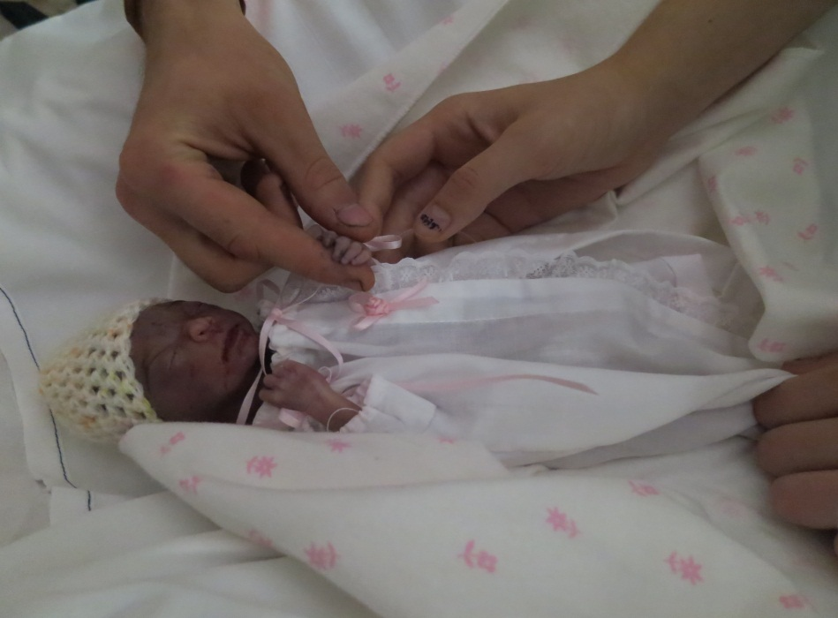
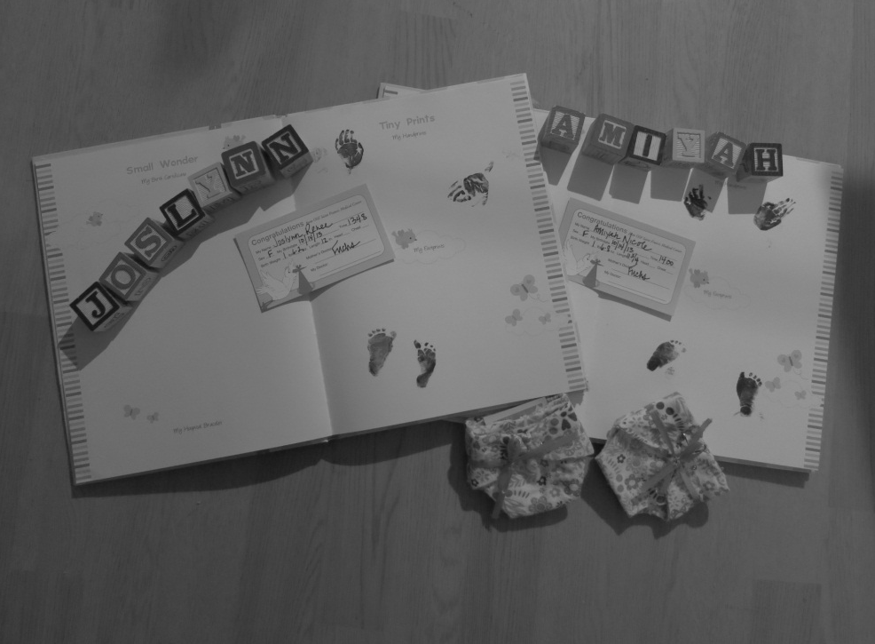
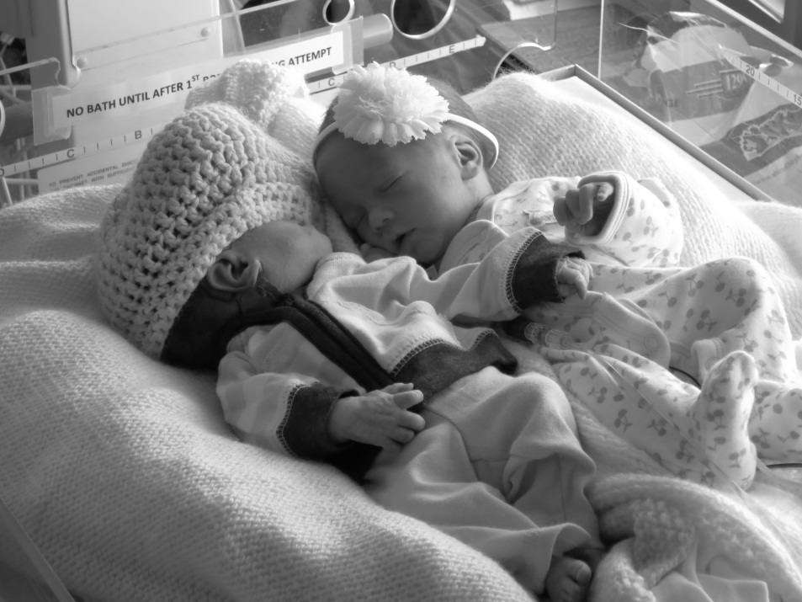
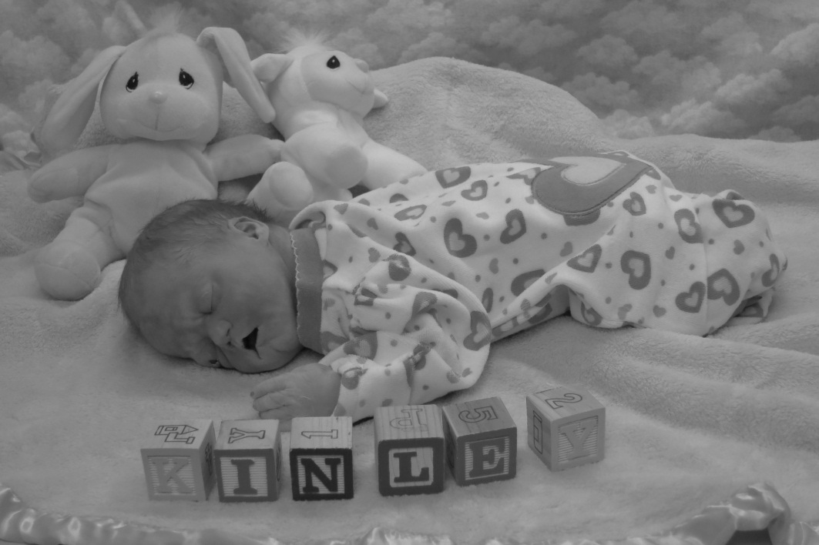

Slide 25
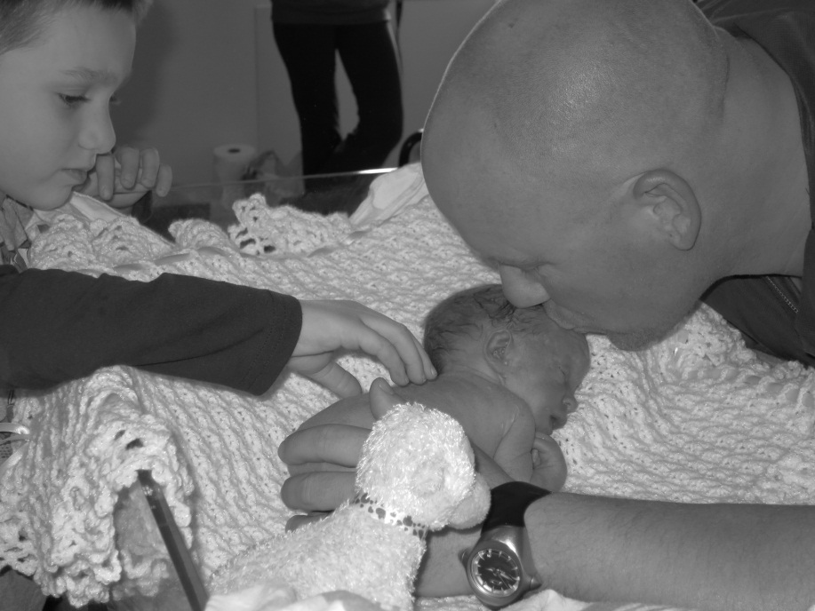
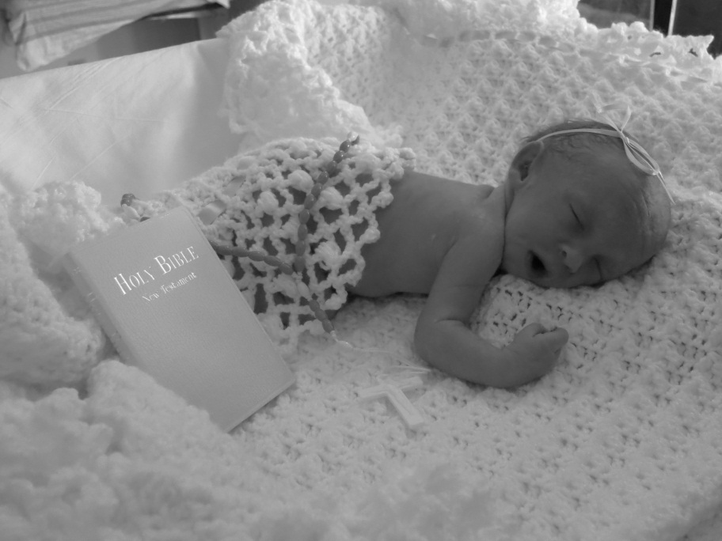
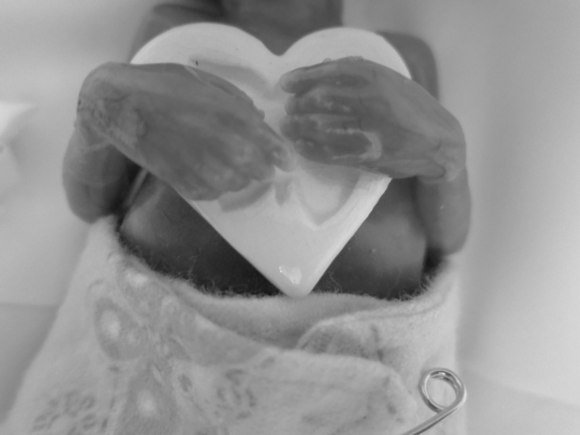
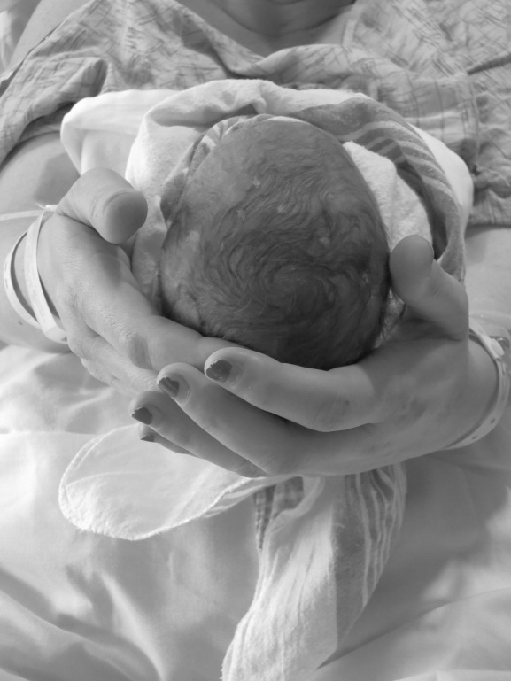
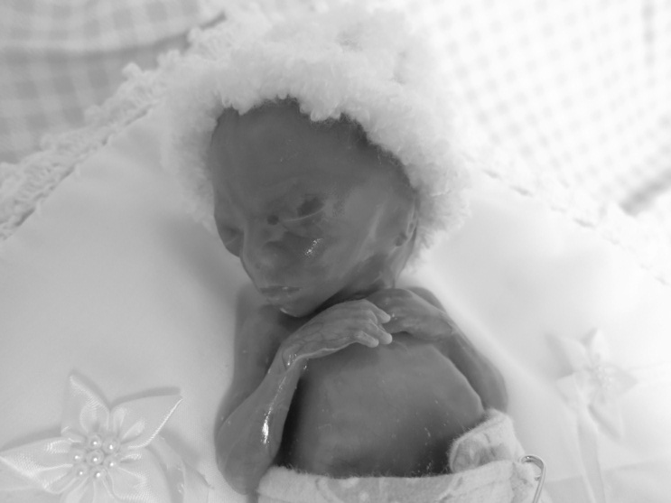

Slide 26
Close up shots of the hands and feet are important. Please take photos before using ink for footprints. If you forget, clean feet well. Lotion often removes the ink without harming the skin. Use objects in photos that will be important to parents.

Slide 27
-Ask yourself: “Have I gotten the photos that are going to have meaning to these parents?”
-Remember these are the only pictures they will ever have of their child.

Slide 28
Memory Making
Offer to mom and dad to bathe and dress the baby if appropriate. Allow them to parent this child in the short time they have.
Foot and hand molds
Foot prints
On scrapbook cards
Can do sibling’s prints side by side
On birth certificate
On memory book
On Bible

Slide 29
Care After Delivery:
Where is the mother’s room? Father’s experience
Time: quality or quantity?
Cuddle Cot
Sit…Allow parents to talk about their baby / feelings
Lactation suppression
PPD screen
Pastoral Care
Counseling services
Do they have their folder and resources before discharge?
1-2 week postpartum visit with OB

Slide 30
Response to Loss: Mothers
Typically more intense in acute grief
May display more emotion
Impacted by physiological changes and hormone levels
May feel deeper attachment to baby, particularly in early months of pregnancy
May feel openly responsible for the loss or the inability to carry to viability

Slide 31
Response to Loss: Mothers
Physiological grieving
Loss of energy and fatigue
Change in sleep habits
Decreased concentration and forgetfulness
Muscle aches or weakness
Headaches
Nausea, lack of appetite

Slide 32
Response to Loss: Mothers
Physiological grieving, cont.
Restlessness, irritability
Pain or heaviness in chest
Shortness of breath
Dizziness
Hot / cold spells
Changes in sexual desire
Make sure your patient knows these are all normal physical responses to grief.
Written info

Slide 33
Response to Loss: Fathers
Grief may be more controlled, less visible; may feel a need to be “strong”
Level of attachment to baby, prior to delivery, can be more abstract
Can have intense need to care for the mother
Often returns to work / routine more quickly

Slide 34
Notes:
All learned in school
Nice smooth line, going through the steps
Not designed to describe someone grieving the loss of a loved one
Kubler Ross was in the study of death and dying. Her focus was on terminally ill patient’s and their grief process facing death.
Over the years, this is how many have described their grief journey to me after the loss of a child….

Slide 35
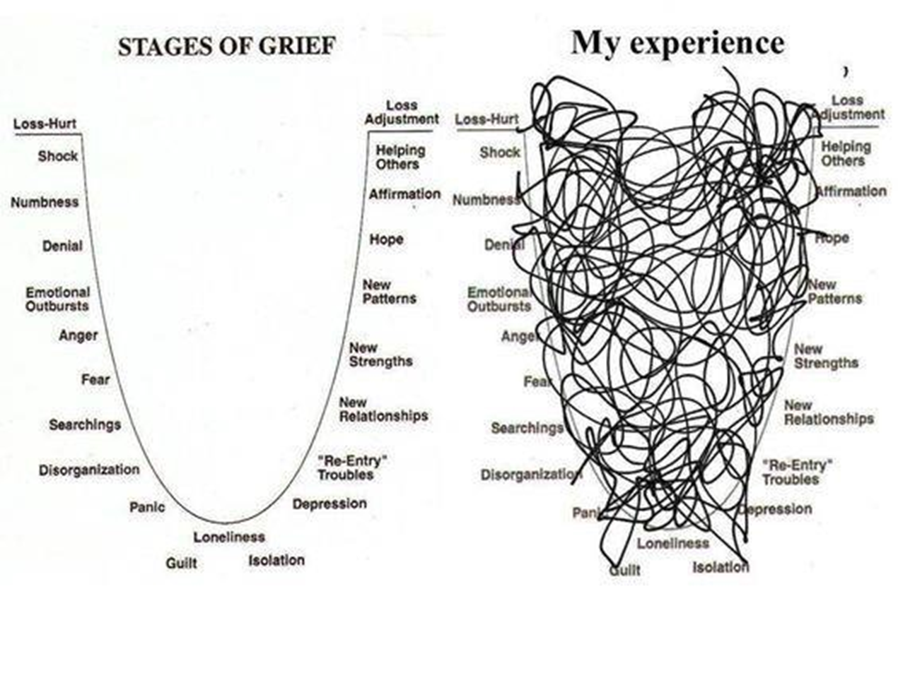

Slide 36
The Perinatal Loss Experience
Deep psychological wounds that can be isolating for many parents
Expressions of grief once thought pathologic are likely normal in this population
“Giving birth to a dead baby is a psychobiological trauma: the parallel paradox of birth & death.” (Cacciatore & Thieleman, 2019)
Notes:
Story of patient:
Struggling with this even before the birth.
4 previous healthy vaginal deliveries
“Not how this is supposed to be”

Slide 37
The Perinatal Loss Experience
The Next Pregnancy: Case Study
Elizabeth was pregnant for the 2nd time. She had one healthy, full-term child.
At her 20 week anatomy sono a fetal demise was diagnosed.
Although this pregnancy was unplanned, Elizabeth and her husband were very upset.
A year later they decided to get pregnant again and were successful.
Elizabeth was continually worried she would lose this baby as well. Hearing the heart beat at visits helped her anxiety, for awhile.
They did not tell anyone about the pregnancy until she could feel the baby move.
She did not make any preparations for this baby until she was 34 weeks.
Notes:
We are going to go through a little case study and I want you to think about your personal practice when talking with patients.

Slide 38
The Perinatal Loss Experience
Charge nurse assigns you to Elizabeth. G3P2 @ 39 weeks, expectant management for labor.
Find out the details of G’s and P’s before entering the room if possible.
See if the patient has a need to talk about the previous loss. It is possible that for the nurse to just acknowledge the loss is sufficient.
This delivery is not just about the current baby.
Ask how they’re feeling (may be distressing being in similar room from delivery of stillbirth) and how you can help.

Slide 39
Care for the Care Team
We grieve as caregivers
We sometimes feel helpless
We can become desensitized to loss
Our patients remember our response
Caregiver fatigue syndrome
Take time for self care

