Slide 1
Marijuana, breastfeeding, & the newborn
Juanita Aguila-Corrales, MD
Neonatology
Children’s Hospital of Illinois

Slide 2
I have nothing to disclose.

Slide 3
Objectives
To discuss the mechanism of action of cannabinoids
To discuss the effects of Tetrahydrocannabinol (THC) during pregnancy
To discuss the effects of THC in the fetus & the newborn

Slide 4

Marijuana
Cannabis sativa (marijuana) is the illicit drug most commonly used during pregnancy
Self-reported prevalence of MJ use during pregnancy ranges from 2 % to 5 %, ↑ to 15 – 28% among young, urban, socioeconomically disadvantaged women.
(El Marroun, 2011; van Gelder, 2010; Passey 2014; Beatty, 2012; Schempf, 2008)
“The fact that marijuana is legal in many states may give the impression the drug is harmless during pregnancy, especially with stories swirling on social media about using it for nausea with morning sickness.”
(Ryan, MD, Chair of AAP Committee on Substance Use & Prevention)

Slide 5
Pharmacology of Cannabis
Tetrahydrocannabinol (THC) is the major psychoactive cannabinoid of marijuana
Small & lipophilic molecule, rapidly distributed to the brain & fat
Metabolized by the liver
Half life of THC varies :
- occasional users = 20-30 hrs.
- heavy users = 4-5 days & may require 30 days to complete excretion.

Slide 6
Marijuana potency over the years
1983 – averaged 3.2 %
2008 – averaged 13.2 %
Isolated samples – 27.3 % & 37.2 %
Dabbing & vaping ↑ ↑ ↑ THC concentration
↑ THC conc. ↓ cannabidiol (↓ medicinal benefits)
Marijuana is often grown with the use of pesticides, herbicides, rodenticides, & fertilizers, many of which are toxic.
National Criminal Justice Reference Service 2009
Denver Post 2015
Notes:
The potency of marijuana now is much higher than was available a decade ago.
These higher potencies as well as practices of marijuana use such as vaping can significantly increase the concentration of THC.
Vaping is heating the cannabis to release THC & cannabinoids without making it smoke.
Dabbing is the practice of inhaling small quantities of a concentrated & vaporized drug, typically cannabis.

Slide 7
Synthetic marijuana
Man made, chemically different
“fake weed”, imitates the effects of marijuana
Effects on the brain are much stronger, include paranoid delusions, anxiety, severe agitation, hallucination, & even total memory loss.
Common names: K2, Spice, Spike, Mr. Happy, Scooby Snax, Kush
March 2018 – 1st case of hypocoagulopathy in IL
Illegal to sell, possess, or distribute
Notes:
Chemicals present in these synthetic marijuana imitations are often unknown & variable
Sprayed on dried, shredded plant so they can be smoked or sold as liquids to be vaporized & inhaled in e-cigarettes
Presence of brodifacoum (rat poison), a long acting vit K antagonist was confirmed in 150 cases of synthetic cannabinoid use that presented with severe bleeding

Slide 8
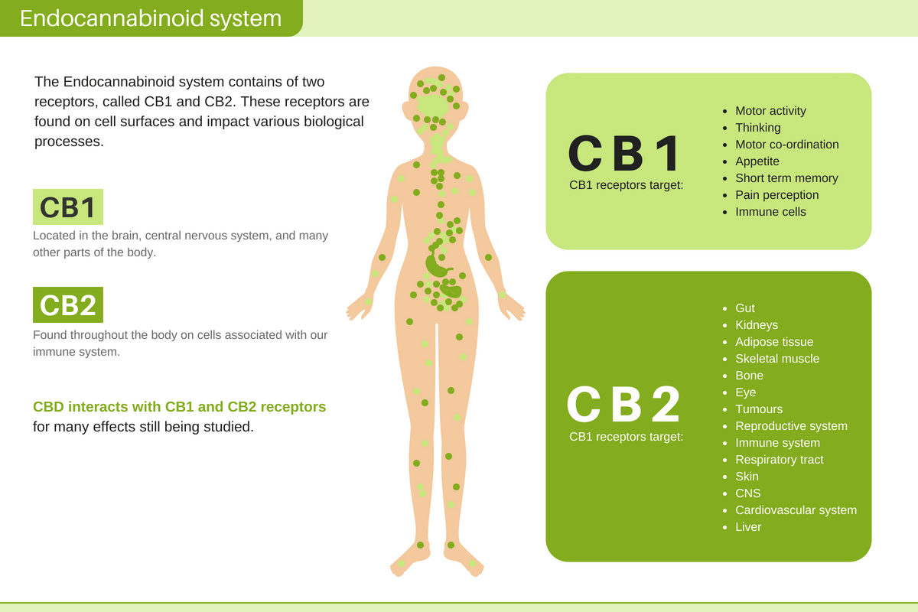
Endocannabinoid system
Endocannabinoid system (ECS) is detectable as early as 5 weeks gestational age; play an essential role in neuronal development & cell survival
CB1 receptors ↓ dopamine & glutamate release & ↑ GABA activity in the synapse→ locomotor activity slowdown
CB2 receptors are responsible for anti-inflammatory effects, & other therapeutic effects like analgesia, antiemetic effects, & ↓ intraocular pressure
Notes:
The endocannabinoid system (EDS) is a biological system composed of endocannabinoids, which are endogenous lipid-based neurotransmitters that bind to cannabinoid receptors.
The EDS is involved in regulating & modulating movement, memory, thinking, coordination, appetite, thermoregulation, sleep, pain, pleasure sensations, the immune system response, & sensory & time perception.
THC is a phytocannabinoid which is similar in structure to anandamide. Because of this similarity in chemical structure, THC attaches to the cannabinoid receptors on the neurons.
Anandamide, the body’s own antidepressant. Synthesized in the brain. Those who are born naturally happy produce less of the enzyme FAAH (fatty acid amide hydrolase) which is responsible for breaking down a chemical in the body called anadamide.

Slide 9
CB1 receptors
present in the placenta, brain, kidneys, lungs, & liver.
The CB1 receptors in the placenta is involved in the regulation of serotonin transporter activity. Fetal brain requires serotonin in the dev. of critical neural circuits.
hippocampus contains a large amount of CB1 receptors, significant in the newborn sucking reflex
impair fetal growth by inhibiting cytotrophoblastic proliferation
Direct effect on cellular processes, influence embryogenesis & fetal development
Notes:
..fetal development. This include disruption of normal angiogenesis, inducing apoptosis leading to premature cell death, impairment, & reduced cellular migration & disruption of DNA replication.

Slide 10
CB2 receptors
In the immune system & hematopoetic cells
Instrumental in pain relief & immunologic activity
Also found in brain expressed by microglial cells
Found in fetal astrocytes

Slide 11
Effects of Marijuana Use on Pregnancy

Slide 12
Cannabinoids & pregnancy: pharmacokinetics
Variable, depends on route
Smoking→ rapid drug delivery
Ingestion → depends on absorption, breakdown of the drug in the stomach, & metabolism in the liver
Cannabinoids are lipophilic, when present in the bloodstream→ cross the placenta into the fetus
Martin, J of Perinatology 2020

Slide 13
Pharmacokinetics of Cannabinoids During Pregnancy
Recreational drugs directly cross the placenta either through passive diffusion or less commonly, through active transport or pinocytosis
THC is highly lipophilic & is distributed rapidly to the brain & fat of the fetus after ingestion or inhalation by the pregnant woman. Concentration of THC in the fetal blood is 1/3 to 1/10th of maternal concentrations.
Clinical Pharmacokinet 1997 & 2003
Notes:
These concentrations can vary depending on the permeability & biological capacity of the placenta.

Slide 14
Pharmacokinetics of Cannabinoids During Pregnancy
Short term exposure to cannabidiol can enhance placental barrier permeability to pharmacologic agents & recreational substances
Feinstein, et al, Am J Obstet Gynecol 2013
Increased resistance index & pulsatility index of the uterine artery
↑ placental resistance and ↓ placental circulation
Marroun et al, Early Human Dev 2010
Notes:
Short term exposure to cannabidiol….(a non psychoactive substance found in MJ)…potentially placing the fetus at risk from these agents. Marroun found that … with resulting potential effects on uterine blood flow, such as increased placental resistance & reduced placental circulation.

Slide 15
Pharmacokinetics of Cannabinoids During Pregnancy
When MJ is smoked, serum carbon monoxide in the pregnant woman are 5 times higher than those when tobacco is smoked resulting in impaired maternal respiratory gas exchange & subsequent adverse effects on the fetus.
( N Engl J Med 1988)
Notes:
Given these findings, it is biologically plausible that MJ use during pregnancy could affect both maternal & fetal outcomes.
As a side note, cannabis is often combined with tobacco in a joint. Thus, side effects of tobacco on infant must be considered.

Slide 16
Effects of concomitant use of both marijuana & tobacco
↑ risk of multiple adverse perinatal outcomes
↑ rates of maternal asthma & preeclampsia
↑ Preterm births
Infants with ↓ HC (<25th %ile) & ↓ BW (<25th %ile)
(Am J Obstet Gyne 2016)
Notes:
Effects of concomitant use of both marijuana & tobacco, compared with tobacco use alone…

Slide 17
Cannabinoids & pregnancy: metabolism
THC interferes with fetal folic acid uptake by disturbing syncytiotrophoblast development.
Folic acid is essential for fetal growth
Dietary supplementation is necessary during pregnancy
Folic acid deficiency → neural tube defects
Chronic use of cannabinoids is more consistent in disturbing folic acid metabolism.
Martin, J of Perinatology 2020
Notes:
Folic acid is essential for fetal growth, & since it is not synthesized de novo, dietary….

Slide 18
Cannabinoids & pregnancy:
Interference with vascular endothelial growth factor (VEGF) by restricting movement of human umbilical vein endothelial cells which induces apoptosis
Disrupts DNA replication, cellular motility, & cellular migration & replication; critical in embryogenesis, esp. fetal brain development
Induces a neurotrophic factor (brain derived neurotrophic factor – BDNF), necessary for “synaptic efficiency, neuronal survival, new neuron differentiation, & long term memory.
Tortoriello. EMBO J. 2014
THC decreases the levels of microtubule-binding protein in axons which is necessary for organized brain wiring.
Friedrich, et al. BMC Pharm Tox, 2016
Notes:
Use of cannabis in the past was mainly inhalation through smoking. This pathway with added toxins increased the effects of cannabis on the maternal lung. In today’s world, the different products available with varying degrees of purity, complicates the toxic effects of smoking or ingesting marijuana.

Slide 19
CDC 2016 & ACOG 2012
emphasized that healthcare professionals should conduct verbal screening for substance abuse at the first prenatal visit & continue screening throughout for women at higher risk.
encourages providers to use open-ended and nonjudgmental questions.
Maternal urine testing is the most accurate method of testing (J Psych 2012)

Slide 20
Pregnancy Risk Assessment Monitoring System (PRAMS)
Surveillance project of the CDC & state health departments
Pregnant women who reported MJ use:
Younger (< 25 y.o.)
Lower income households
Smoke cigarettes
Experienced significant emotional stressor (traumatic, financial, or partner related)
Notes:
PRAMS – collects state specific data on maternal attitudes & experiences before, during, & after pregnancy.
Has conducted surveys in Vermont with live births since 2001 & has included questions about MJ use during pregnancy since 2009.
2013: 9.4% of women in Vermont reported MJ use during pregnancy, with no significant change since 2009.

Slide 21
Cohort studies:
Ottawa Prenatal Prospective Study (OPPS)
Maternal Health Practices & child development Study (MHPCD)
OPPS & MHPCD found no relationship between prenatal MJ use and preterm births, miscarriages, pregnancy complications, Apgar score, or physical anomalies in the neonates
Generation R study
↓ fetal growth beginning in the 2nd trimester → LBW
Role of paternal marijuana use: no association
Avon Longitudinal Study of Pregnancy & Childhood
Smaller birth lengths, smaller HC, & LBW
Notes:
OPPS – a longitudinal cohort study of low-risk, white, middle class families
MHPCD – a cohort study of high risk, low socio-economic status women, representing both white & AA
Generation R study – a population based from the Netherlands . ↓ fetal growth beginning in the 2nd trimester & resulted in LBW. Specifically when MJ use was begun early in pregnancy & continues throughout the entire pregnancy.
Avon – UK based

Slide 22
Knowledge is power!
Retrospective cohort study of urban (AA)
21.8% initially (+) MJ use
Only 1.9% (+) MJ urine screen at delivery
High rate of cessation-> education about adverse effects of drug use, including tobacco & MJ, during prenatal visits
(Mark, et al; Arch Women Ment Health 2016)
Notes:
Predominantly African American women, receiving prenatal care & delivering at their institution…
..initial screen was either self report or urine toxicology

Slide 23
Cannabinoid hyperemesis syndrome (CHS)
Chronic marijuana use
Acute onset nausea, vomiting, & abdominal pain
Symptoms alleviated by hot showers
Episodes typically last 24 to 48 hrs
Notes:
There is a prevalent belief that cannabis is natural & can be safely used for nausea in pregnancy. Paradoxically, marijuana use before pregnancy has been associated with increased reports of nausea in pregnancy. It’s chronic use might lead to the development of cannabinoid hyperemesis syndrome. Episodes of diffuse abdominal pain, N & V, typically acute in onset & last 24 to 48 hours. They are often preceded by a prodromal phase of escalating nausea, which leads to increased use of cannabis. The symptoms are often alleviated by hot showers.

Slide 24
Given the potential for neurodevelopmental effects, cannabis is not recommended for the treatment of nausea & vomiting in pregnancy.
Pregnant women should be encouraged to abstain from cannabis use

Slide 25

I tested positive to marijuana
because I was around people
smoking pot!

Slide 26
What are the effects of secondhand exposure to marijuana smoke?
Researchers measured the amount of THC in the blood of non MJ smokers who spent 3 hrs. in a well-ventilated space with people casually smoking MJ; THC was present in the blood of the non-smoking participants, but the amount was well below the level needed to fail a drug test.
Another study varied the ventilation & the potency of the marijuana: non-smokers exposed for an hour to high THC (11.3% THC conc.) in an unventilated room showed (+) urine assays in the hours directly following exposure
(www.drugabuse.gov/publications/research-reports/marijuana)
Notes:
A follow-up study showed on this second study reported mild subjective effects of the drug – a “ contact high” & displayed mild impairments on performance tasks.

Slide 27
Second- hand cannabis exposure
Independent risk for sudden infant death syndrome
Counsel lactating mothers to smoke outside of the home & change their clothing before caring for their infant
mother’s ability to care for her child while she is impaired, owing to cannabis’ effect on mood & judgement
Notes:
Cannabis use itself is not an indication for involvement of child protective services & punitive discussions can lead to further harms such as discontinuation of prenatal care.

Slide 28
Mainstays of intervention
Education on the risks of marijuana use
Assessment of willingness to quit
Discussion of harm reduction options

Slide 29
Effects of Marijuana use on the Fetus

Slide 30
Study: Marijuana use while pregnant more likely to lead to premature birth, early infant death
BY LEXI LONAS - 04/23/21
The journal analyzed the medical records of nearly 5 million women in California who gave birth between 2001 and 2012
The data included more than 20,000 women whose delivery records noted that they were cannabis dependent or used cannabis more recreationally during pregnancy
6 % more likely to be born prematurely.
13 % more likely to be born underweight
35 % more likely to die in their first year of life.

Slide 31
Mechanism of action of Cannabinoids on the Developing Fetus
Fetus: CB1 receptors acts on brain development, regulating neural progenitor differentiation into neurons & glia & guiding axonal migration & synaptogenesis.
Postnatal: CB1 receptor blockade induces oral motor weakness
Journal of neuroendocrinology, 2008
Notes:
ECS plays a key role in pre and postnatal development. Postnatal: CB1 receptor blockade induces oral motor weakness, which reveals a critical role of CB1 receptors in the initiation of milk suckling by neonates.

Slide 32
Mechanism of action of MJ on the Developing Fetus
In the fetus, CB1 receptors are found primarily in the mesolimbic structures such as the amygdaloid complex, the hippocampus, & the ventral striatum, all areas that are important for emotional regulation, cognition, & memory.
(Biol Psychiatry 2004)
Epigenetic mechanism, proposed as an explanation for vulnerability to later addiction & psychiatric disorders.
(Eur J Neurosci 2011)
Notes:
Epigenetics refers to the mechanism by which gene expression is altered without changes to the genetic code.
Epigenetic mechanism, proposed as one of the explanations for the consequences of prenatal MJ exposure on fetal neurodevelopment & to explain why adolescents & adults who have been exposed to MJ prenatally demonstrate an increased vulnerability to later addiction & psychiatric disorders.

Slide 33
Effects of Marijuana Use on Lactation

Slide 34

Can I pump & dump my
breastmilk?

Slide 35
Because THC is stored in body fat it stays in the body for a long time. This means that “pumping & dumping” breastmilk will not work the same way it does with alcohol.

Slide 36
Cannabis & breastfeeding
THC in marijuana is a very lipophilic compound & has a low molecular weight. Both these properties combine to cause transfer of THC into human milk.
(S. Verma, MD; Hassenfeld Children’s Hospital)
In one feeding, the infant would ingest 0.8% of the weight adjusted maternal intake of one joint.
(Drugs & Human Lactation, 2nd ed, Netherlands; 1997)
THC traceable in breastmilk approximately 6 days after MJ use
(Bertrand, et al, Pediatrics 2018)
THC excreted in baby’s urine during 2 – 3 weeks
(Breastfeeding Review, 1998)
In animals: ↓ prolactin & direct action on mammary glands
(Hale, 2006)
Notes:
Studies in animals, suggest that marijuana could inhibit lactation by inhibiting prolactin production, & possible by a direct action on the mammary glands.
There is no human data to confirm these observations.
Infants exposed to MJ through mother's milk will excrete THC in their urine during 2 – 3 weeks.

Slide 37
Effects of Marijuana on Breastfed Infants
Tennes et al (1985)
- 258 mothers using MJ & compared them to mothers who did not use MJ
Results:
1. MJ users were more likely to use illicit drugs & alcohol
2. Infants exposed to MJ are slightly shorter
3. Most mothers decreased use of MJ during pregnancy
4. No differences were noted in 1 year growth & scores on the Bayley Scales of Infant Development
Notes:
There are 2 small studies by Tennes at al & Astley & Little in which the authors attempt to evaluate the effect of maternal marijuana use while breastfeeding. Both studies included mothers who also used alcohol, other drugs, & tobacco.
Results in the Tennes are limited by small number, only 27 of the infants were tested at 1 year were exposed to MJ while being breastfed. Another limitation is the lack of control for use of other substances, particularly alcohol.

Slide 38
Effects of Marijuana on Breastfed Infants
Astley & Little (1990)
68 infants had developmental evaluation at 1 year
Mothers who used MJ while breastfeeding were matched with mothers with similar alcohol & tobacco use who did not use MJ
Results:
Exposure to MJ during the first month was associated with 14+/- 5 points decrease in motor scores
No effect of MJ use in the third month of life
Notes:
Astley & Little studied diet, alcohol, & tobacco use during lactation in a group of middle class mothers.
Result # 1 – … motor scores after controlling for tobacco, alcohol, & cocaine during pregnancy & lactation.
Result # 2 – Marijuana use in the first trimester confounded these results, & it was not clear whether exposure prenatally or during breastfeeding had more association.
These studies had small sample sizes, were completed 30 years ago, were associated with use of marijuana during the mother’s pregnancy, & had no long term follow-up.

Slide 39
Effects of Marijuana in the Newborn

Slide 40
Clinical signs & symptoms in the newborn period
Increased Moro reflex (startle response)
Tremors
High pitched cry
Abnormal sleep pattern
increased muscle tone
Uncoordinated suck-swallow reflex
Increased irritability
Tachycardia
Increased blood pressure
Seizures
Thermoregulation instability
EEG – sleep disturbance
Notes:
Note that many of these descriptions are similar to what is present with opioid withdrawal

Slide 41
Environmental & non-pharmacologic interventions
A dimly lit room environment
Minimal sensory or environmental stimulation (noise reduction)
Positional support
Swaddling
Gentle handling
Skin-to-skin contact (kangaroo care)
Gentle vertical rocking
Frequent small volume feedings with higher calories
Non-nutritive sucking
Maintaining temperature stability
Protective sleep, clustered care
Use of family-integrated neonatal care
Notes:
Presently there is no indication for using medications.
Gentle vertical rocking (supports self-regulation, use of rocking beds, or mechanical swings)
Unlike the NAS, ther is no well defined clinical approach to withdrawal in neonates who are exposed only to marijuana through breastmilk.

Slide 42
Immediate Newborn behaviors in those exposed to marijuana in utero
Altered arousal patterns, regulation, excitability
(NICU Neurobehavioral Scale)
J Pediatr 2006
increased tremors & prolonged exaggerated startle reflexes (Neonatal Behavioral Assessment Scale) – observed in the first week of life & persisted at 9 & 30 days of life.
J Dev Behav Pediatr 1987
Poor habituation and responses to visual but not auditory stimuli, abnormal pitched cries, & abnormal sleep patterns & increased sleep motility in the first week of life.
Notes:
Similarities with symptoms in NAS, there is no data being used now to support a clinical withdrawal syndrome with MJ exposure.
In summary, the evidence for adverse effects of MJ on human neonatal outcomes & prenatal development is limited & inconsistent. This is due to confounding variables like polysubstance use & sociodemographic risk factors.

Slide 43
Colorado experience
2000: legalized medical marijuana
2009: US Attorney General issued a statement passing the jurisdiction of MJ law enforcement to state governments → sharp increase in the number of medical MJ users in the state.
2012: legalized recreational MJ
There is no stipulation in the law stating that pregnant women cannot purchase or possess MJ.
Jan. 2014: revenue was $ 3.5 million
Oct. 2014: monthly revenue was $ 7.6 million
Following legalization of MJ:
↑ pediatric overdoses
↑ Emergency visits for MJ toxicity (Monte,et al, JAMA 2015)

Slide 44
Colorado experience during transition to recreational MJ use:
Colorado Children’s, ↑ burns
Prior years = 0
2 years after = 31 hospitalizations for MJ related burns, some involved 70% of body surface area & 31 required skin grafting.
Majority of these flash burns occurred during home based THC extraction from MJ plants using butane as solvent.
ED at CHC, ↑ unintentional MJ ingestion
5 years prior = 0
2 years after = 14
(Monte,et al, JAMA 2015)
Notes:
The vast majority of intensive care admissions were related to ingestion of edible THC-containing products made available to the general public as part of the marketing of legal recreational marijuana.

Slide 45
Policy Statements

Slide 46
Take home points:
ACOG discourages the use of marijuana during pregnancy.
Committee opinion 2017
AAP recommends encouraging mothers not to breastfeed while using marijuana.
Pediatrics 2018

Slide 47
Take home points
“As more states continue to legalize marijuana, parents & health care providers should treat it like any other medication: locked up, away, & out of sight of children.”

Slide 48
Take home points
“THC is stored in body fat. A baby’s brain & body are made with a lot of fat. Since your baby’s brain & body may store THC for a long time, you should not use marijuana while you are breastfeeding.”
Colorado Dept. of Public Health & Environment 2017
Notes:
In Colorado, for example, state guidance aligns with the AAP recommendations & focuses on non-judgmentally informing patients about the potential risk of marijuana use while breastfeeding, emphasizing that there is no known safe amount of marijuana use, & encouraging support & referral for cessations.

Slide 49
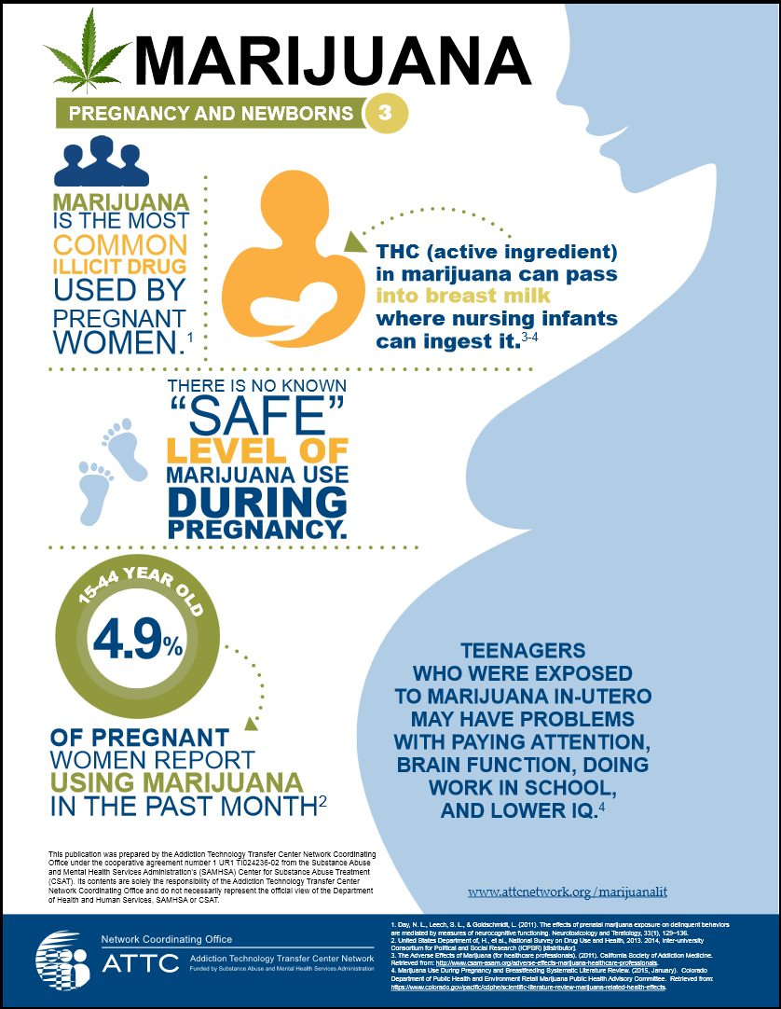
Notes:
From Addiction Technology Transfer Center network

