Slide 1
Upcoming Education
North Central Illinois Perinatal Network

Slide 2
Updates in NeONATAL Care
Audience: RNs who provide care to newborns (nursery/Level 2, LDRP, postpartum), new graduates through senior staff. Helpful to already have NRP. Respiratory therapists, providers always welcome!
Time commitment: ~ 8 hours
Content covers fetal to newborn transition, respiratory disorders and care, hemodynamic instability, stabilization of premature infants (<32 weeks), opioid exposed newborns, sepsis and antibiotic stewardship, newborn “red flags”
Didactic presentations and hands on simulations/skills stations- PREFER to come to local facility in order to simulate “in situ”
To schedule, please reach out to Janessa Jenkins (Janessa.m.Jenkins@osfhealthcare.org) or schedule via new website- will be listed as date and time “TBD”, make a request and I will reach out to schedule.

Slide 3
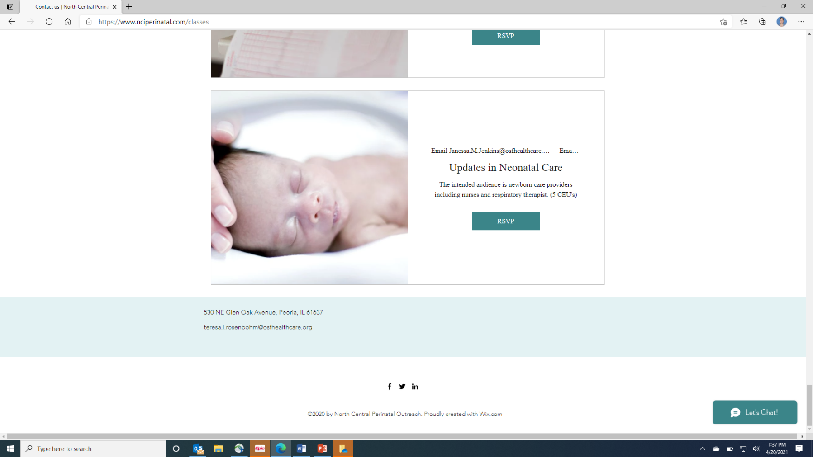
How to Schedule Via Website

Slide 4
Level II Cliff Notes
Audience: RNs caring for newborns in nursery/Level 2 setting. Respiratory therapists and providers always welcome!
Time commitment: ~2 hours
Content covers issues in the management of infants requiring Level 2 care: brief overview of respiratory conditions, use of respiratory modalities, isolette use, fluid management/feeding progression and techniques, septic evaluations and antibiotic stewardship, development of the late preterm infant
Can be presented virtually or in person. If in person, can include hands-on respiratory stabilization skills.
Schedule as per Updates in Newborn Care.

Slide 5
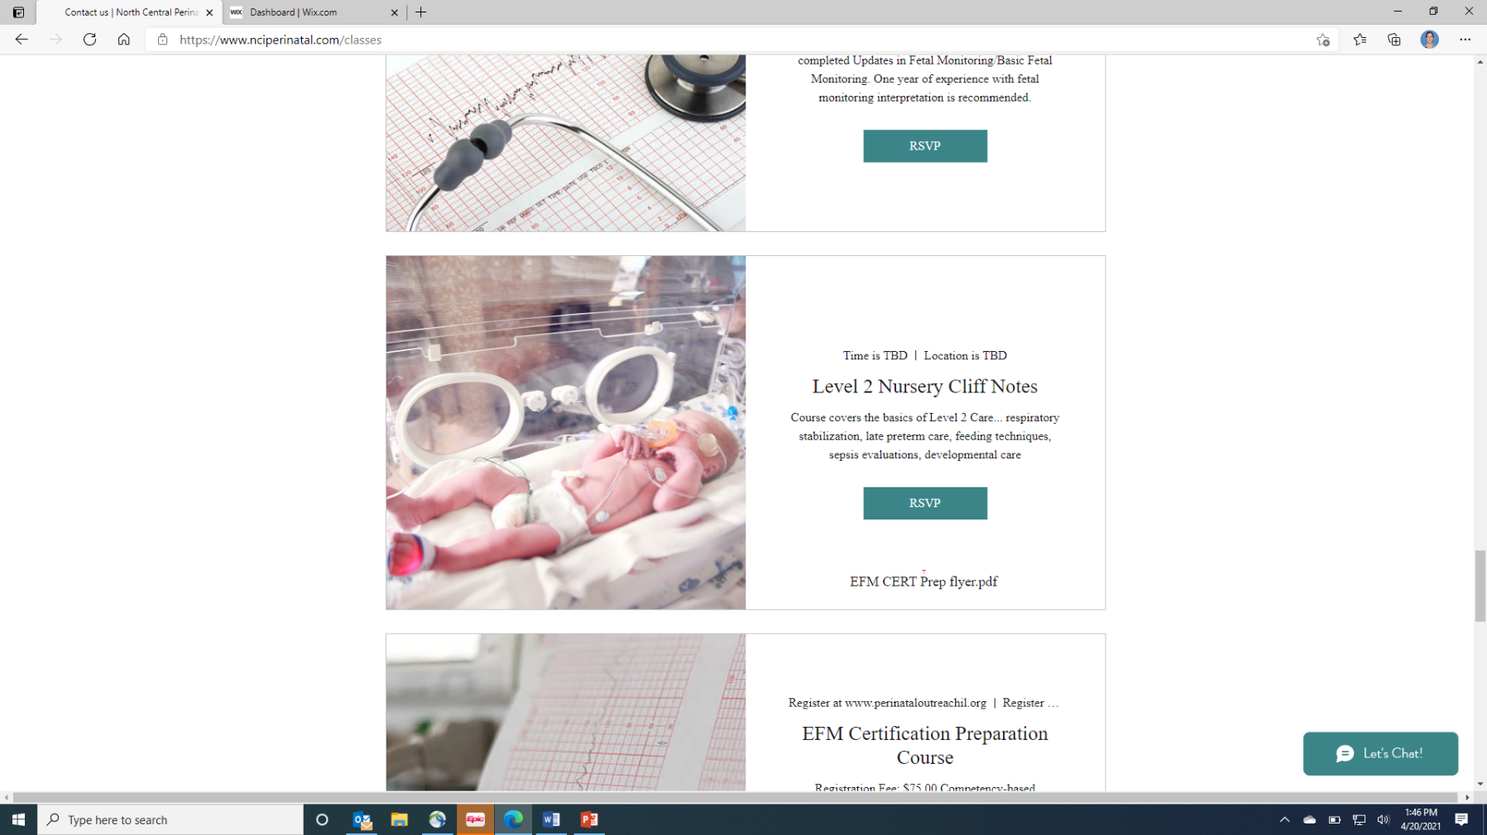
How To Schedule Via Website

Slide 6
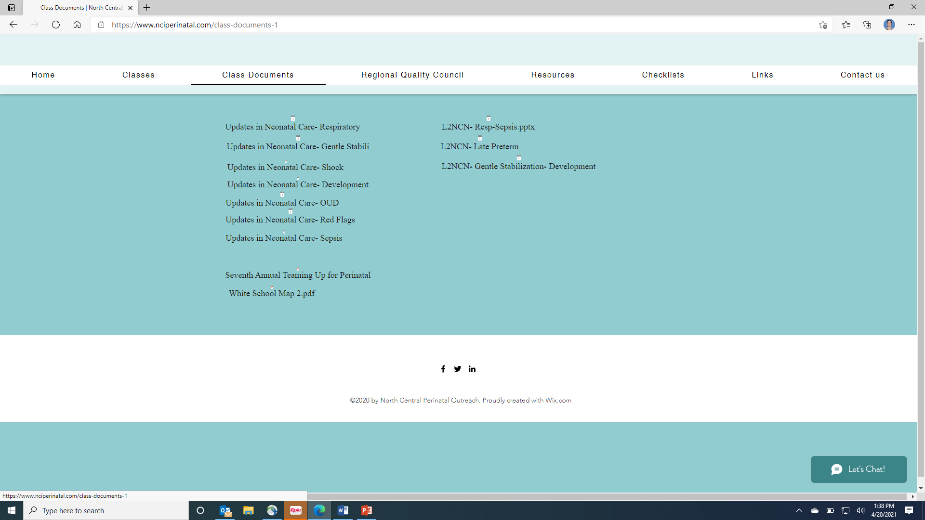
Course Documents

Slide 7
nrp
UPCOMING CHANGES TO NRP with 8th edition!
  What isn’t changing- the algorithm! No significant changes to the care itself.
  Can begin using 8th edition in June, required to switch to 8th edition as of 1/1/22.
  TWO TRACKS- NRP Essentials and NRP Advanced
    All labor/delivery/nursery etc staff will need NRP Advanced
    NRP Essentials for locations where deliveries occur infrequently (ED, EMS, etc)
  RQI Component- frequent practice with PPV
  Still recommending whole team practice (“megacode”) every 2 years to continue competencies with other skills, teamwork, communication
I am happy to partner with local NRP instructors to assist in hands-on sessions for staff or mentoring for new NRP instructors.
Please reach out via email with your institution’s particular need.

Slide 8
POEI Newborn Assessment
CLASS IS CURRENTLY IN DEVELOPMENT, anticipating Summer 2021 roll-out
Audience anticipated to be RNs new to caring for newborns outside of NICUs ( first 2 weeks to 12 months)
Time commitment anticipated to ~8 hours
Class content will focus on a system-based assessment of the newborn, and include integrative case studies to assist in synthesizing information.
Content will be presented virtually 3-4 times yearly at the state level, with flexibility for local educators to offer it more frequently if needed.
Watch for more information to come!

Slide 9
Train the Trainer (T3)
Audience: People whose role includes facilitation of simulation for their local hospital/department. May already be in an educator/charge-type role, or simply looking to become a content expert!
Time Commitment: ~4 hours for initial class, willingness to conduct simulations with local hospital
Content includes developing effective simulations, specific objectives/education to emphasize on maternal hemorrhage/hypertensive crises and neonatal resuscitation/management, and debriefing techniques.
Initial 4 hour class virtual, plus on-going support for local simulations (may be in person). Anticipating second “touch-base” virtual meeting approximately 6 months after class for feedback, lessons learned and support.
Next class scheduled for July 28th 0830-1300
Sign up via website

Slide 10
Fetal Monitoring
Fundamentals of Fetal Monitoring
  Replaces Updates in Fetal Monitoring
  Taught by Perinatal Outreach Educators of Illinois
  Maximum of 25 participants
  Register at: www.perinataloutreachil.org
  The attendee MUST register themselves!
  2021 Date:
August 11 FULL November 16 September 15 December 9
        October 18

Slide 11
AWHONN Changes
  Updating materials in 2022
  Intermediate AWHONN will be a combination of online learning and 1 day, in person class for skills and didactic. There will be a 3-4 hour pre-learning requirement. Allow for 12 hours of time.
  Advanced AWHONN will remain a 1 day, 8 hour class. Hopefully will continue with virtual offerings as well as in person.
  New AWHONN Principles and Practices book in 2022!

Slide 12
Intermediate AWHONN Class Dates
August 2 & 3 November 9 & 10
September 15 &16 December 15 & 16
All held in Peoria at the Wozniak Learning Academy (formerly White School)

Slide 13
Advanced AWHONN
August 4
October 13
December 8
Will be held virtually until further notice.

Slide 14
RNC Prep Classes
For review classes for the NCC certification exams in Inpatient OB, Maternal – Newborn and EFM, please refer to:
www.perinataloutreachil.org

Slide 15
Education Needs Assessment
www.nciperinatal.com

Slide 16
Educational Needs Assessment
Please complete by
August 30, 2021
Access at www.nciperiantal.com
Educational Needs Assessment
NCIPN ~ 2021
In an effort to serve the educational needs of the NCIPN most effectively and efficiently, we ask that you complete this education needs assessment by August 30, 2021.
When thinking of the content in each of the following classes, please rate each offering on a scale of 1-5. 1 = Completely dissatisfied, 2= Moderately dissatisfied, 3 = Neutral, 4 = Satisfied, 5 = Completely Satisfied
If you have chosen a 2 or less, please offer feedback with thoughts of ways to improve below:
Demographics
Level of Facility | I II II+ III
Role | Educator | Manager
Years in Nursing
Content/Offerings
 | 1 | 2 | 3 | 4 | 5
Updates in Newborn Care
Level II Cliff Notes
Fundamentals of Fetal Monitoring
Intermediate AWHONN
Advanced AWHONN
EFM Strip Review
Newborn Simulations
Maternal Simulations
Regional Quality Council Meetings
Train the Trainer

Slide 17
Educational Needs Assessment

Slide 18
www.ncipernatal.com
Please offer suggestions and feedback
Thoughts and Ideas
Please use this space to offer any suggestions or ideas that you wish your perinatal center provided.

Slide 19
Educational Needs Assessment
It will be posted on www.nciperinatal.com
An email will be sent to with further instructions on how to complete and return to us.
Please have done by August 30, 2021

