Slide 1
Illinois MIECHV What It Is and How To Make Referrals For At-Risk Mom's and Babies!
Glendean Burton MPH, BSN, RN, CLC, CRADC (Inactive)

Slide 2
About the Maternal, Infant, Early Childhood Home Visiting (MIECHV) Program
Funding
HRSA
$8.26M for Illinois in FFY20, overseen by IDHS
Goals
strengthen and improve Title V programs and activities
improve coordination of services for at-risk communities
identify and provide comprehensive services to improve outcomes for eligible families who reside in at-risk communities.
Notes:
By way of brief background, starting in 2011, Illinois applied for and received funds from MIECHV (spell out), through HRSA and the Administration for Children and Families. The goals of MIECHV are to strengthen and improve Title V programs, improve coordination of services for at-risk communities, and provide comprehensive services to improve family outcomes, and we do this through evidence-based home visiting programs, which we’ll be talking about shortly.

Slide 3
Presentation Objectives
Increase understanding of home visiting (HV) services and their effectiveness
Review MCH outcomes that are shared by health care providers and Maternal, Infant, and Early Childhood Home Visiting (MIECHV) programs
Provide materials and procedures that can assist hospital staff in making referrals to home visiting services
Explore how home visiting can partner with hospital providers to help ensure that high-risk mothers and babies have on-going care and support.

Slide 4
Presentation Outline
What is home visiting?
Social determinants of health
Priority populations
Health benchmarks
Evidence of effectiveness
HV models and training
Collaboration and referrals
Questions and discussion

Slide 5
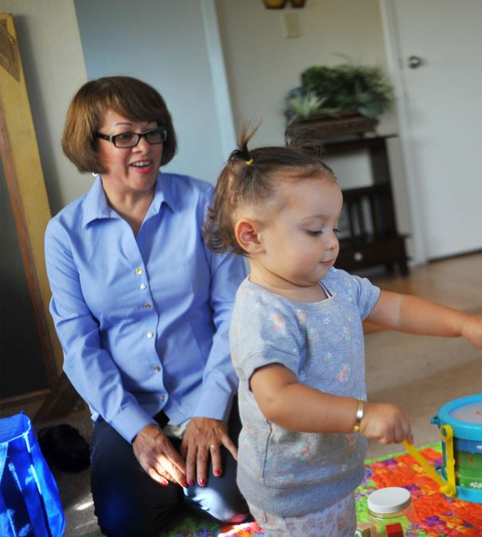
What is home visiting?
Notes:
Let’s get started: What comes to mind when you hear the term “home visiting?” (audience participation)
Home Visiting is NOT
Child welfare
Home safety inspections
Family Case Management

Slide 6
Home Visiting and SDOH
Addresses needs of families with young children related to the parent-child bond as well as access to care, safe housing, transportation, education, employment, food security, childcare, and intimate partner violence
Works to connect families to community resources, increase social support, and decrease personal isolation
Notes:
Evidence-based home visiting is a relationship-based program that aims to address the social determinants of health. Our programs help families with access to a wide range of resources and services to address early childhood development as well as comprehensive needs. Home visiting works to connect families to community resources and build their social supports.

Slide 7
Priority populations for home visiting
Families with teen parents
Families experiencing homelessness
Families in poverty or deep poverty (at or below 100% or 50% FPL)
Families with child welfare involvement
Families of children with disabilities
Families in which parents/caregivers are migrant or seasonal workers
Families in which parents/caregivers have low educational attainment
Families that face barriers based on culture, language, and religion
Families in which the parent has a disability
Families with refugee or asylee status
Families who face barriers due to immigration status
Notes:
These are some of the priority populations or target populations for home visiting: teen parents, families with young children experiencing homelessness, families in deep poverty, families with child welfare involvement, and so on. These are the families that we’d like to see receiving home visiting services, so that young children with risk factors can have a stronger start in life.

Slide 8
What is home visiting?
WHAT Family support and coaching
WHO By a trained professional
WHERE Through planned, regular visits to the home
WHEN Prenatally, through a child’s early years
Notes:
Home visiting provides family support and coaching through planned, regular visits with a trained professional based on a family’s needs. The home visits start prenatally and continues through a child’s early years. Most home visiting programs start with weekly visits, and some will move to a biweekly or monthly schedule at a designated point in time or based on the family’s needs.
Home visiting is a voluntary program, and home visitors work with parents on practical parenting skills as well as family bonding before birth and as children grow up. This is not a one-time service, but an ongoing relationship between families and trained home visitors.

Slide 9
What is home visiting?
High-quality, intensive services that do the following:
Promote positive parenting and child development, with education, screenings, monitoring and referrals
Support preventive pediatric health and prenatal care practices, including administration of routine periodic health screenings, linkage to community resources, and follow-up
Provide breastfeeding support and model desired infant care
Assists parents to set goals, continue education, find employment and overcome language barriers
On-going assessment of individual and family needs, with support, education, and linkage with services to address those needs
Notes:
Home visiting provides high quality, intensive services that address positive parenting and child development, supports preventive prenatal and pediatric health care, breastfeeding support, and works with parents to set and reach goals for their own advancement.

Slide 10
MIECHV Benchmark Domains
Improvement in maternal and newborn health
Reduction in child injuries, abuse, and neglect
Improved school readiness and achievement
Reduction in domestic violence
Improved family economic self-sufficiency
Improved coordination and referrals for other community resources and supports
Notes:
Here are the unified benchmark domains for MIECHV. As you can see, maternal and newborn health is at the top of this list. The other domains are child safety, school readiness, domestic violence, economic self-sufficiency, and coordination and referrals.

Slide 11
Program Performance Monitoring
1. On-going
2. Federal and State requirements
3. Use of data entry program
4. Quarterly performance calls
5. Quality improvement supports
6. National Quality Improvement Collaborative
7. MIECHV Office Hours bi-weekly call

Slide 12
Illinois MIECHV Data Highlights (FFY21)
11.1% preterm births
40.5% of babies were fed breastmilk at 6 months of age
86.9% of new enrollees were screened for depression within 3 months of enrollment
64.6% received their most recent well-child visit on schedule
70% of birthing parents received postpartum care within 8 weeks of delivery
71.4% of parents reporting tobacco use received a referral for tobacco cessation
76.8% of parents report using safe sleep practices
80.4% of enrolled infants and children received a developmental screening at target intervals
Notes:
Here are some of the performance measures and how we did in federal FY 2020. Please note that the data have been impacted by the pandemic.
We should note that not all home visiting programs have MIECHV funding and so not all of them are measuring these benchmarks.

Slide 13
Major Home Visiting Models in Illinois
Notes:
There are 18 home visiting models which meet HRSA’s criteria for being evidence-based. Here are the five major models used in Illinois. These models use different curricula, and all focus on building parent-child attachment, developmental screening and supports, and connecting families with resources.
The frequency of home visits also varies slightly by model. In almost all cases, they start with weekly visits. Some models transition to biweekly or monthly visits after a defined period of time or based on the circumstances of the family.
Each model can enroll families prenatally, and they each have defined eligibility criteria.
You can visit the HOMVEE website for more information about each model and their evidence of effectiveness.

Slide 14
Home Visitor Training and Supports
Estimated 80-100 hours of training
Core training
HV model training (curriculum and approach)
Infant and child development and developmental screening
Advanced training may include
Intimate partner violence (Futures Without Violence)
Maternal depression (Mothers and Babies)
Substance use (4P’s Plus)
Supervision
Reflective supervision
Infant/ EC Mental Health Consultation
Notes:
Home visitors come into the field with a variety of educational backgrounds. All home visitors must successfully complete core training that is specific to their home visiting model, and they also receive training on infant and child development. We are working to expand the reach of our advanced trainings on topics such as intimate partner violence, maternal depression, and substance use.
Reflective supervision is a form of ongoing professional development for home visitors that is distinct from administrative supervision and clinical supervision, because it involves intentional exploration of the parallel process, that is, attention to all of the relationships involved, including the relationships between home visitor and supervisor, between home visitor and parent, and between parent and infant/toddler. Reflective supervision supports professional and personal development of home visitors by attending to the emotional content of their work and how their reactions to the content affect their work.
In addition to reflective supervision, a growing number of home visiting programs also utilize Infant and Early Childhood Mental Health Consultation, which works with the supervisor and home visitor to build capacity and skills around mental health.
So home visitors receive a significant amount of training and supervision before starting their work in the field.
(In Illinois MIECHV, for example, less than 10% of home visitors had just a high school diploma, 16% had an associate’s degree, 58% had a bachelor’s degree, and 16% had an advanced degree.)

Slide 15
MIECHV Coordinated Intake Communities
Chicago Southside Cluster (Englewood, West Englewood, Greater Grand Crossing)
Cicero
East St. Louis
Elgin
Rockford
DeKalb County
Kankakee County
Macon County
McLean-Piatt-DeWitt-Woodford Counties
Peoria-Tazewell Counties
Stephenson County
Vermilion County
Notes:
MIECHV funds currently support coordinated intake in 13 communities, which are listed here.

Slide 16
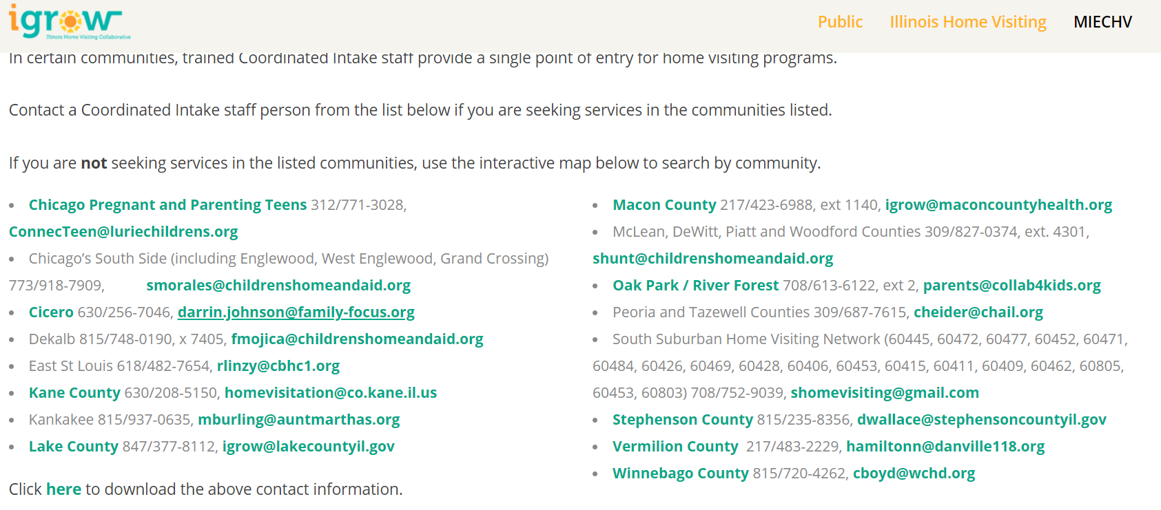
MIECHV Coordinated Intake Communities
http://www.igrowillinois.org/find-a-program/
Notes:
On the igrowillinois website, you can find the contact person for each coordinated intake community. To make a referral to these communities, simply contact coordinated intake staff and they will speak with the family to collect some basic information and to make a referral that best fits their situation.

Slide 17
Referrals to Home Visiting in Communities without Coordinated Intake
http://www.igrowillinois.org/find-a-program/
Notes:
Most communities do not have a coordinated intake system. For these communities, you can search for the nearest home visiting program on the iGrowIllinois website and it will pull up their contact information. Here you see a screenshot of the search page on the igrowIllinois website.

Slide 18
Next Steps: Strengthening Connections
Share igrow (MIECHV) information and our contact information with your staff and families
Explore how we can better partner with hospital providers
Establish a system of referral and care that supports the woman and her newborn, reduces risk for both, effectively promotes health and well-being, and is bi-directional in approach

Slide 20
Thank you!
Glendean Burton, MPH, BSN, RN, CLC, CRADC (Inactive)
MIECHV MCH Nurse Consultant
Glendean.Burton@hotmail.com
Joanna Su, MSW
Manager of Strategic Planning, MIECHV
Joanna.Su@Illinois.gov

