Slide 1
REGIONAL QUALITY COUNCIL
MNO-OB INITIATIVE
7/14/21

Slide 2




Key Messages to Make Change Happen
    Opioid Use Disorder is an urgent obstetric issue
    Opioid Use Disorder is a life-threatening chronic disease with lifesaving treatment available, reducing stigma improves outcomes
    There are key steps OB providers need to take prenatally and on L&D to care for women with Opioid Use Disorder
    Linking moms to MAT/Recovery Services
    Reduces overdose deaths for moms
      Improves pregnancy outcomes
      Increases # women who can parent their baby

Slide 3
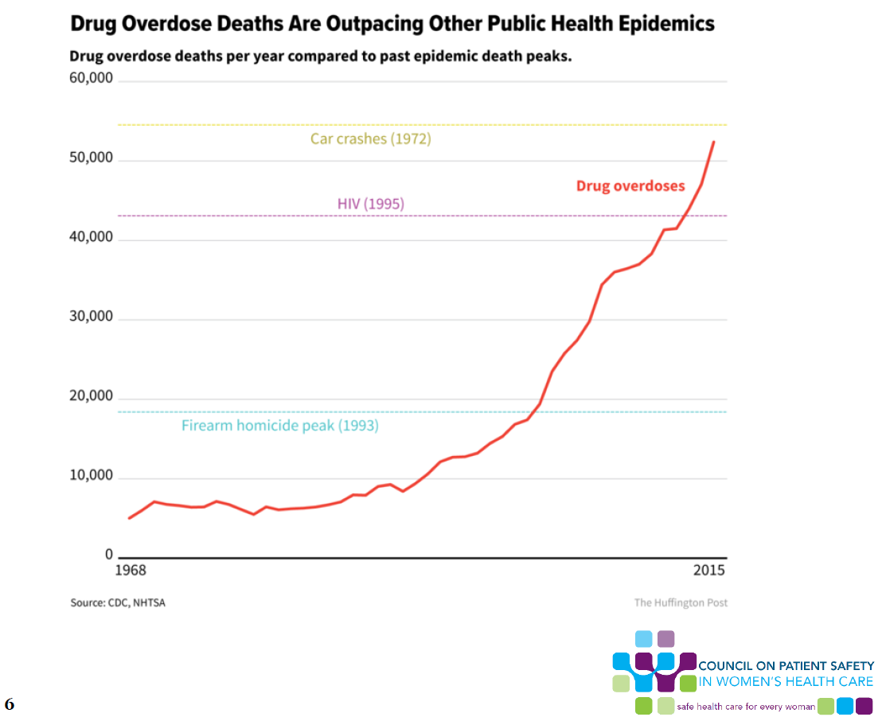
Notes:
There are any number of epidemiologic slides that demonstrate the magnitude of the opioid epidemic in the US. This data from the Huffington post demonstrates, alarmingly, that death from drug overdose has exceeded peak deaths from firearm homicides (1993), HIV (1995), and is on pace to exceed peak car crashes deaths (1972).

Slide 4
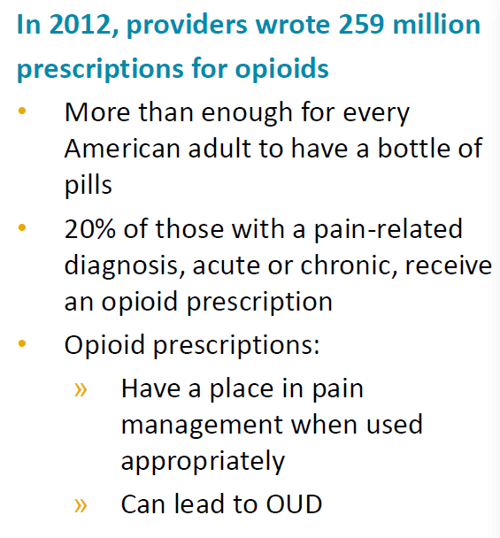

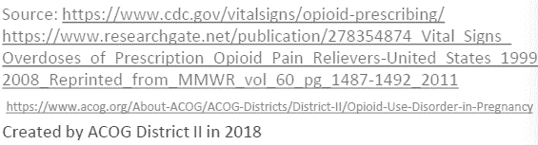
Prescribing Practices
Notes:
We as prescribing providers have unfortunately contributed to the magnitude of this problem…

Slide 5
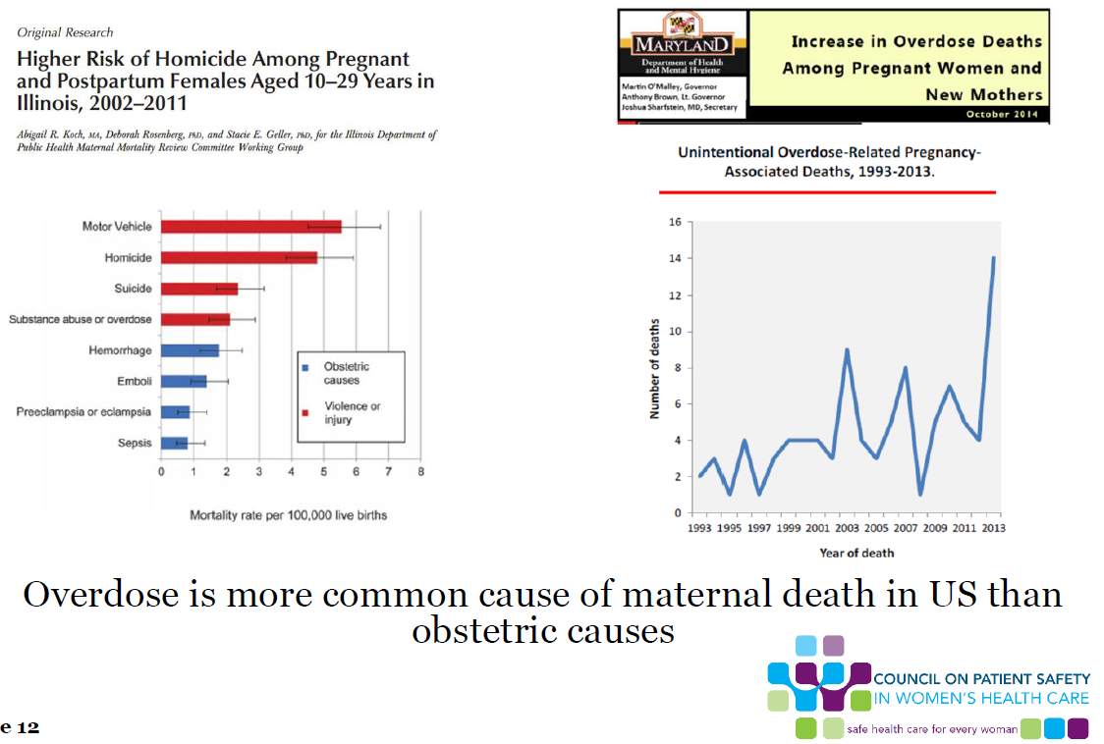
The Opioid Crisis and
Maternal Mortality
Notes:
Most relevant to all of us here in this room is the impact of opioid use in pregnancy. This chart to the left demonstrates maternal mortality in IL between 2002 and 2011. The blue bars represent obstetric causes and the red non-obstetric causes. Here, we see, that substance abuse overdose exceeds all obstetric-related causes of death below. We see to the right here the rise in maternal mortality related to overdose in Maryland. The risk to our mothers reflects the risk we see nationally.

Slide 6
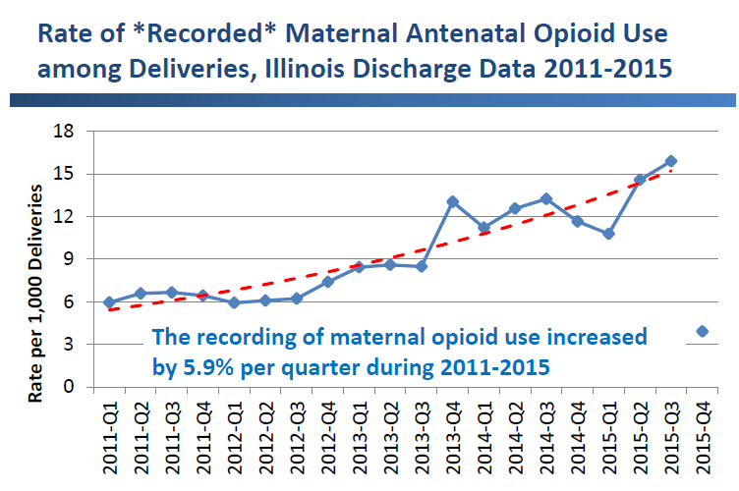
Mothers Affected by Opioids
in IL: Scope of the Problem
116% increase in recorded maternal opioid use between 2011 and 2015
Pregnancy is a window of opportunity to identify women with OUD and link to treatment as well as begin to develop a plan for optimizing her baby’s care
Notes:
Also:
Women have higher rates of hospitalizations for opioid overdoses⁷
Women are more likely than men to:
be prescribed opioids⁸
use opioids chronically⁸
receive prescriptions for higher doses⁸
engage in “doctor-shopping” ⁹
be prescribed opiates in combination with sedatives¹⁰
face barriers in access to substance abuse treatment¹¹

Slide 7
Rate of Drug Poisoning Deaths among IL
Women of Reproductive Age (WRA; 15-44 years), 2008-2017
The rate of drug poisoning deaths for WRA increased 101% between 2008 and 2017.
The rate of opioid-related poisoning deaths for WRA increased 175% from 2008 to 2017.
Data Source: Illinois death certificates, 2008-2017. 2017 data are provisional
Notes:
There were 207 drug poisoning deaths among women of reproductive age in 2008 and 400 in 2017, a 101% increase.
There were 122 opioid-related poisoning deaths among women of reproductive age in 2008 and 323 in 2017, a 175% increase.

Slide 8
Rate of Opioid-Related Poisoning Deaths
Among IL Women of Reproductive Age
(WRA), By Opioid Type
The rate of heroin-related deaths for WRA increased more than 10-fold in ten years
The rate of synthetic-opioid-related deaths for WRA increased by 9-fold in only four years
Data Source: Illinois death certificates, 2008-2017. 2017 data are provisional
Notes:
Heroin was involved in approximately 50% of opioid-related poisoning deaths in 2017
Synthetic opioids were involved in approximately 55% of opioid-related poisoning deaths in 2017.

Slide 9
Rate of Opioid-Related Poisoning Deaths
Among IL Women of Reproductive Age
(WRA), By Race/Ethnicity
The rate of opioid-related deaths is highest among non-Hispanic white WRA
White, Black and Hispanic WRA have all experienced increases in opioid-related deaths over the last 10 years
Data Source: Illinois death certificates, 2008-2017. 2017 data are provisional
Notes:
Rates of overdose are highest among non-Hispanic white women, however, all race/ethnicity groups have experienced significant increases in overdose rates for women.

Slide 10
Rate of Pregnancy-Associated Deaths
Due to Drug Poisoning, IL Residents, 2008-2016
Between 2008 and 2016:
Pregnancy-associated deaths related to any drug poisoning nearly tripled.
Pregnancy-associated deaths specifically related to opioid poisoning increased almost 6-fold.
Data Source: Illinois death certificates, 2008-2016.
Notes:
There were 10 pregnancy-associated deaths related to opioid poisoning in 2016. Pregnancy-associated deaths related to any drug overdose nearly tripled. Pregnancy-associated deaths specifically related to opioid overdose increased almost 6-fold across the last 10 years.

Slide 11
Number of Pregnancy-Associated Deaths
Due to Drug Poisoning, IL Residents, 2008-2016
The number of drug poisoning and opioid-related deaths has increased over time.
Opioids were involved in 83% of pregnancy-associated drug poisoning deaths during 2014-2016.
Data Source: Illinois death certificates, 2008-2016.
Notes:
Opioids were involved in 83% of pregnancy-associated drug overdose deaths during 2014-2016

Slide 12
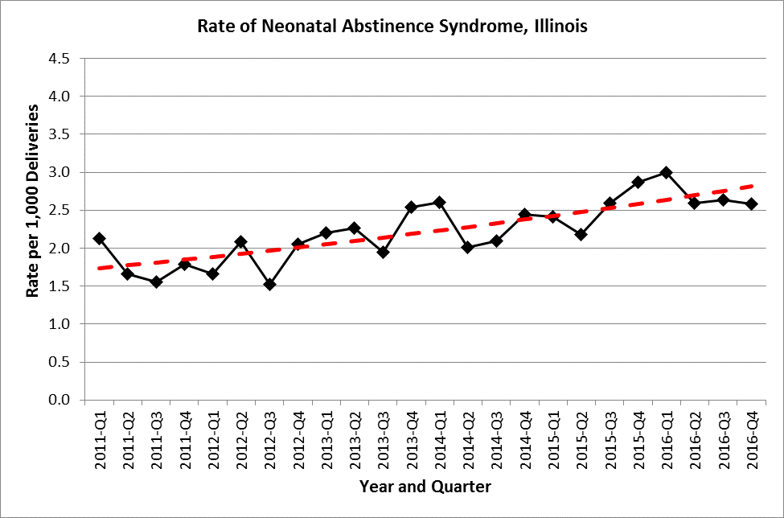
Neonatal Abstinence Syndrome
in IL: scope of the problem
53% increase in rate of NAS from 2011 – 2016
NAS rate increased 2.1% per quarter from 2011-2016
Notes:
53% increase in rate of NAS from 2011 – 2016
NAS rate increased 2.1% per quarter from 2011-2016

Slide 13
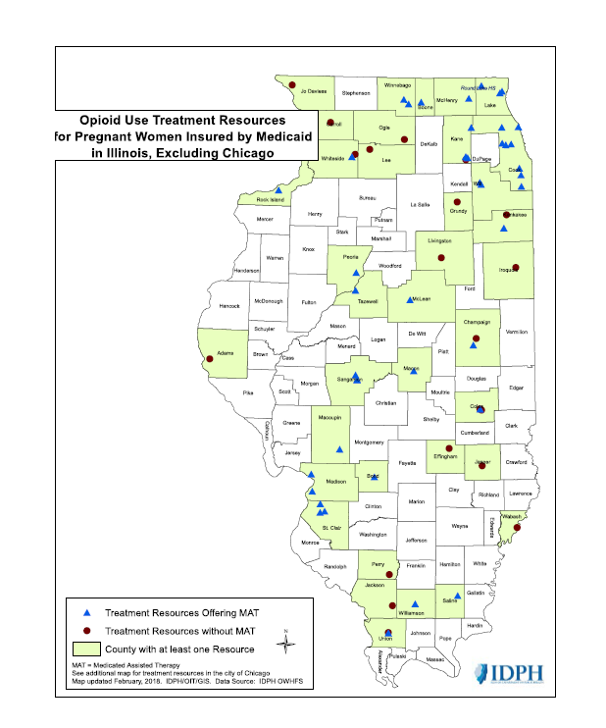
Opioid Use Treatment Resources for Pregnant Women Insured by Medicaid in IL, excluding Chicago
Notes:
So, this map displays resources in IL by county. The county’s in green are those that have at least 1 treatment resource available for our underserved/Medicaid population. We have the fewest resources available for our women in greatest need.

Slide 14
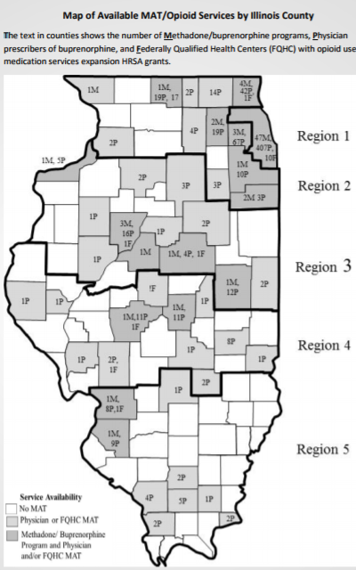
Mothers Affected by Opioids:
How do We Improve Care?
Increase moms on Medication Assisted Therapy by delivery
Hospitals implement and share with affiliated prenatal care sites a validated screening tool, implement SBIRT protocol, map local resources and create a process flow to link moms with OUD to MAT and needed services.
Provide education to providers/care team on stigma reduction and key protocols (screening, SBIRT, linkage to care, optimal care protocols)
Engaging moms in the non pharmacologic care of babies with NAS (breastfeeding, eat sleep console, rooming in)
Care checklist prenatally and at L&D
Patient education (consult and standardized education materials) empowering moms their participation matters!
Hospital level process flow / protocol changes to increase maternal participation (rooming in, breast feeding, eat-sleep-console)

Slide 15
The MNO Initiative Aims
Improve identification of pregnant women with opioid use disorder (OUD) through standardized screening and assessment for OUD on: admission to labor and delivery, emergency rooms, affiliated outpatient prenatal sites; and implementation of Screening, Brief Intervention, Referral to Treatment (SBIRT) protocol.
Improve linkage to addiction care for moms with OUD through standardized mapping of local resources to link moms to addiction services/MAT/behavioral health services in your area. Share completed local linkage to care resources document and process flow for linking moms with OUD to MAT and needed services, with inpatient OB units, ER and affiliated prenatal care sites.
Optimize clinical care of pregnant women with OUD through patient and provider education, implementation of care protocols/checklists and consultations to be completed prior to or during delivery admission.

Slide 16
MNO Initiative Aims
4. Improve outcomes for opioid exposed newborns (OENs) through key interventions: standardized identification and assessment of OENs, increased maternal participation in OENs newborn care, optimize non-pharmacologic newborn care, standardize pharmacologic treatment, and develop standard safe discharge plans.
5. Optimize prevention of OUD through provider and patient education, provider compliance with PMP lookup state law when prescribing any narcotic, and implementation of clinical guidelines for strategies to reduce opioid over-prescribing after delivery.

Slide 17


MNO Key Elements Link to our Improvement Goals
Screening and Linkage to Care
Optimizing Care for Moms/Babies
Prevention

Slide 18
GETTING STARTED:
Validated Screening Tool
SBIRT
Mapping Resources and refer to Treatment

Slide 19
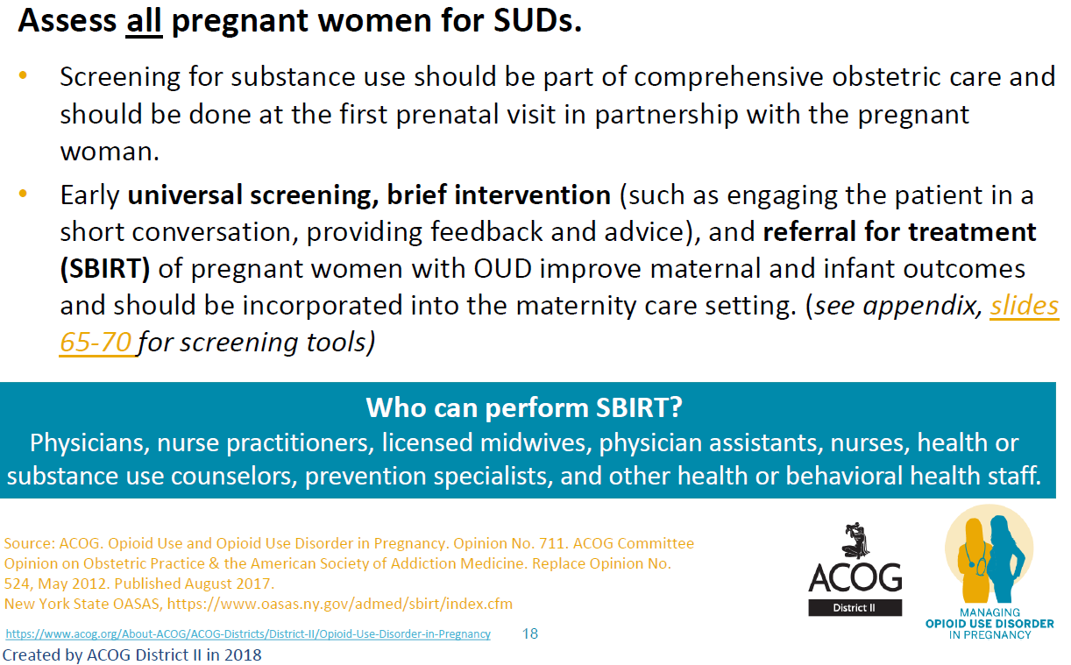
Screening
Notes:
Screening all pregnant woman on all units caring for pregnant women as a part of comprehensive obstetric care.
Early universal screening with a validated tool chosen from the ILPQC toolkit

Slide 20
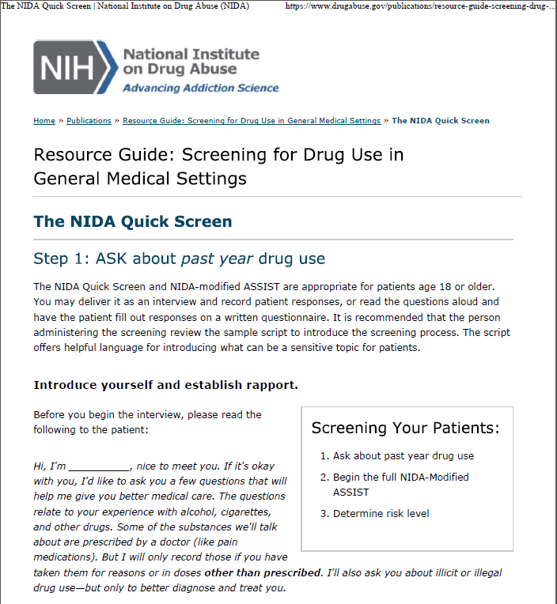
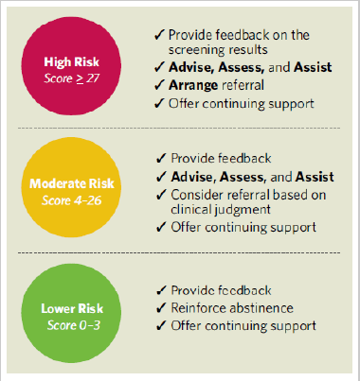
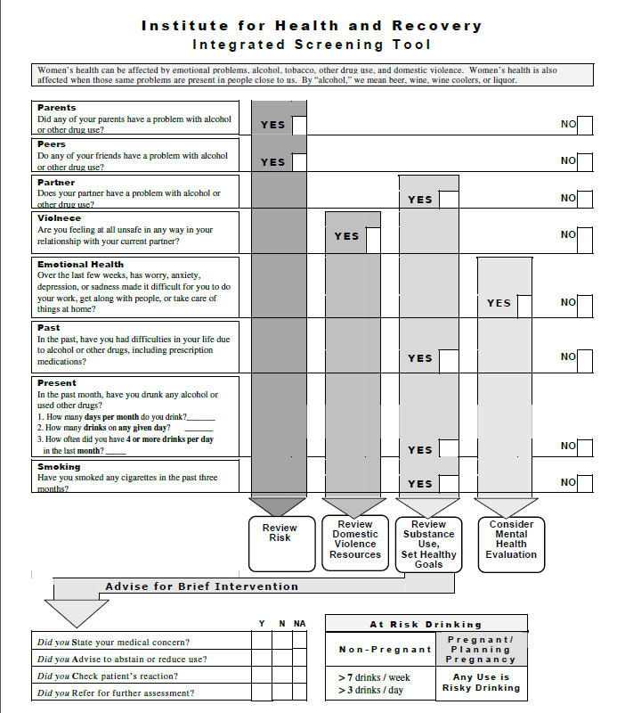
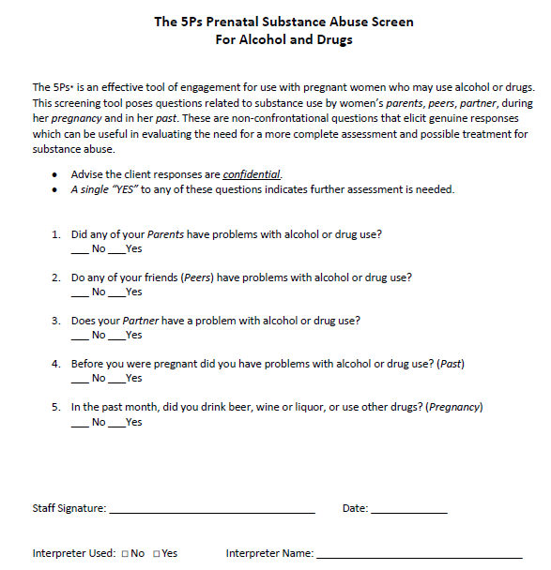
Example Screening Tools
NIDA Quick Screen
5 P’s Screening Tool & Follow-Up Questions*
Institute for Health and Recovery Integrated Screening Tool*
Notes:
Example of tools that are provided in the ILPQC toolkit…need to add info from Daisy’s talks about screening and the tool they used.

Slide 21

Patients who Screen Positive
ALL patients who screen positive for OUD should receive a brief intervention and referral to treatment
Should be administered privately with open-ended discussion and without judgment
Providers can be reimbursed for SBIRT (see ILPQC toolkit for codes)
“Providing written handouts to ALL women can reach those who are afraid to disclose use, but may be at risk/need treatment.”*
*ACOG district II slide set
Notes:
What are we going to do with patient’s who screen positive. Patient’s should be receiving a brief intervention and referral to treatment. Hospitals can be reimbursed for this.

Slide 22

MANUEVERING ILPQC WEBSITE
Website: ILPQC.org
Click initiatives

Slide 23
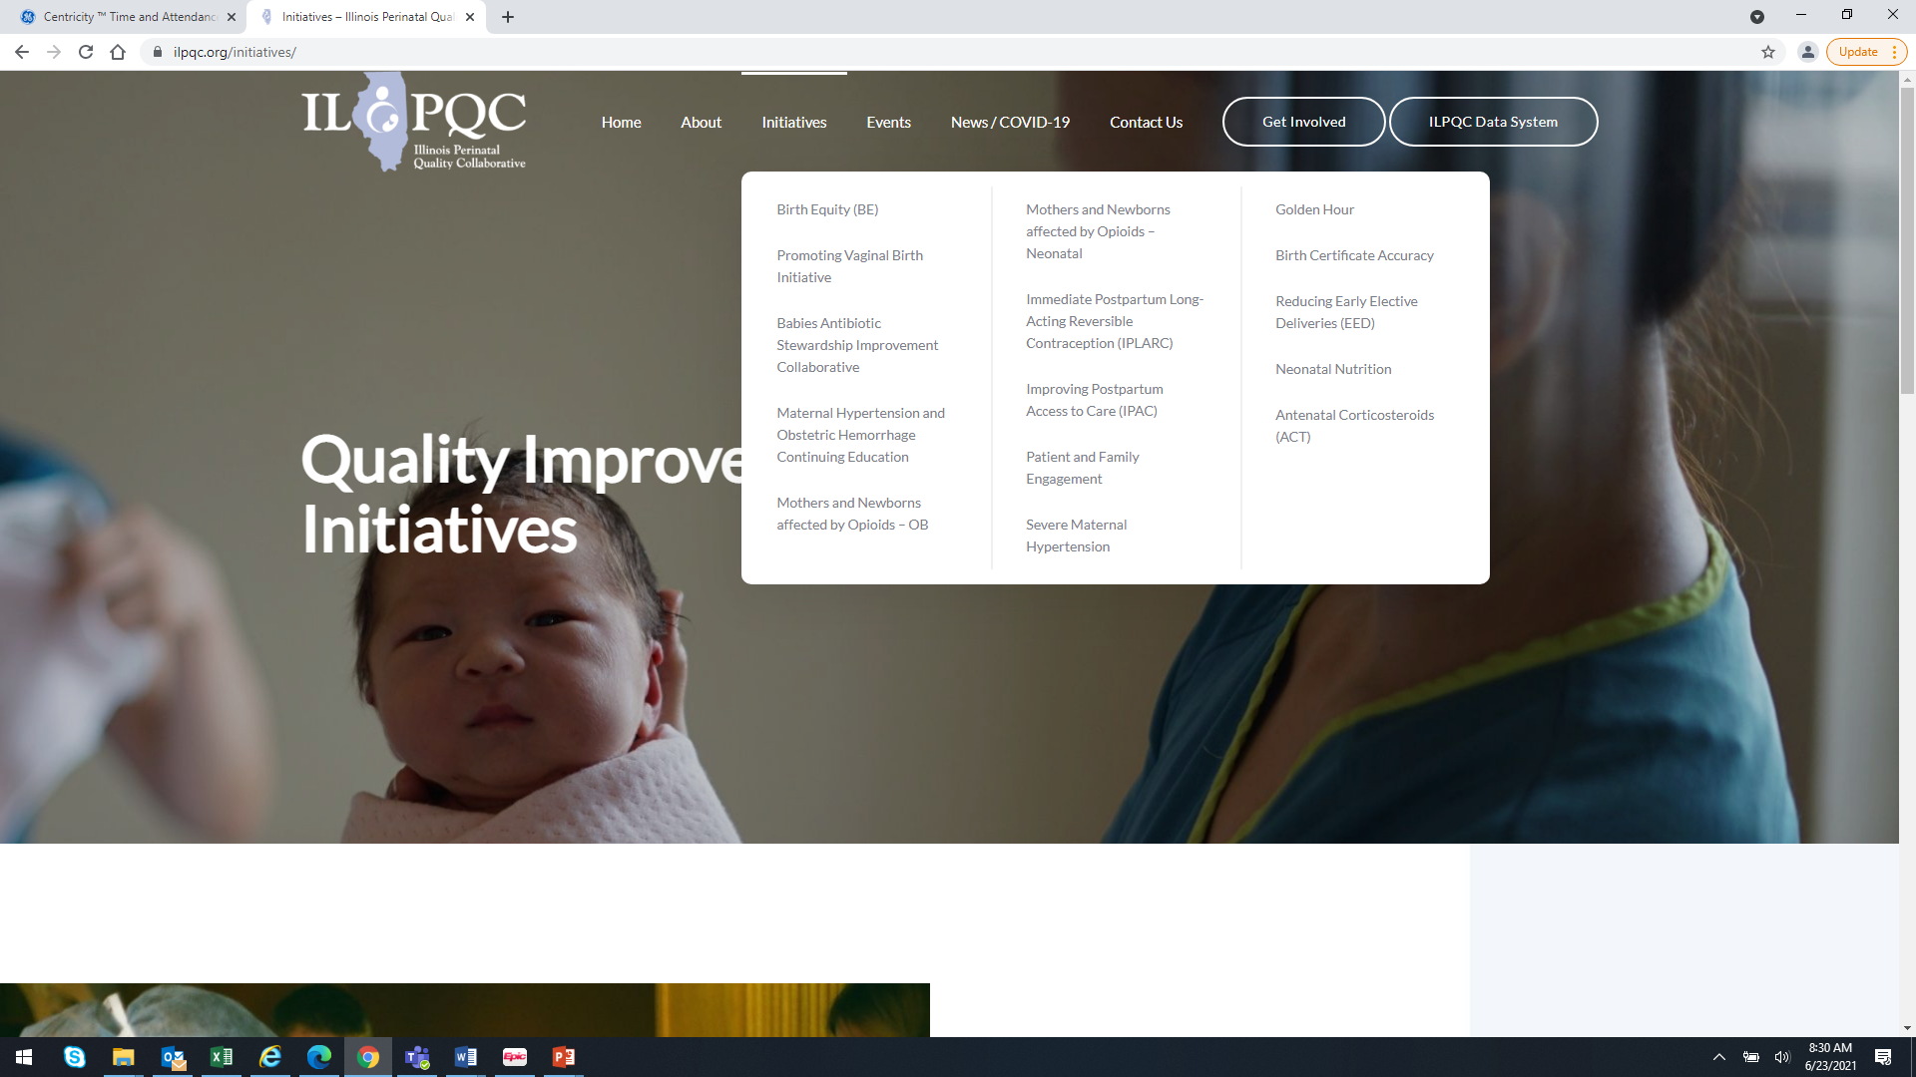

Slide 24

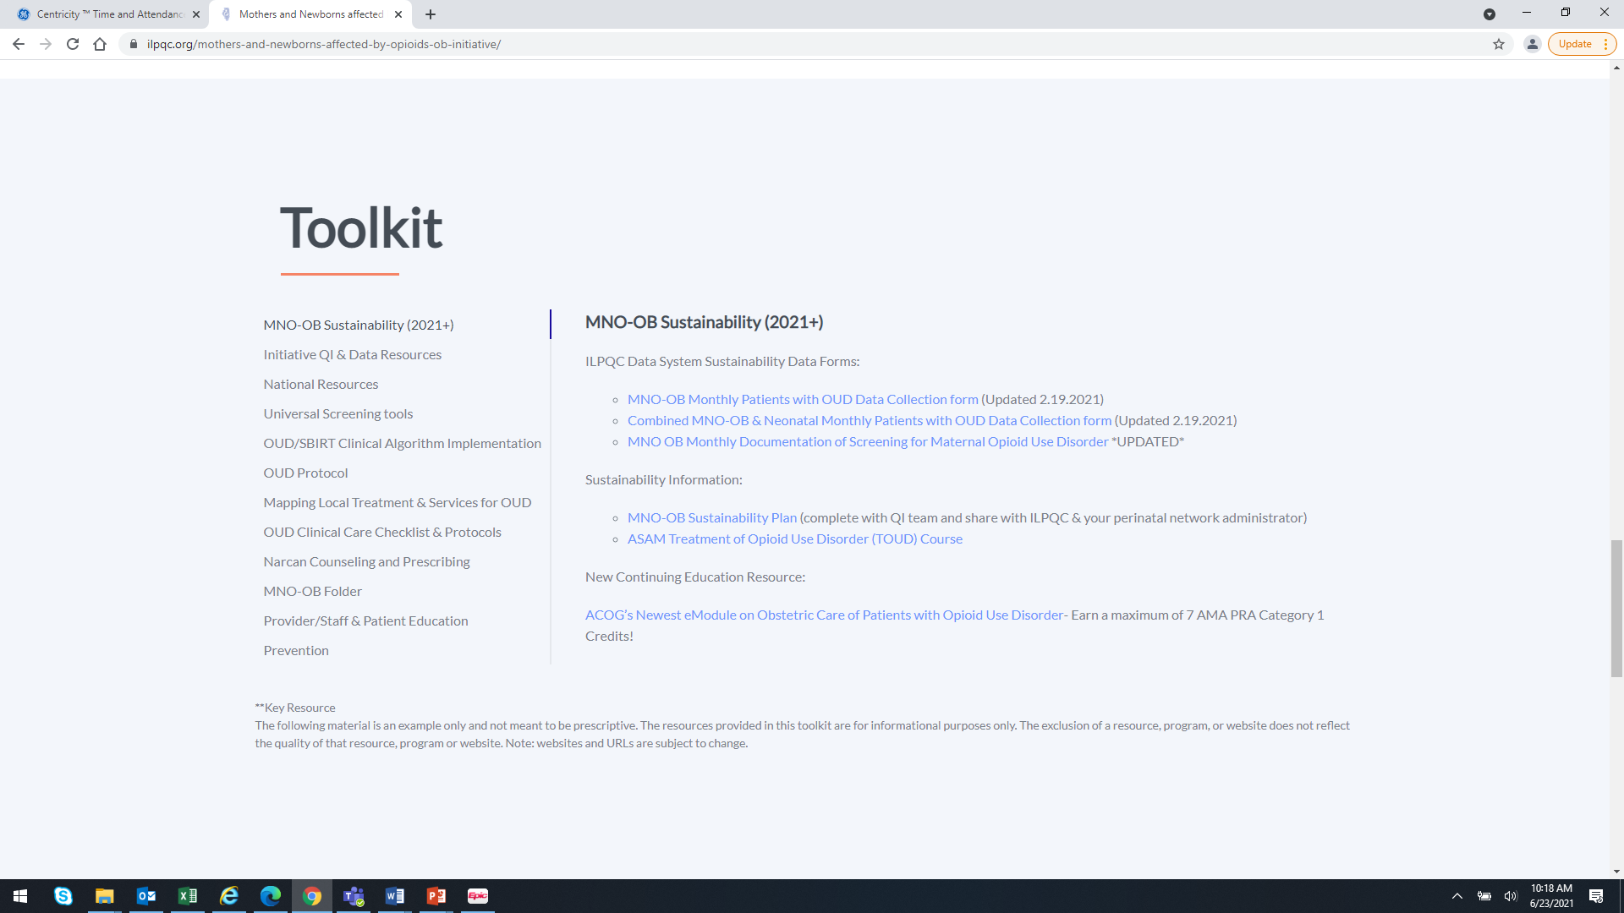

Slide 25
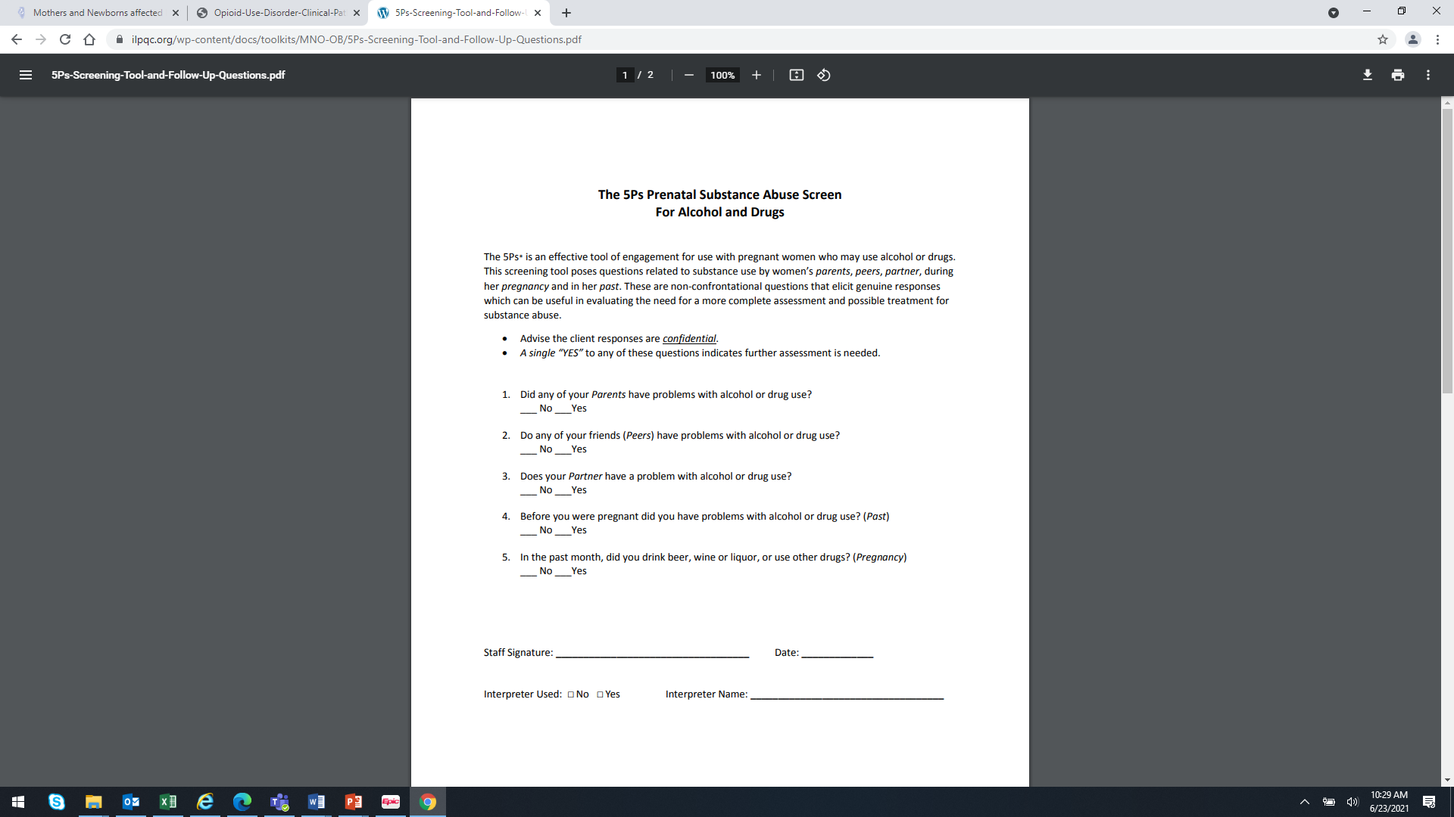
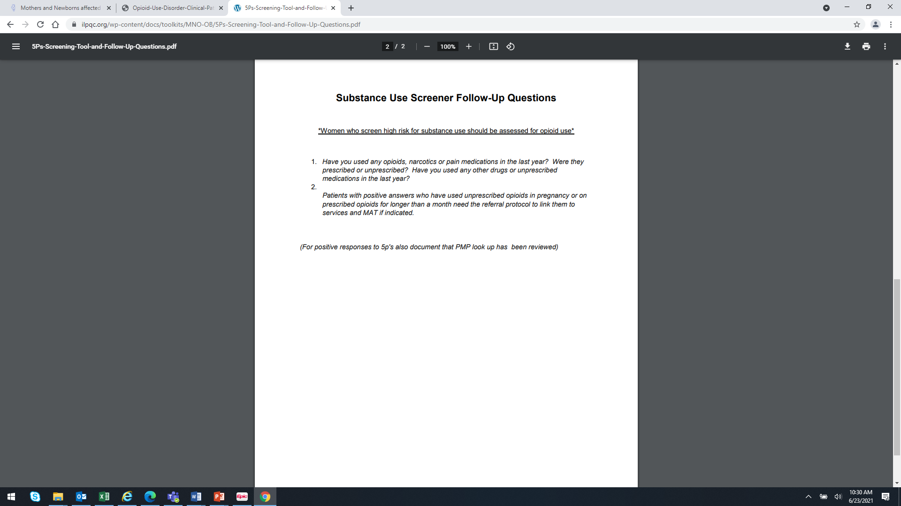

Slide 26
Taking a look at the websites
nciperinatal.com
https://ilpqc.org/

Slide 27
GETTING STARTED:
Validated Screening Tool
SBIRT
Mapping Resources and refer to Treatment
Provider/Staff Education—ILPQC PowerPoint

Slide 28


