Slide 1
North Central Perinatal Region
Education Updates
February 2024

Slide 2
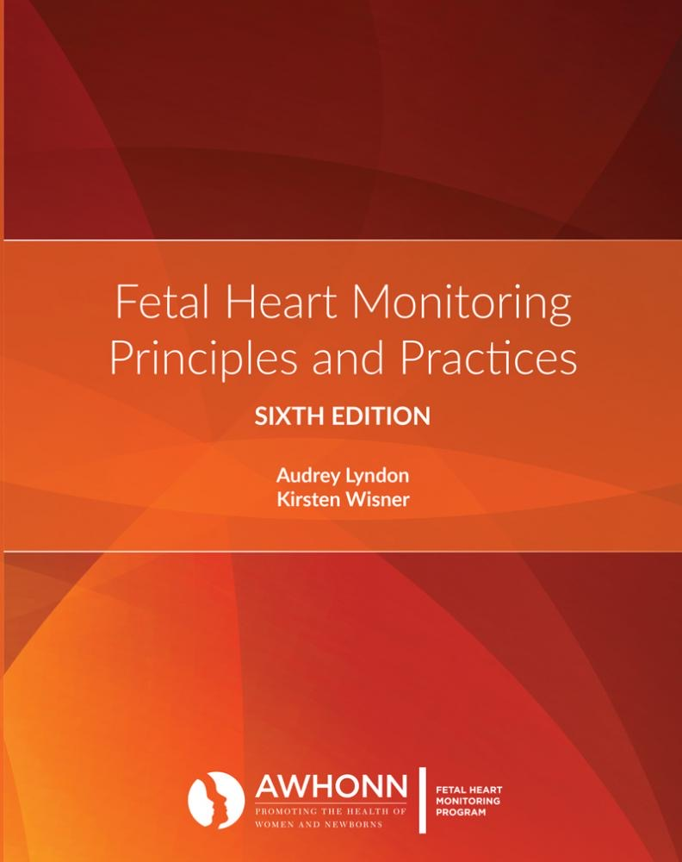
FUNDAMENTALS OF FETAL MONITORING (FOFM)
Audience: Novice Registered Nurses in the State of Illinois who will be providing fetal monitoring to antepartum and intrapartum patients.
Time commitment – 8 hours – CEU’S will be available.
Content will be presented every month at the state level. These classes will be taught by Illinois Administrative Perinatal Center Educators.
For more information, please contact Jen at Jennifer.l.carius@osfhealthcare.org

Slide 3
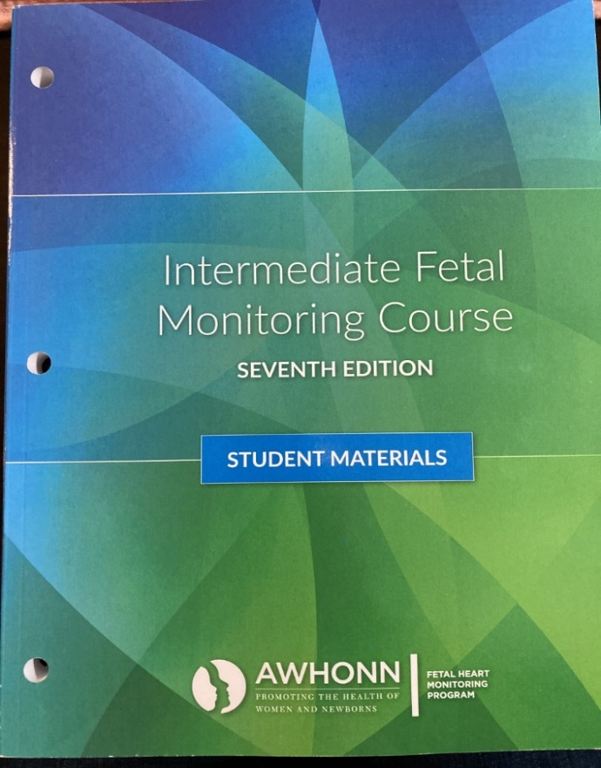
AWHONN Intermediate Fetal Monitoring Course
Audience - Nurses who have completed Updates in Fetal Monitoring/Basic Fetal Monitoring/Fundamentals of Fetal Monitoring.
One year of experience with fetal monitoring interpretation is recommended.
Time commitment – 8 hour in person class. There will be on-line coursework that must be completed prior to class (approximately 2-4 hours).
4 Classes are offered in 2024 – April, June, August, and October.
To register and find available classes, please visit Contact us | North Central Perinatal Outreach (nciperinatal.com)
This class is free, the only cost associated is the cost of the book required by AWHONN to attend and complete the course.

Slide 4
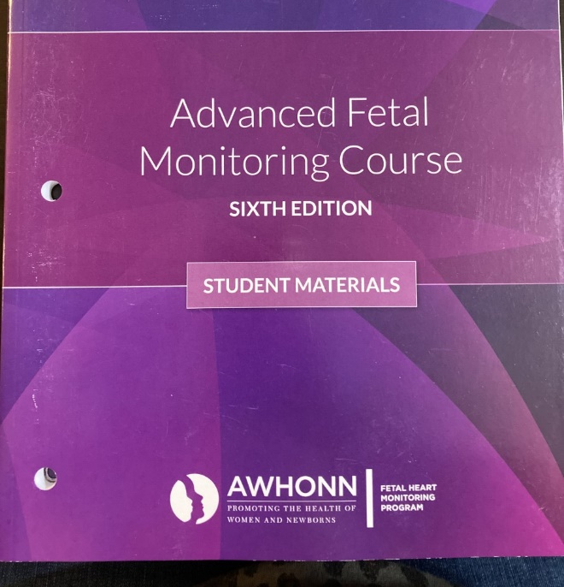
AWHONN Advanced Fetal Monitoring Course
Audience - Experienced Nurses who have taken the AWHONN Intermediate Fetal Monitoring Course or are certified in fetal monitoring.
Time commitment – 8 hour virtual class. There will be on-line coursework that must be completed prior to class (approximately 2-4 hours).
Classes are offered every other month beginning in January 2024.
To register and find available classes, please visit Contact us | North Central Perinatal Outreach (nciperinatal.com)
This class is free, the only cost associated is the cost of the book required by AWHONN to attend and complete the course.

Slide 5
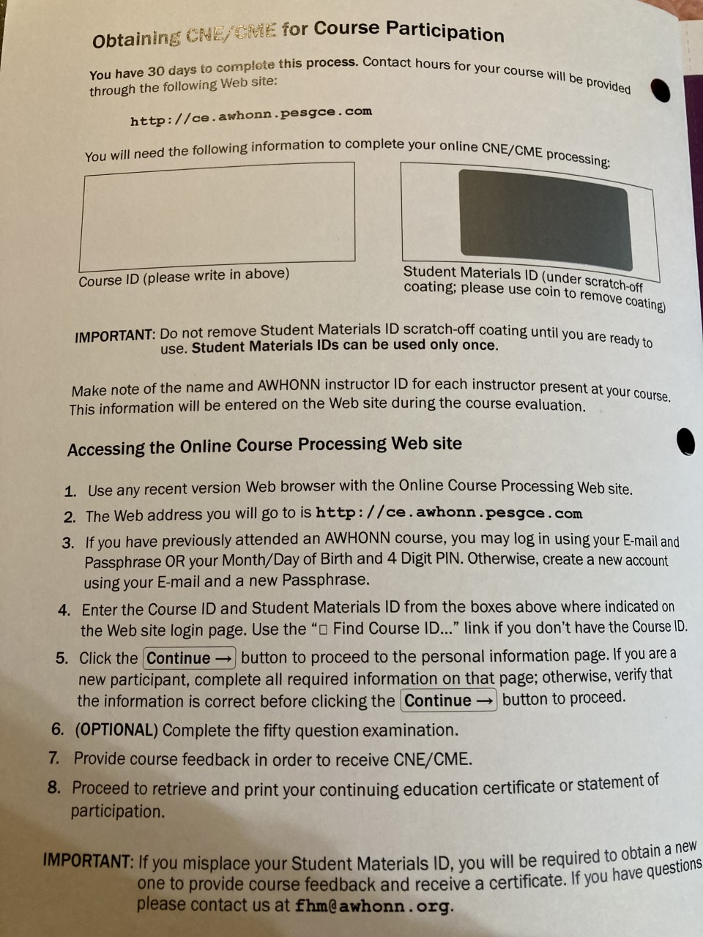
AWHONN COURSE iNFORMATION
Books – cannot be shared among participants, due to the unique code in each book required to complete on-line coursework.
Course ID – will be provided once participant is registered for the class.
CNE’s will be provided to the participant by AWHONN after completion of the class and on-line post exam.

Slide 6
PREPARING FOR THE EXPECTED
Audience: RNs who provide care across the spectrum of perinatal services, particularly in LDRP settings, but anyone with a basic understanding of EFM and newborn resuscitation is welcome! Interdisciplinary participation with RTs/MDs etc is always encouraged!
Time commitment: 2 hours, in person learning facilitated in-situ
Content: Following a brief review of EFM principles, a multiple case-study format is used to follow a maternal history, her labor course and EFM tracing with an emphasis on anticipating the correlating care needs of a newborn.
Then, learners simulate the newborn stabilization following delivery.
Please reach out to Jen or Emalee if interested!

Slide 7
Coming in 2024...
Basics of Maternal and Newborn Assessment and Care
Geared towards nurses on orientation with minimal OB experience
Looking at in-person and virtual class offerings
S.T.A.B.L.E
Class offered in person at Wozniak Learning Center (White School) on June 25th
Sign up available on NCIPN soon

Slide 8
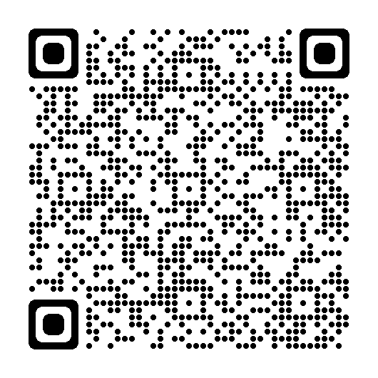
Spinning Babies 2024
Workshop with Tammy Ryan AdvCBD/BDT(DONA), SpBT
September 26, 2024 | 9:00-5:00 – In person
OSF Ministry Headquarters – Basement Conference Room
124 SW Adams St.
Registration information will be posted on website
Please use the QR code below to register:

Slide 9
Education Needs Assessment
Purpose: Receive feedback from the network regarding how NCIPN can best assist you with learning opportunities. This is how we develop what education to offer to all network hospitals.
New Format
Look for an email to be sent out after today's meeting
Only need one response per hospital
Please complete assessment by March 15th

Slide 10
If you have specific education requests, please reach out to Jen and Emalee.
Jennifer.L.Carius@osfhealthcare.org
Emalee.P.Brink@osfhealthcare.org

