Slide 1
Regional Quality Council (RQC)
North Central IL Perinatal Network
February 29, 2024

Slide 3
Welcome and Introductions
Please Share:
Name
Facility
How long in your current role
Is your birthday today? Do you know anyone whose birthday is today?
Do you do anything special for Leap Day?
This Photo by Unknown Author is licensed under CC BY-NC-ND

Slide 4
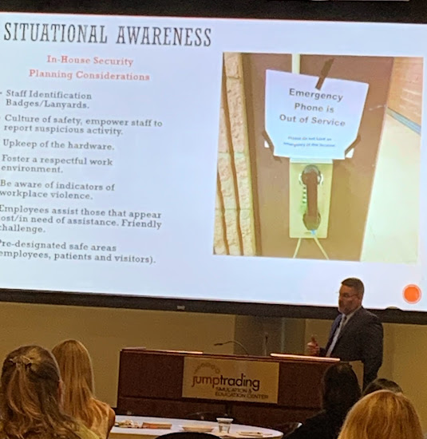
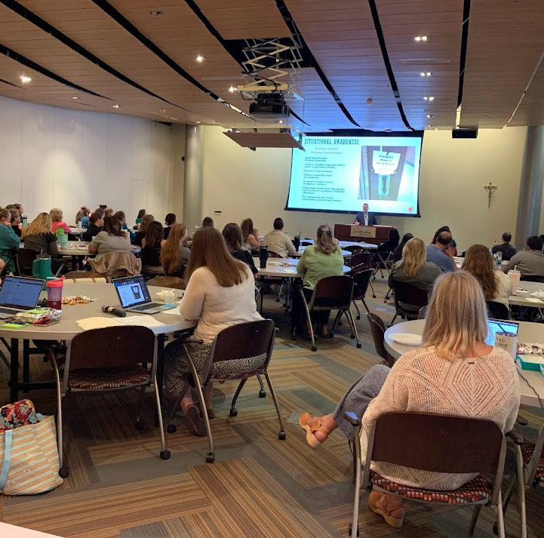
Save the Date! Teaming Up for Perinatal Care
Friday, November 15, 2024

Slide 5
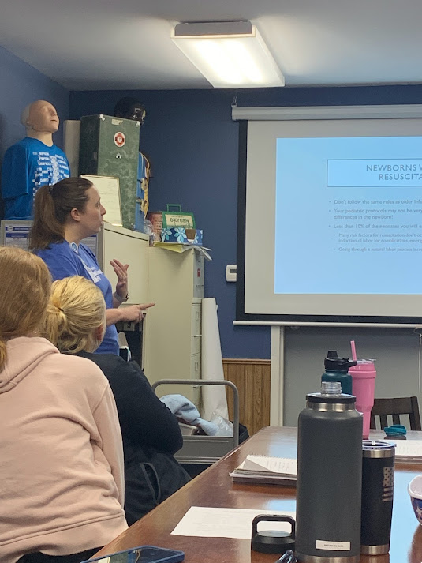
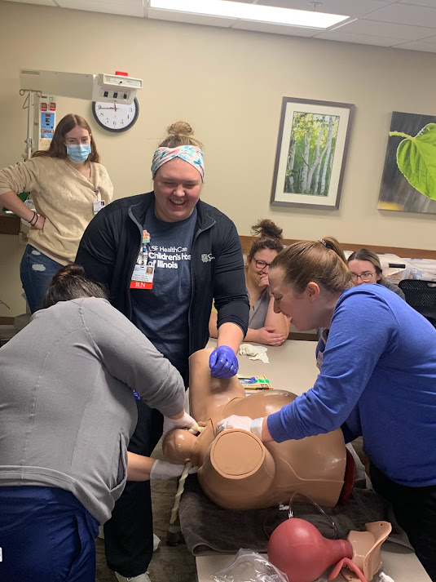
NCIPN Educational Updates
Jen Carius, Maternal Outreach Educator
Emalee Brink, Neonatal Outreach Educator

Slide 6
NCIPN Updates

Slide 7
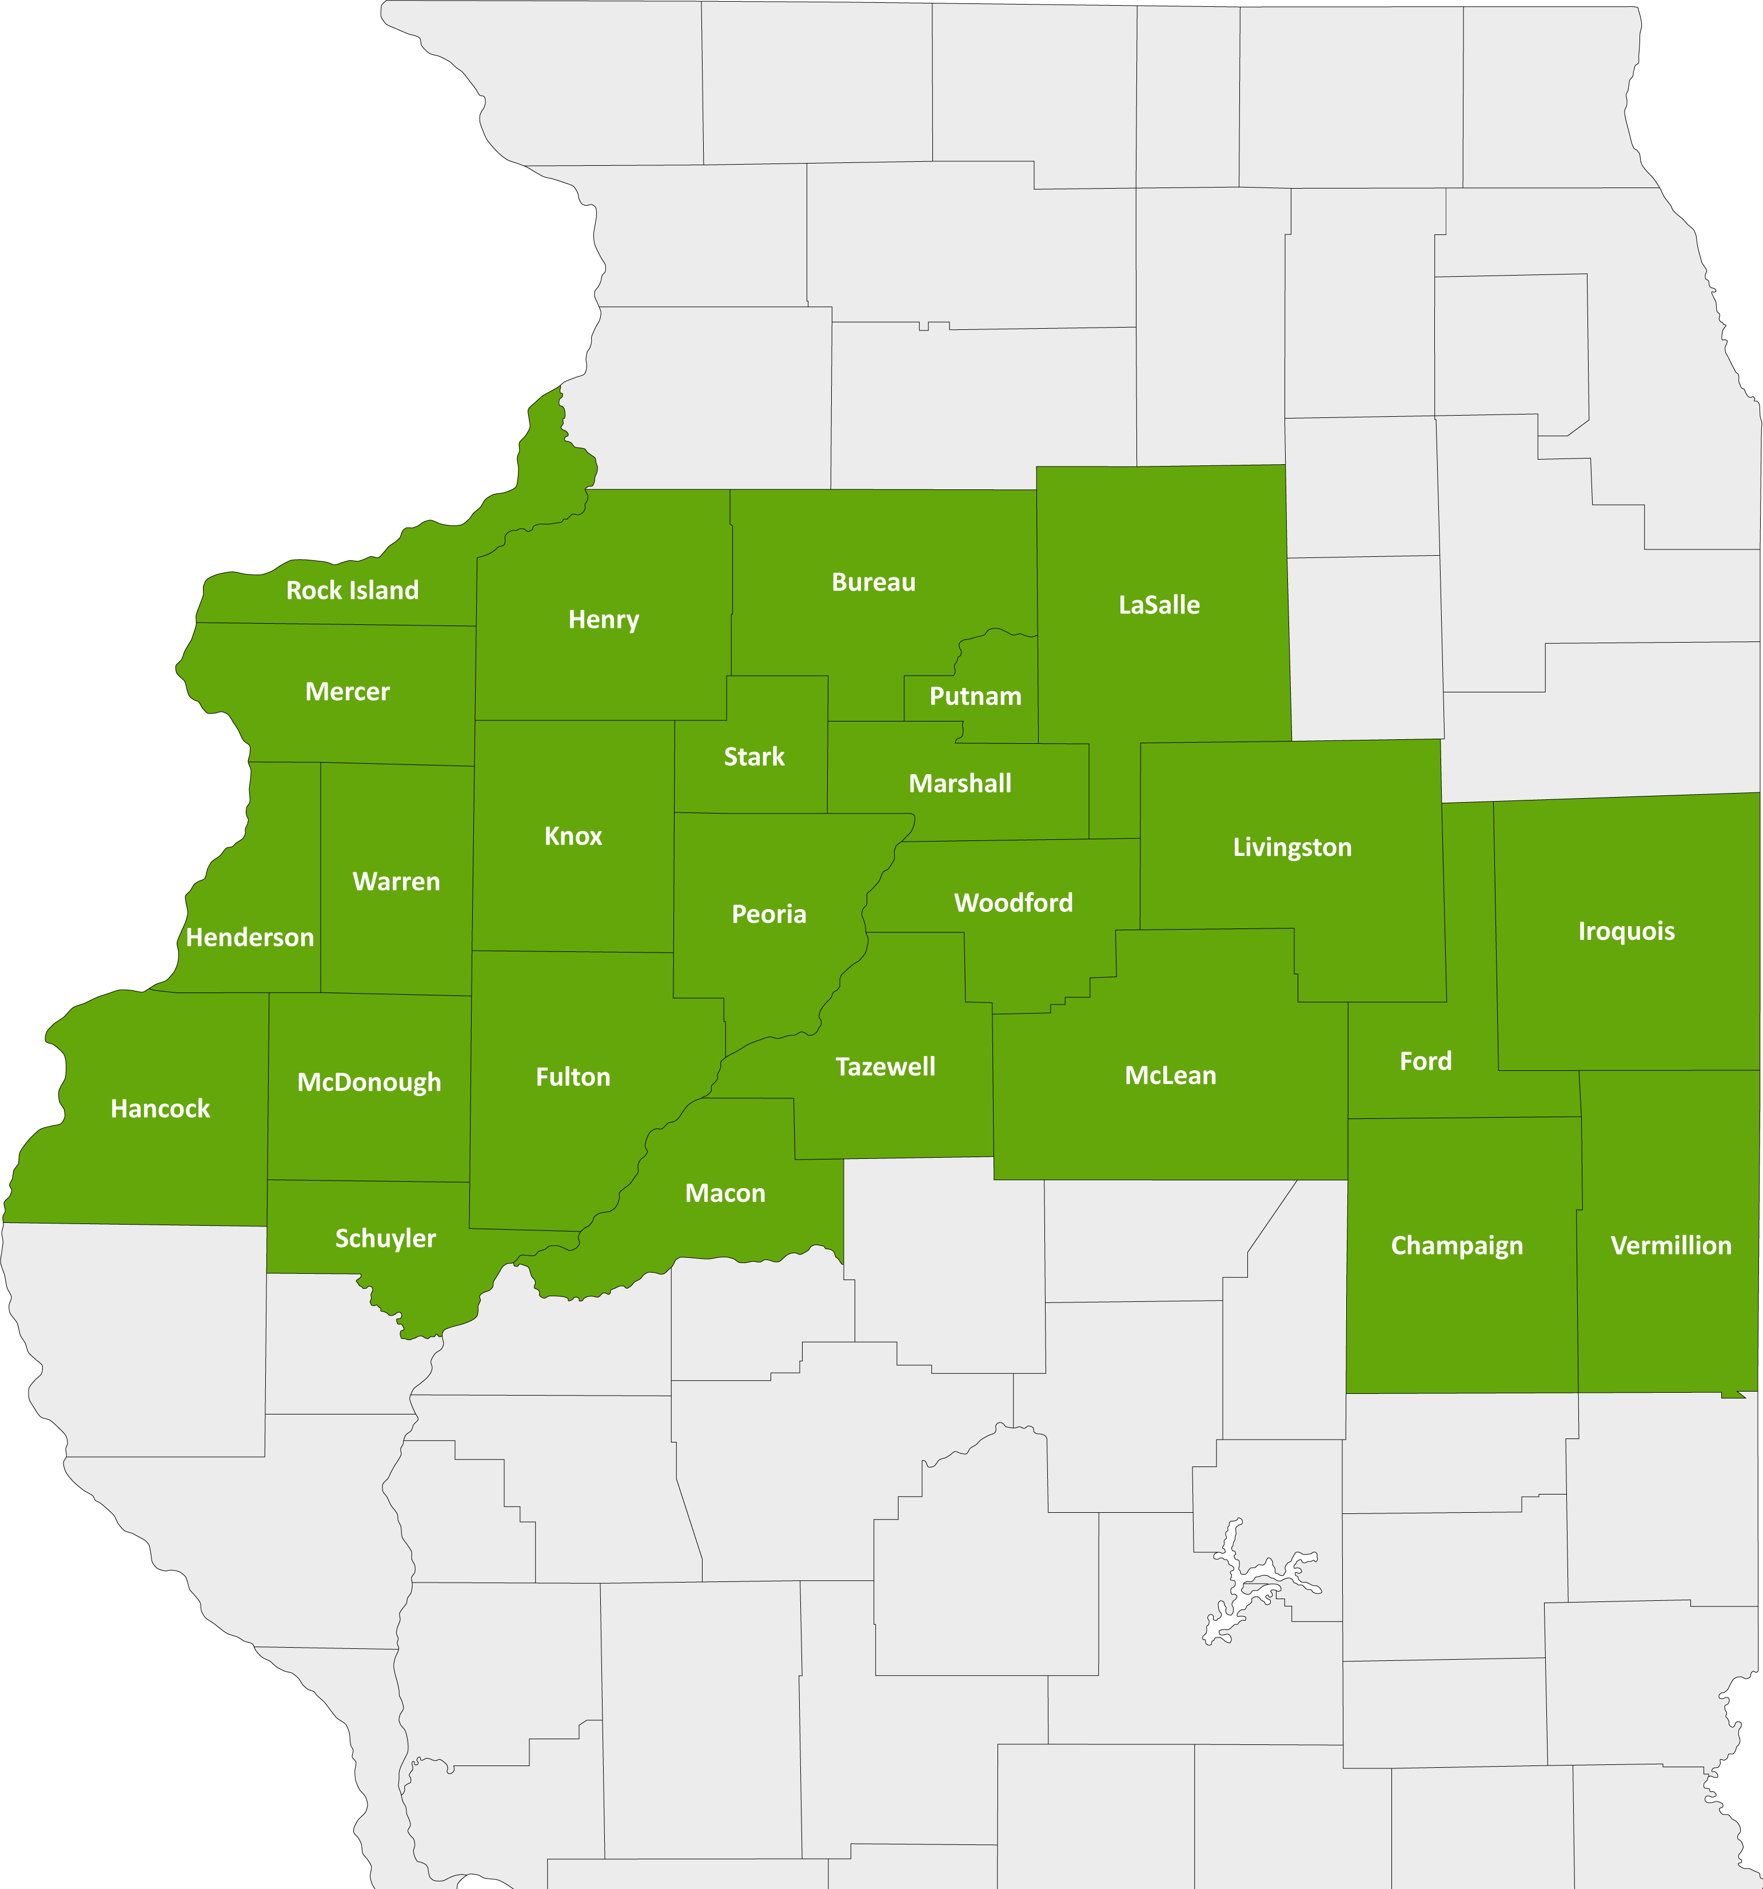
North Central Illinois Perinatal Network
The NCIPN covers 25 counties and 27 hospitals. Our administrative perinatal center (APC) is OSF HealthCare Saint Francis Medical Center in Peoria.
An APC facility provides
Education
Case reviews
Site visits for level of care re-designations
An on-call maternal-fetal medicine physician and neonatologist for consultation, support and supervision of transfers

Slide 8
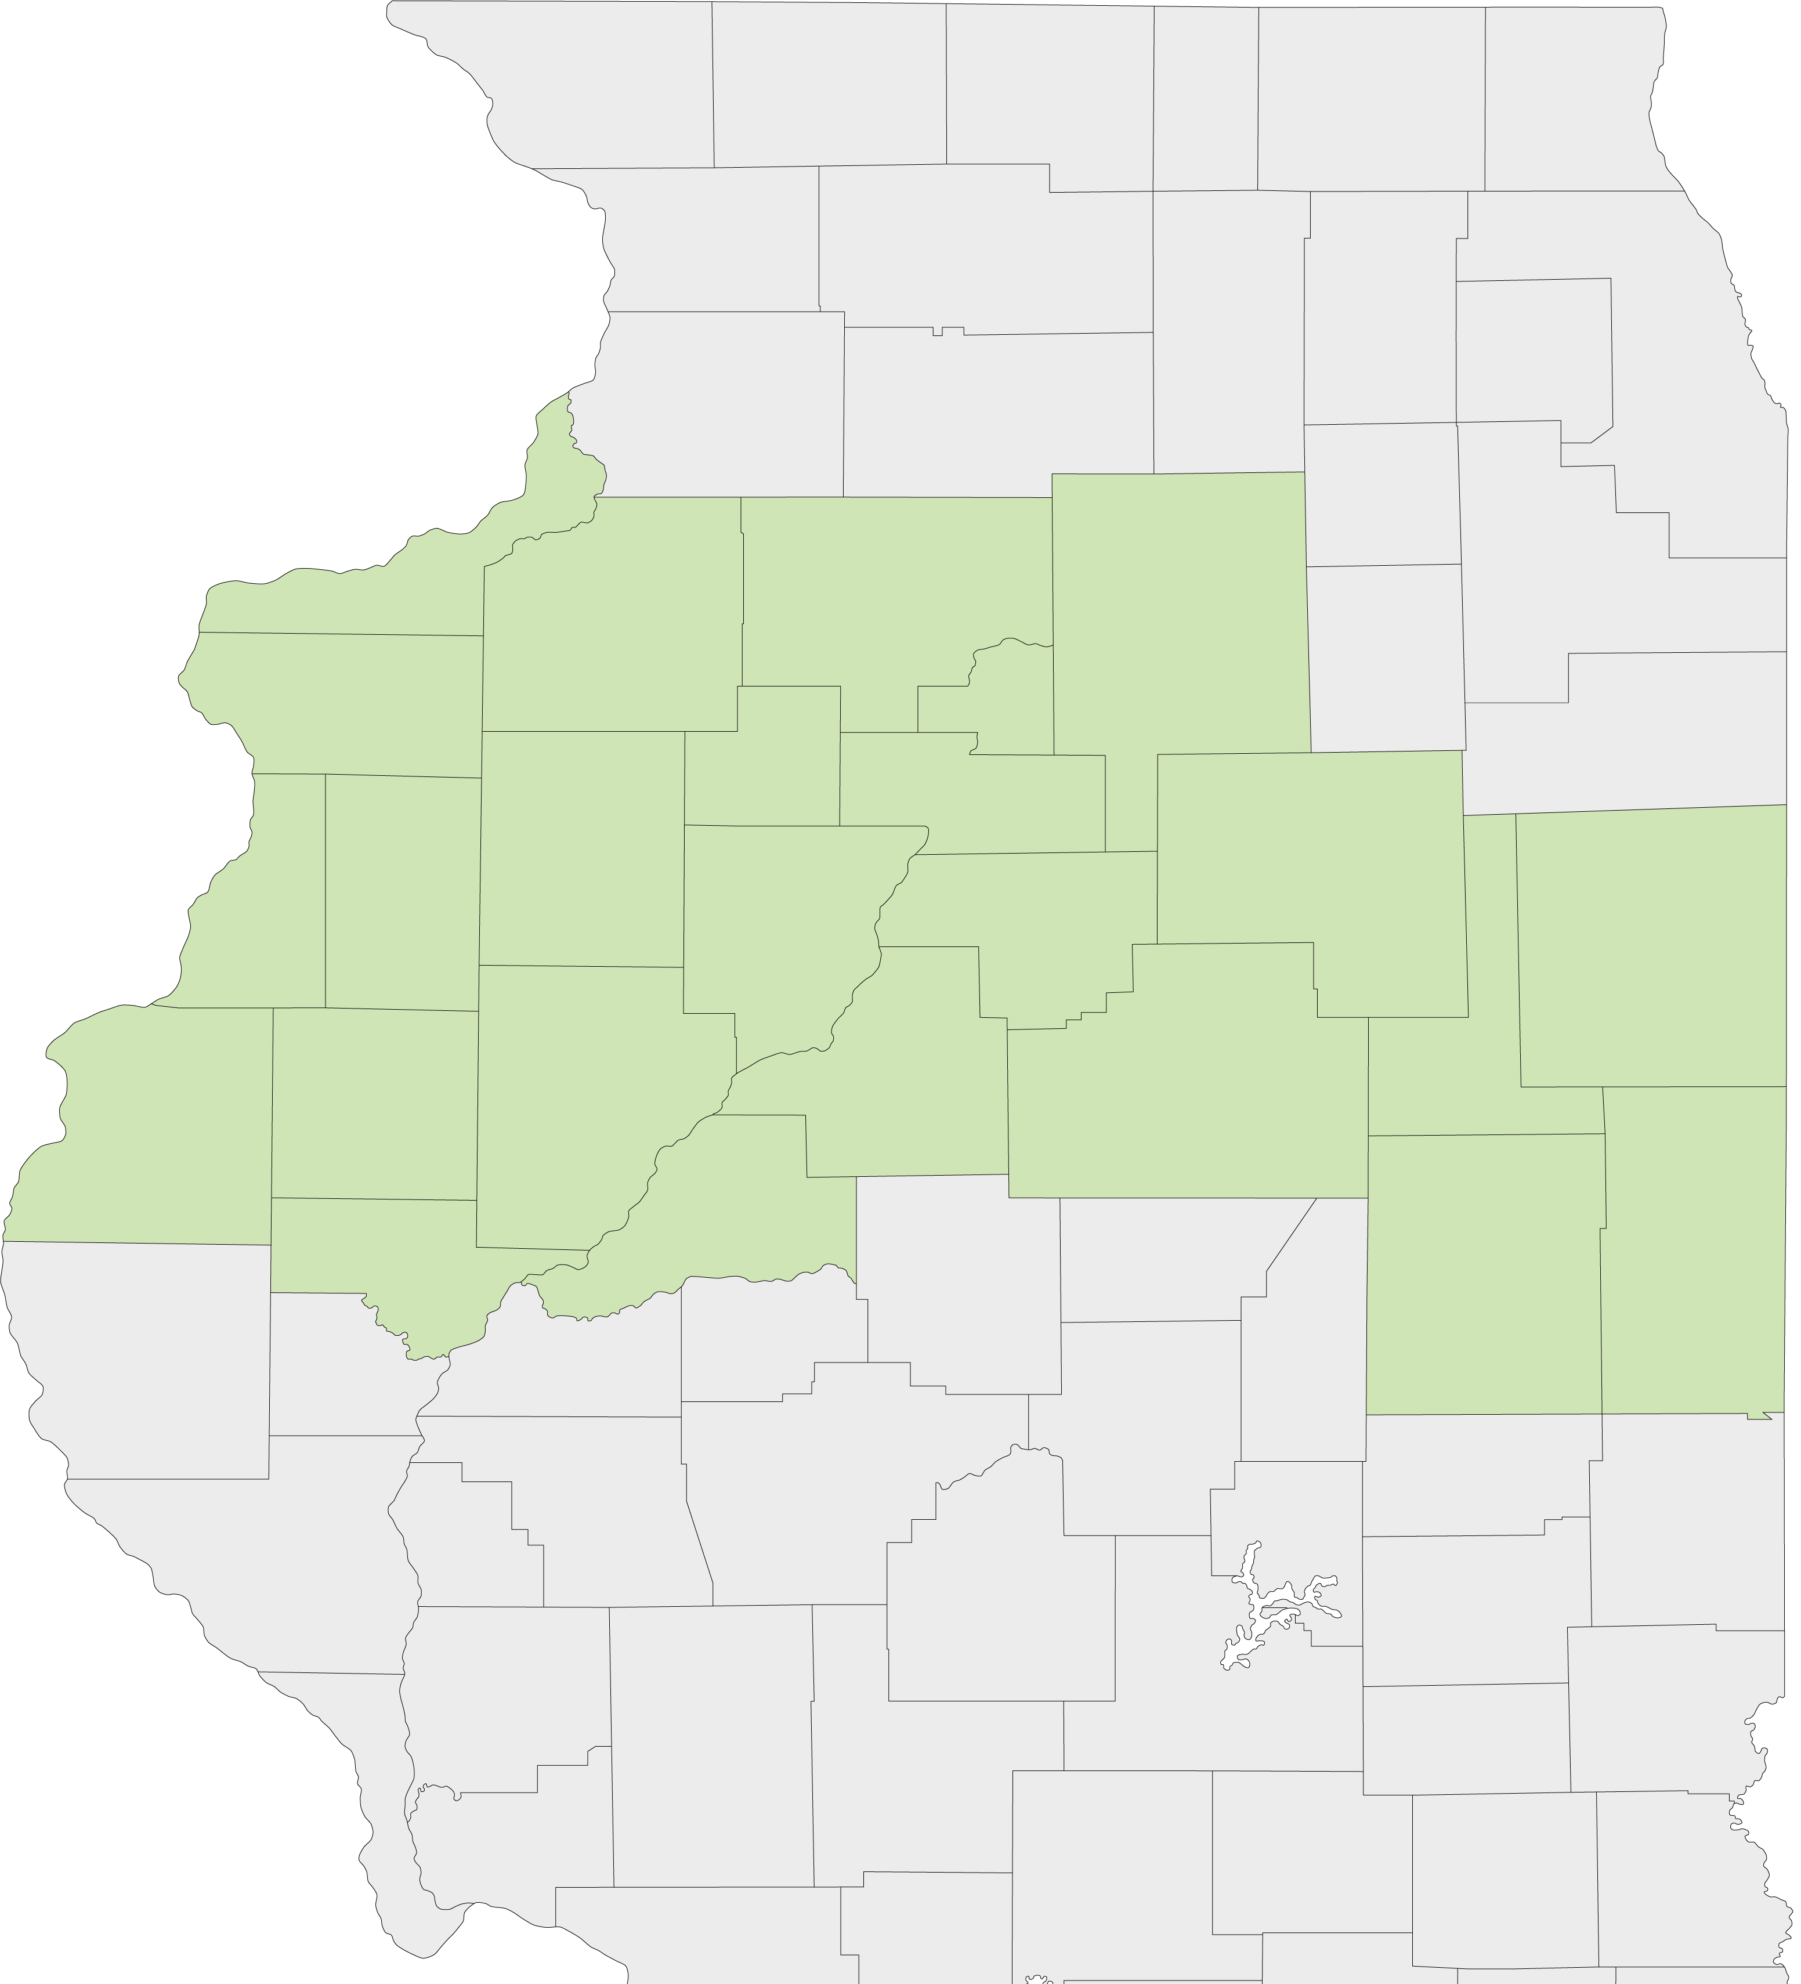
Current State Nursery Levels
LEVEL III – Provides care for patients requiring increasingly complex care and has a NICU.
LEVEL IIE – Has extended neonatal capabilities and provides care to pregnant women and newborns at moderate risk. No NICU or special care nursery.
LEVEL II – Provides care to women with low-risk pregnancies. Operates intermediate care nursery but no NICU or special care nursery.
LEVEL I – Hospitals that provide care to low-risk pregnant women and newborns, operate general care nurseries and do not operate an NICU or Special Care Nursery.
LEVEL 0 – No obstetrics services

Slide 9
North Central Illinois Perinatal Network Hospitals
Level III
OSF Saint Francis – Peoria
Level IIE
UnityPoint Health-Methodist – Peoria
UnityPoint Health-Trinity – Moline
Level II
Carle BroMenn – Normal
Genesis – Illini Campus – Silvis
Graham – Canton
OSF Saint Elizabeth – Ottawa
OSF St. Mary – Galesburg
McDonough District Hospital – Macomb
OSF St. Joseph – Bloomington
OSF Sacred Heart - Danville
Level I
LEVEL 0 – No maternity services
2
2
4
5
1
1
6
3
7
6
1
8

Slide 10
North Central Illinois Perinatal Network Hospitals
Level III
Level IIE
Level II
Level I
Level 0
Level 0 – no maternity
Genesis – Aledo
Hammond Henry – Geneseo
Iroquois – Watseka
OSF Center for Health – Streator
OSF Saint Clare – Princeton
OSF Saint Paul – Mendota
OSF St. James - Pontiac
OSF Holy Family – Monmouth
OSF Saint Luke – Kewanee
UnityPoint Health-Pekin – Pekin
UnityPoint Health-Proctor – Peoria
Carle Eureka – Eureka
Hopedale Medical Complex – Hopedale
Memorial Hospital – Carthage
OSF Heart of Mary – Urbana
OSF St. Elizabeth’s - Peru
2
6
5
16
9
1
4
8
7
11
3
12
10
14
13
15

Slide 11
Historical Look at OB Closures
2014
Perry Memorial – Princeton (85/yr)
St. Mary’s – Streator (186/yr)
Proctor Community Hospital – Peoria (604/yr)
2017
Hammond Henry – Geneseo (240/yr)
Iroquois Memorial – Watseka (89/yr)
2019
Cottage Hospital – Galesburg (370/yr)
Pekin Hospital – Pekin (367/yr)

Slide 12
Historical Look at OB Closures
2023
St. Margaret Health – Peru (364/yr)
2022
St. Margaret Health – Spring Valley (269/yr)
Memorial Hospital – Carthage (101/yr)
OSF Heart of Mary – Urbana (209/yr)
OSF St. James – Pontiac (77/yr)

Slide 13
Where did they go?
Closing Hospital | Year of Closure | Average Delivery (3 yrs prior to closure) | Absorbing Hospital | Change in Deliveries
Princeton | 2014 | 85/yr | Spring Valley | 2015 +49
Streator | 2014 | 186/yr | Ottawa | 2015 +89
Proctor | 2014 | 604/yr | Methodist | 2015 +350
Geneseo | 2017 | 240/yr | Silvis | 2018-19 +115
Watseka | 2017 | 89/yr | Out of Network
Cottage | 2019 | 370/yr | SMMC | 2019-20 +258
Pekin | 2019 | 367/yr | Methodist | 2019-20 +448
Spring Valley | 2022 | 269/yr | Peru | 2022 +154
Carthage | 2022 | 101/yr | Quincy/MDH
Peru | 2023 | 354/yr | Ottawa/Morris

Slide 14
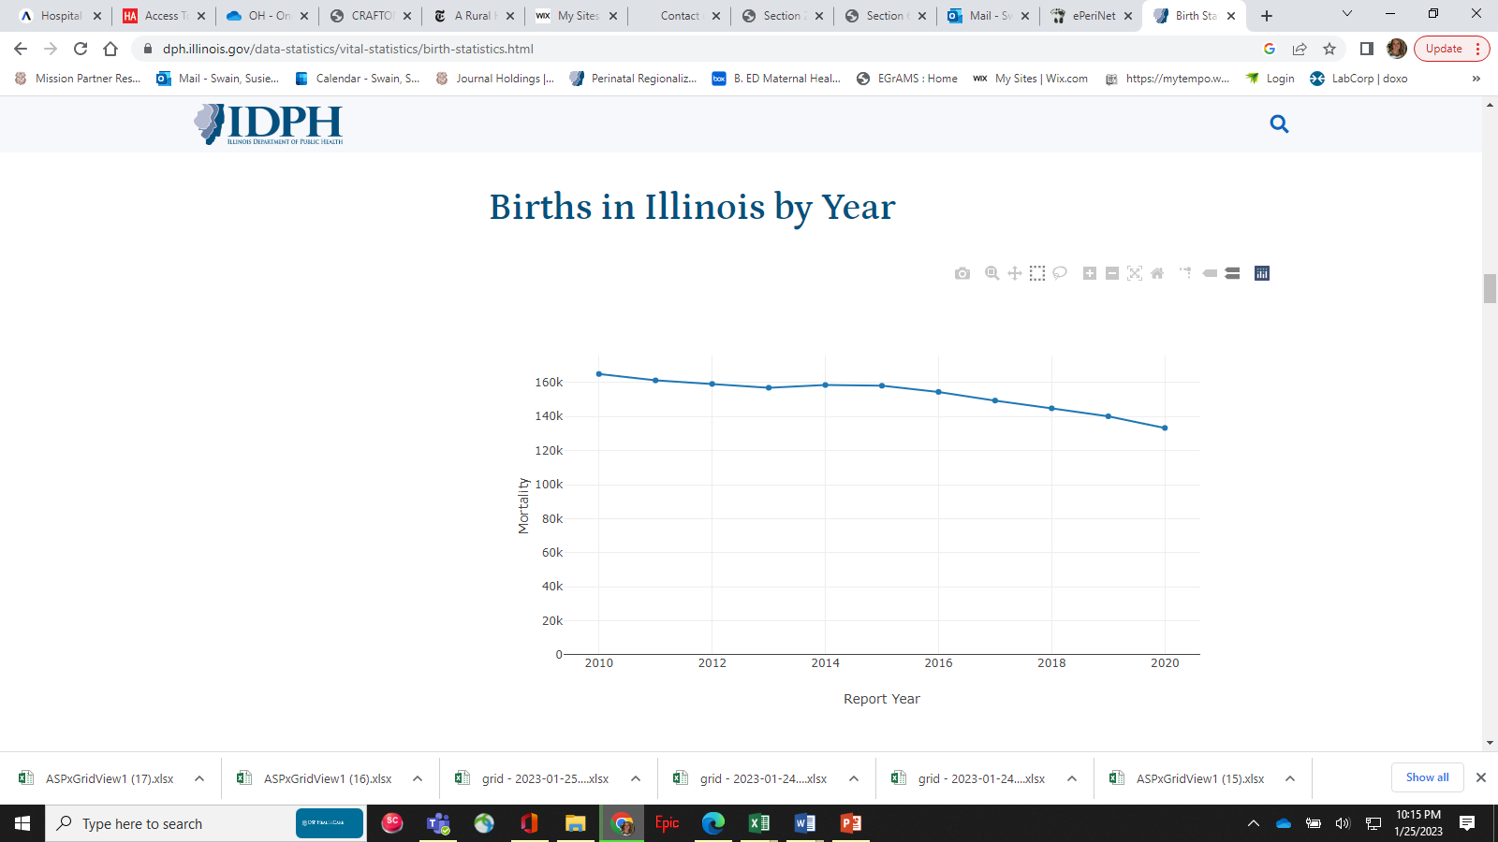
Year | IL Births
2014 | 158,522
2015 | 158,101
2016 | 154,467
2017 | 149,390
2018 | 144,828
2019 | 140,145
2020 | 133,304 (-25,218)

Slide 15
IDPH Updates

Slide 16
IDPH
Various
Site Visits
MLOC – draft of rules by April – June 2024
HIV testing – We just received and will send to you
APORS – Timeliness Reports
Airway Management
Syphilis (Slide deck on website)
Please keep working on materials
Materials to NCIPN 6 weeks in advanced. Review and Update
Materials to NCIPN for distribution to IDPH & Team 3 weeks prior (3Protected USB)
Hybrid format

Slide 17
Illinois Congenital Syphilis Elimination Strategy Comes to You
The What, Why, How and When
of Congenital Syphilis Testing, Prevention, and Treatment During Pregnancy
Full slide deck is on the NCIPN website:
www.nciperiatal.com
Under Regional Quality

Slide 18
Conclusions
Congenital Syphilis is detectable, preventable, and treatable DURING PREGNANCY.
Third Trimester Testing for maternal syphilis is the LAW in IL.
Ideally, third trimester syphilis testing takes place between 28-34 weeks gestation in order to allow for effective treatment of pregnant person and fetus, but testing beyond 34 weeks, even at delivery, is still beneficial for the health of baby and parents.
Detection of syphilis during pregnancy demands multiple ACTIONS
Perform thorough history and exam to determine stage of disease
Treat with Penicillin urgently, according to stage of disease
Test and treat partner(s)
Arrange linkage to care for maternal postpartum syphilis monitoring, for partner, and for neonate.
Let’s Do This!

Slide 19
Syphilis Screening Monthly Report Form
Please return this form to reports@maca-us.org. If you have any questions, please contact Anne Statton at 312-334-0974. You may also return this form by fax to 312-334-0973.

Slide 20
HIV/Syphilis Hotline/Warmline
1-800-439-2079
For support with Syphilis diagnosis, record search and treatment support for providers testing pregnant people for syphilis. That telephone number is the same as the HIV hotline number.

Slide 21
Welcome Elle Suse & Kiela Moreno
Review of IL PQC
Initiatives
Question ~ Answer

Slide 22
Closing
Dear God,
Bless our last day of February with miracles and blessings. Help me walk into the month of March with a better approach, mind, and attitude! I pray today that you do the impossible in our lives and in others. Heal bodies and minds, change lives, and turn situations around!
In Jesus’ name, Amen.

