Slide 1
Regional Quality Council (RQC)
February 16, 2023
North Central Illinois Perinatal Network

Slide 2
Agenda

Slide 3
Reflection
“When change happens,
you have a choice for how you are going to respond.
You can either lose your composure and react impetuously or use the event or situation as a learning opportunity to shift your mindset and respond appropriately.
Begin to notice your responses when changes occur and do your best to choose a breakthrough over a breakdown.”
~Susan C. Young
Author and Speaker on Positive Change

Slide 4
Introductions
Name, your facility, how long you have been there and answer: What do you like to create?

Slide 5
NCIPN Updates
Visit our website:
www.nciperinatal.com
Classes
Links (IL Perinatal Code 640 and Hospital Licensing 250)
Items from RQC
Contact Information
For Newborn questions reach out to Janessa Jenkins
For Maternal questions reach out to Jen Carius
For class attendance reach out to Teresa Rosebohm
For Everything else reach out to Susie Swain

Slide 6
Outpatient Monitoring Class
Coming Spring 2023!
Reach out to Jen Carius for more details and information

Slide 7
NCIPN OB Deserts
As of January 2023

Slide 8
Loss of Essential Resources
Please contact Susie as early as possible to help facilitate notification of IDPH, education, and coordination with APC

Slide 9
Provider Onboarding Packet
A shell of procedures and facility specific policies to review with new provider at the facility.
Serves as a guide to assist in onboarding new providers
Reviews
Illinois Perinatal Code
Level/Facility Specific Capabilities
Reasons for consults and transfers from Letter of Agreement
Accessing Care Hub
Scripting provided when calling
Discuss more in Maternal and Newborn Workgroups
A shell of procedures and facility specific policies to review with new provider to the facility.

Slide 10
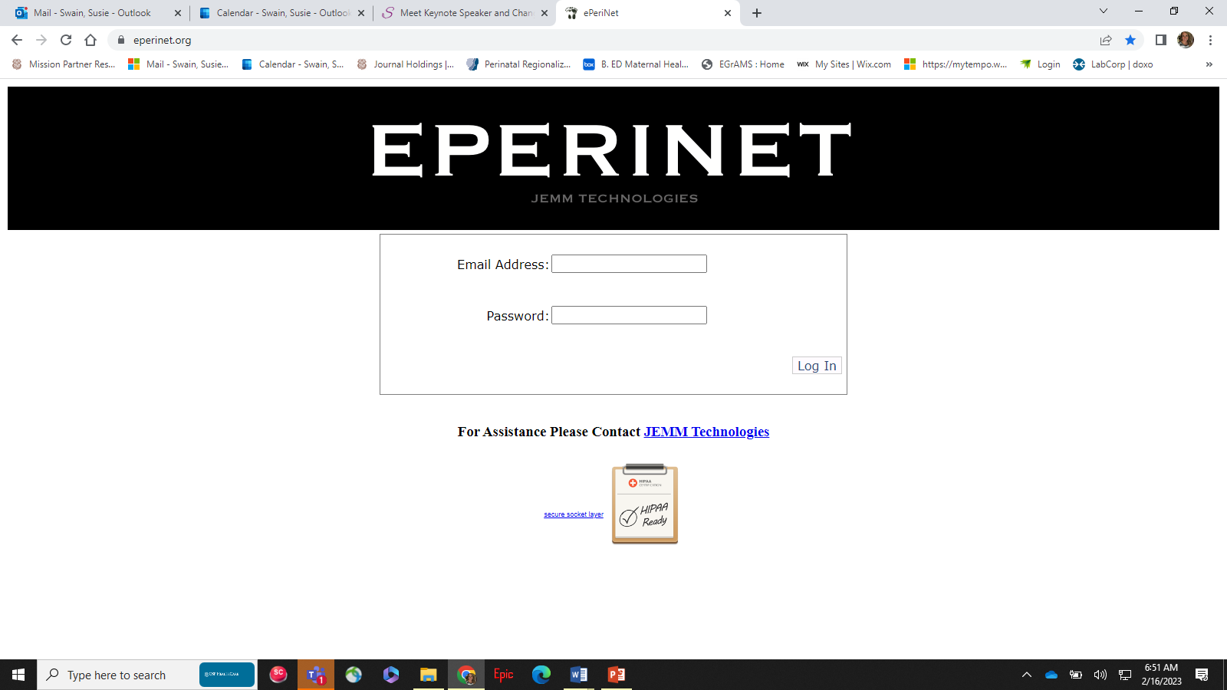
ePerinet
For any access assistance, please reach out to Jeff at Jemm Technologies
New shortcut was sent out in December/January
To add a new user, reach out to Jeff and Susie will need to approve
Please try to have data entered by the 15th of following month

Slide 11
Birth Certificate Review
Linda Blackert

Slide 12
2024 IDPH Perinatal Site Visits
Quality Improvement Focused
Make you unit and staff shine
Use graphs and tables
We have to assume the new Maternal Levels of Care Rules will not be completed so prepare just as we have in the past
GOAL: One on one meeting with NCM by June 2023
Think multidisciplinary everything
Include pictures of education, simulation, etc
Yes, we need to talk about it…. =)

Slide 13
Perinatal Case Review (PCR)
See 11.3.22 RQC Slide Deck

Slide 14
Break
Move around! Get a snack/beverage

Slide 15

IL PQC 2023 Dates
May 24 - Maternal
May 25 - Newborn
Face to Face
Springfield
November 2, 2023
Annual Conference
Lombard

Slide 16
Illinois Perinatal Quality Collaborative (IL PQC)
Ellie Suse
Dan Weiss
Aleena Surenian (newest IL PQC team member) WELCOME!
IL PQC Updates
Please ask questions!

Slide 17
NCIPN Workgroups Choose which one you would like to attend and follow to new Teams Meeting (sent in email)
Maternal
Newborn
New Provider Onboarding Packet
One-way ambulance transfers
Topics for RQC
Previous topics
Network!
New Provider Onboarding Packet
Infant Blood Transfusions
Topics for RQC
Previous topics
Network!

Slide 18
Lunch
Feel free to grab your lunch and join Melissa Millinger presentation

Slide 19
The Dark Side of the Moon
Melissa Millinger

