Slide 1


Mothers & Newborns Affected By Opioids

Slide 2
Illinois Perinatal Quality Collaborative (ILPQC)
Involves all perinatal stakeholders
Utilizes data-driven, evidence-based practices
Improves perinatal quality resulting in improved birth outcomes, improved health for women & infants, & decreased costs
Builds on Illinois’ existing state-mandated Regionalized Perinatal System
Operates with long-term sustainable funding

Slide 3




Key Messages to Make Change Happen
    Opioid Use Disorder is an urgent obstetric issue
    Opioid Use Disorder is a life-threatening chronic disease with lifesaving treatment available, reducing stigma improves outcomes
    There are key steps OB providers need to take prenatally and on L&D to care for women with Opioid Use Disorder
    Linking moms to MAT/Recovery Services
    Reduces overdose deaths for moms
      Improves pregnancy outcomes
      Increases # women who can parent their baby

Slide 4
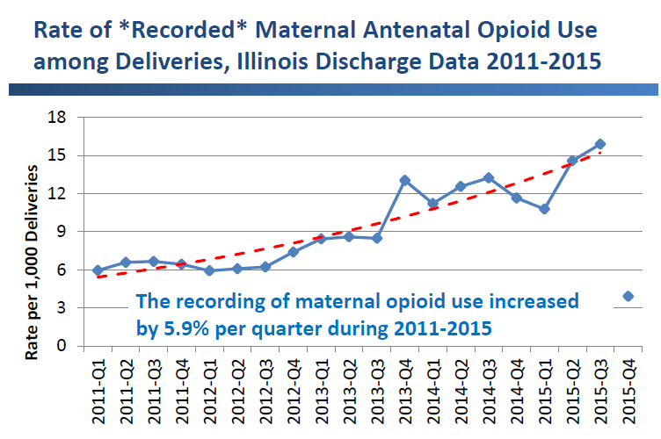

Slide 5
MNO Focus For Improvement
Prevention
Screening & Linkage to Care
Optimizing Care for Moms/Babies

Slide 6

Optimize Prevention of OUD
Provider & patient education on risks of OUD & alternate pain management strategies
Provider compliance with state law on documentation of PMP lookup when prescribing any narcotic
Implementation of clinical guidelines for strategies to reduce opioid over-prescribing after delivery

Slide 7
MNO OPPORTUNITIES FOR IMPROVEMENT
Improve identification of pregnant women with opioid use disorder(OUD)
Improve linkage to addiction care for moms with OUD
Optimize clinical care of women with OUD
Increase maternal participation in the care of opioid exposed newborns
Improve outcomes for opioid exposed newborns through key interventions
Optimize prevention of OUD

Slide 8
Utilization of a Validated Screening Tool
Follow SBIRT (Screening, Brief Intervention, Referral to Treatment) process for all pregnant women
5 P’s Screening Tool given to patients at points of entry
  Office Visits
  Triage
  Admission to ED, L&D, Women’s Care Unit
Follow process map based on screening results

Slide 9
5P SCREENING TOOL

Slide 10
Suggestions for Screening
Positive Perinatal Substance Use Screen (once, twice, thrice monthly)
  Moderate use
  Motivational Interviewing
  Contract for Safety
  Referral for Peer Support
    Online
    In Person

Slide 11
Suggestions for Screening (continued)
Positive Perinatal Substance Use Screen (weekly or more)
  Provide motivational interviewing to gain the patient’s consent for treatment
  Have the patient return for frequent follow up visits
  If the patient agrees, then collaborate with her to create treatment goals and make necessary referral (Contract for Safety)
  Referral for professional treatment

Slide 12
Screening, Brief Intervention and Referral to Treatment
In the past year, how many times have you used: Tobacco? Alcohol? Marijuana?
Never
Once
Monthly
Weekly or more
Positive Response
Once or Twice
Monthly
Weekly or More
Never
In the past year, how many times have you used: Illegal drugs? Inhalants? Herbs/Synthetic Drugs? Prescription Drugs not prescribed for you?
Never
Once or Twice
Monthly
Weekly or more
Reinforce Choice
Once or Twice
Monthly
Weekly or More
Advise to Quit
Explain negative impact
Motivational Interviewing
Plan of Safety
Motivational Interviewing
Referral
Plan of Safety

Slide 13



SCREENING TOOLS & RESOURCES
SBIRT screening app: A tool to quickly screen patients for substance misuse and depression. The app is free of charge to providers through SBIRT Oregon, www.sbirtoregon.org.
The Five Ps Screening Tool
https://d3vz56oilt3wha.cloudfront.net/resources/5p_forms/5Ps%20screening%20tool%20-%20English.pdf
TAPS Screening Tool https://www.drugabuse.gov/taps/#/
Safe Care Plan from the Institute for Health Recovery
http://www.healthrecovery.org/safecare/
https://30qkon2g8eif8wrj03zeh041-wpengine.netdna-ssl.com/wp-content/uploads/2013/10/ASAM-WAGBrochure-Opioid-Labor_Final.pdf

Slide 14
Referral To Appropriate Specialties
Statewide Resources:
Illinois OUD Hotline – To find MAT/recovery treatment locations
IL DocAssist – Free perinatal OUD Addiction Med Consult for provider OUD/MAT questions
ILPQC Toolkit/Resources: www.ilpqc.org

Slide 15


Treatment Resources
SAMHSA treatment providers: The Substance Abuse and Mental Health Services Administration maintains a confidential and anonymous source of information for persons seeking substance abuse treatment and other mental health services. www.findtreatment.samhsa.gov
SAMHSA National helpline: A confidential, free 24-hour, 365 day a year information source for individuals and family members facing mental and/or substance use disorders.
www.samhsa.gov/find-help/national-helpline
  Call SAMSHA at 1-800-487-4889
Illinois Helpline for opioids and other substances
  Helplineil.org
  Call 833-2FINDHELP

Slide 16
Notes:
We will be working on helping providers counsel women with OUD on access to NARCAN as an overdose prevention strategy

Slide 17
Clinical Care Checklist
Key Measures
OUD Folder (patient/provider information)
Narcan counseling & prescription documented
Future birth planning discussed & documented
Hep C Screening
Pediatric/Neo Consult completed
Social Work Consult completed
Standardized education on NAS & the mom’s important role in the non pharmacologic care of the newborn

Slide 18

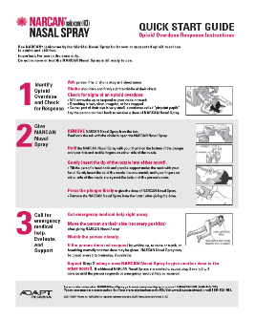
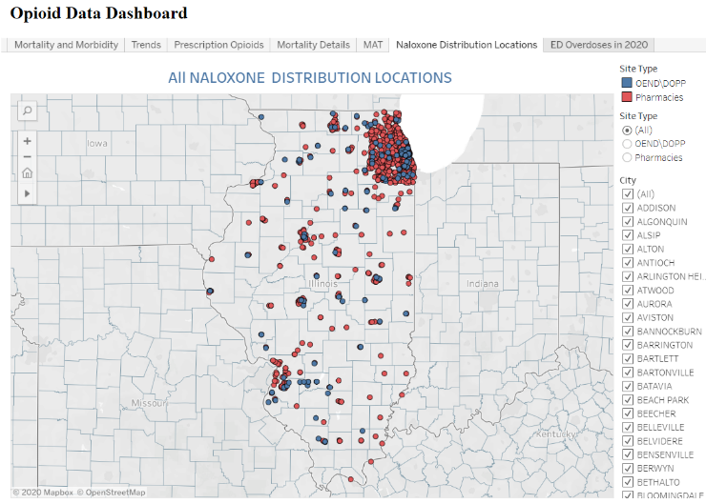
NARCAN Tools & Resources for Teams
Narcan- Save a Life Flyer – provider education on how to prescribe Narcan
Narcan Quick Start Guide – handout for patients on how to use Narcan
IL DHS Helpline for Opioids & Other Substances Magnet: https://helplineil.org/app/home you can search for community-based Naloxone/Narcan distribution locations and view by insurance status
IDPH Opioid Data Dashboard- Naloxone Distribution Locations & contact information: https://idph.illinois.gov/OpioidDataDashboard/
IL DocAssist 866-986-ASST (2778)→ Free Addiction Medicine Consult for caring for pregnant & postpartum with OUD… Ask them about Narcan Counseling!!!

Slide 19
New FDA Recommendation for Narcan/Naloxone
Added a labeling change to require that patient handouts for opioids and opioid use disorder (OUD) treatment drugs include information about naloxone
Recommends that all healthcare professionals discuss Narcan/naloxone prescription with all patients with OUD and all patients on opioids
All patients are at risk of experiencing an overdose, especially those also on benzodiazepines or other central nervous system depressants, those who have experienced a prior overdose, those with OUD, and anyone who lives with someone at risk of opioid overdose
https://www.fda.gov/drugs/drug-safety-and-availability/fda-recommends-health-care-professionals-discuss-naloxone-all-patients-when-prescribing-opioid-pain

Slide 20

MOM HAS A VITAL ROLE
  - Encourage breastfeeding
- Establish importance of mom as a key caregiver
after delivery
- Rooming in
  - Frequent feeding
  - Soothing/comfort
  - Bonding

Slide 21
Improve Outcomes For Opioid Exposed Newborns
Standardize identification & assessment of opioid-exposed newborns (Eat-Sleep-Console)
Increase maternal involvement in care
Optimize non-pharmacologic newborn care
Standardize pharmacologic treatment
Develop standard safe discharge plans

Slide 22
Optimal OUD Obstetric Care
Given the high risk of maternal death from OUD, need systems to make sure optimal OUD OB care is provided for every patient, every time.
MNO Folders
  Stored in prenatal care sites and L&D, contains all provider, nurse and patient resources needed for optimal care. Obtain MNO folder for every OUD pt.
L&D Care Team Huddles
  Called by charge nurse, care team huddle for every OUD pt with OB/MFM, nursing, neonatalogy/peds, SW, anesthesia, addiction med/psych etc, review MNO Folders, checklist and care plan confirm optimal care provided.
Prenatal Care Team Conference for OUD pregnant pts
  Multidisciplinary prenatal care meeting /call with OB/MFM, neonatology/peds, nursing, SW to review algorithm & checklist to confirm key clinical elements completed.
OUD Order set
  Establish OUD order set with Narcan order, Hep C screen, consults, and key elements from checklist.

Slide 23

Development/Distribution Education Folders
MNO-OB
Pain Control
Provider Info
Patient Info
All pregnant & postpartum patients
OUD Protocol
OUD SBIRT Algorithm
OUD Checklist
ILPMP
Naloxone
Narcan Script
Save A Life Handout
Narcan quick start guide
  Pregnancy & MAT
  NAS
  Narcan Prescription Aid
Prescription Pain Medicine & Pregnancy
Shared Decision Making – Opioid Prescribing

Slide 24
Implementation of an
LD Admission Huddle
Which patients?
  For all for all OUD patients
Who?
  Initiated by the LD Charge Nurse and includes all care team members
    LD RN, MD/CNM, Residents, Social Work and/or Neo/Peds
What?
  to review MNO folder, and OUD checklist, confirm all key elements of care completed before delivery discharge. Some teams use the missed opportunity review as a one pager to complete during the huddle
When?
  Following LD admission

Slide 25
LD MNO Admission Huddles
Ok we have a patient with OUD to discuss, do we have the key clinical team together. I have an MNO-OB Folder here. Let’s start the conversation and review the contents in the folder to make sure optimal OUD care has been completed.
Great, I have her chart opened right here so we can review it against what you have
Let’s start with reviewing the OUD Algorithm and checklist together, do you have the nursing workflow?
Ok it looks like our patient needs narcan counseling, linkage to recovery treatment service before discharge, Hep C screen and neonatology consult / NAS education….
Ok let’s determine who can make sure she gets Narcan counseling documented, has she been linked to recovery treatment service appointment who can make that appt, is there a Hep C screen documented? Has neonatology met with her yet?
So let’s repeat back who will do what and when so we can update the checklist. Dr. X here is the OUD Algorithm so you an document, Nurse X here is the OUD nurse workflow, neonatology can you make sure to review this patient education with her

Slide 26
Prenatal Care Team Conference
Monthly email huddle/newsletter
  Highlights monthly successes in OUD care
  Discuss missed opportunities
  Include tracking log with upcoming OUD patients
OUD PATIENT TRACKING LOG
Revised: 10/22/19
 |  |  |  |  | MAT | Checklist | Peds/NICU
Patient | DOB | Physicians | EDC | Diagnosis | Provider | Initiated | Consult | Delivery Plan

Slide 27
Crossing the Finish Line with
MNO-OB
These aims are achievable and there are clear strategies to achieve our goals to screen all pregnant woman for OUD and provide optimal OUD care in every hospital, every patient, every time
  MAT by delivery discharge ≥ 70%
  Linkage to Recovery Treatment Services ≥ 70%
  Narcan counseling by delivery discharge ≥ 60%
  Prenatal SUD/OUD validated tool screening ≥ 50%
The goal is to reduce maternal mortality from overdose, improve pregnancy outcomes and increase the # woman who can parent by providing optimal OUD care every hospital, every patient, every time

Slide 28
Why Does Stigma Matter To
Individuals With SUD?
Stigma is a barrier to treatment and recovery
  Acknowledging having a problem
  Avoid or delay seeking care
  Avoid seeking help earlier
  Predicts sustainment in treatment
  Exclusion
  Seen as ‘less than deserving’
  ‘Bad people doing bad things’
  Fear of losing job, family, friends

Slide 29
Words Matter
Stigmatizing Language | Helpful Response
“She just wants attention” | “She is crying out for our help”
“Those moms have poor coping methods” | “They have survival skills that got them to where they are now”
“They’ll never get over it” | “Recovery is a process, it takes time”
“They are weak” | “They are stronger for having experienced trauma”

Slide 30
Why Words Matter
Isn’t This Just Semantics
In a study of 600 doctoral level clinicians, given these 2 descriptions of the SAME patient……………….
A “Substance Abuser”
  Needed punishment
  Can self regulate but chooses not to
  Can control her drug use
  Blamed for drug use
  Social threat
A person having a “Substance Use Disorder”
  Needed treatment
  Drug us is out of her control
  Drug use is not her fault
  A problem she needs help with

Slide 31


