Slide 1
Regional Quality Council
November 30, 2023
North Central IL Perinatal Network

Slide 2



National Mousse Day!
Introduce yourself!
Facility you are affiliated with
Role
Do you like Mousse or what is your favorite dessert?

Slide 3

Emalee Brink BSN, RNC-OB
Neonatal Outreach Educator
Graduated from Black Hawk College in 2017 (ADN)
Graduated from Blessing-Rieman College of Nursing 2019 (BSN)
5 years of LDRP Experience
2.5 years as OB Educator
NRP Instructor Mentor
Child Passenger Safety Technician with Special Needs designation
S.T.A.B.L.E. Instructor 2024
Pursing MSN in Nursing Education Spring 2024

Slide 4
Agenda
1000 – 1030 Welcome/Introductions
1030 – 1100 NICU Transports
Special Guests: Dr. Rosburg, Neonatology, and Lindsey Ramirez, NICU & Peds Transport
1100 – 1200 Education Updates Jen Carius & Emalee Brink IL PQC Updates Susie Swain
IDPH Updates
PCR Review
Site Visit Prep
2023 NCIP Review
1200 – 1220 Break
1230 -1245 Telehealth Offering Kara Roat OSF On-Call
Pregnancy & Postpartum Support
1245-1330 Maternal/Newborn Workgroups
1330-1400 Report out from Workgroups/Closing

Slide 5


NICU Transport
Dr. K.C. Rosburg, NICU Transport Lead
Lindsey Ramirez, NICU & Pediatric Transport Team Coordinator

Slide 6







Congenital Diaphragmatic
Hernia (CDH) program
OSF Healthcare Children's Hospital of Illinois
is home to the first CDH follow-up clinic
in the Midwest
Since 2003, our monthly CDH clinic brings together the expertise of physicians, social workers, therapists and dietitians to monitor and optimize the care of children close to home.
Our team
Charles Aprahamian, MD
Pediatric surgery
Surgeon-in-Chief
Jeffrey Benson, MD
Pulmonology
Our services
Collaborative prenatal care and individualized pregnancy planning
Evidence-based, multidisciplinary, family-centered care
Board certified pediatric surgeons
ECMO program recognized as a Gold Level ELSO Center of Excellence
NICU with 24/7 neonatologist coverage
Neurodevelopmental approach to care
Full complement of pediatric sub-specialists
Lactation services and donor milk program, both inpatient and outpatient
Transition patients to adult providers in the area, when appropriate
Member of CDH Study Group (international consortium that prospectively collects and contributes data to support patients with CDH)
Ashley Fischer, MD
Neonatology
Michael Leonardi, MD
Maternal-fetal medicine
Anthony Munaco, MD
Pediatric surgery
Who we treat
Anyone diagnosed with CDH (simple or complex) may be referred including:
Prenatal findings of CDH
CDH identified after birth
Patients with CDH new to the area or looking to transfer care
Location
Pediatric Surgery Center
Hillcrest Medical Plaza
420 NE Glen Oak Ave.
Ste. 301
Peoria, Illinois
Phone: (309) 655-3800
Kristin Aigner, RN
Nurse coordinator
Please call (309) 655-3800 or fax (309) 308-3935.
In OSF Epic, use REF615.
09/2023

Slide 7
Education Updates
Jen Carius, Maternal Outreach Educator
Emalee Brink, Neonatal Outreach Educator

Slide 8
Updates
IL PQC, IDPH, PCR, Site Visit Prep, NCIP in Review

Slide 9
IL PQC Save the Dates!
Face to Face
Wednesday, May 22, 2024, Maternal Topics
Thursday, May 23, 2024, Newborn Topics
Abraham Lincoln Hotel ~ Springfield, IL
Annual Conference
WEDNESDAY, October 30, 2024
Westin ~ Lombard, IL

Slide 10
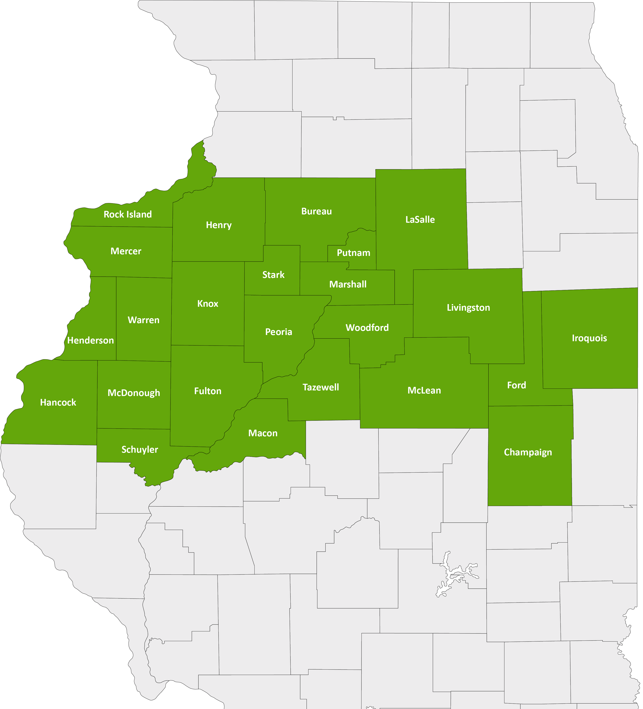
North Central Illinois Perinatal Network
The NCIPN covers 24 counties and 25 hospitals. Our administrative perinatal center (APC) is OSF HealthCare Saint Francis Medical Center in Peoria.
An APC facility provides
Education
Case reviews
Site visits for level of care re-designations
An on-call maternal-fetal medicine physician and neonatologist for consultation, support and supervision of transfers
Representation with IDPH

Slide 11
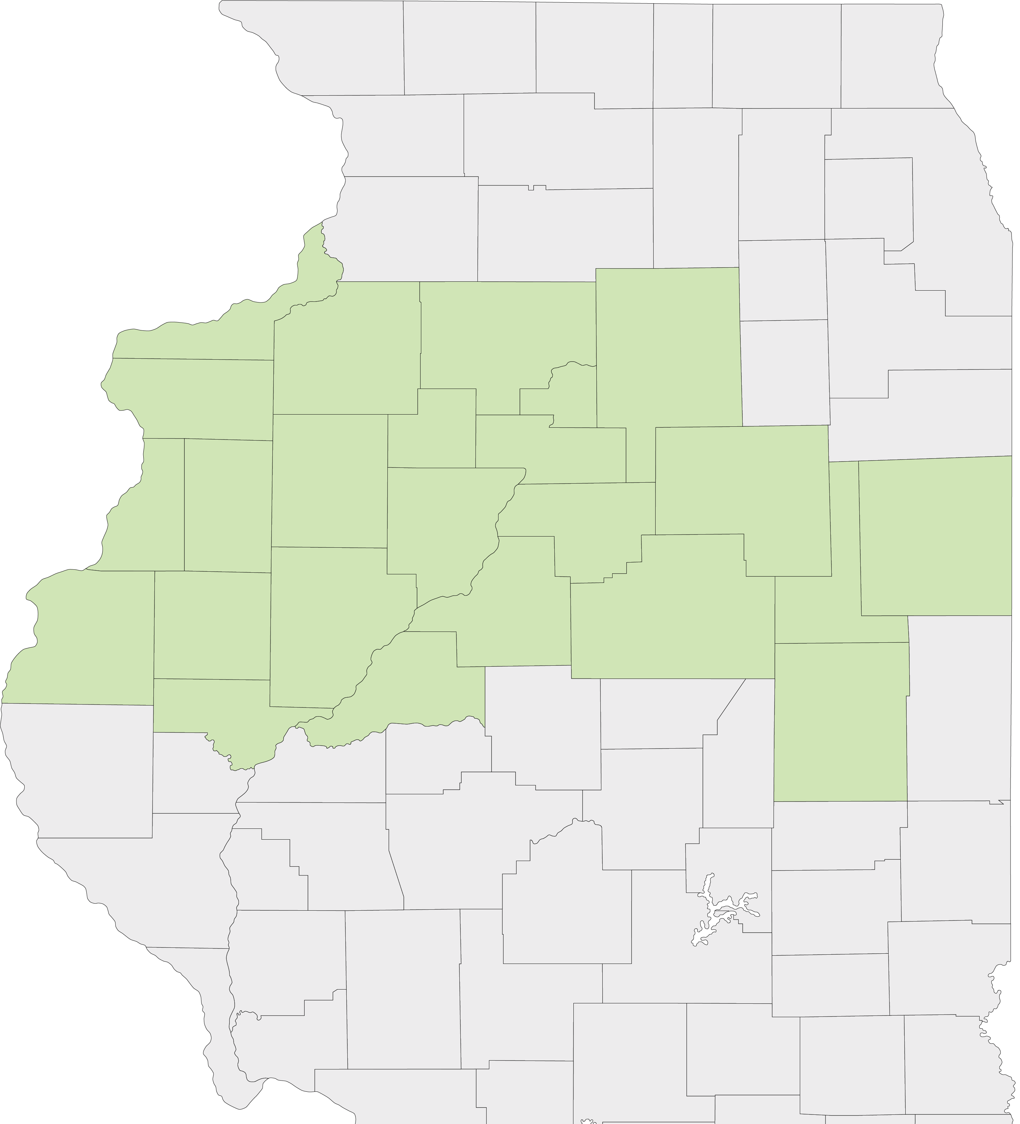
Current State Nursery Levels
LEVEL III – Provides care for patients requiring increasingly complex care and has a NICU.
LEVEL IIE – Has extended neonatal capabilities and provides care to pregnant women and newborns at moderate risk. No NICU or special care nursery.
LEVEL II – Provides care to women with low-risk pregnancies. Operates intermediate care nursery but no NICU or special care nursery.
LEVEL I – Hospitals that provide care to low-risk pregnant women and newborns, operate general care nurseries and do not operate an NICU or Special Care Nursery.
LEVEL 0 – No obstetrics services

Slide 12
North Central Illinois
Perinatal Network Hospitals
Level III
OSF Saint Francis – Peoria
Level II+
Carle Health-Methodist – Peoria
Unity Point Health-Trinity – Moline
Level II
Carle BroMenn – Normal
Genesis – Illini Campus – Silvis
Graham – Canton
OSF Saint Elizabeth – Ottawa
OSF St. Mary – Galesburg
OSF Sacred Heart - Danville
McDonough District Hospital – Macomb
OSF St. Joseph – Bloomington
Level I
None
LEVEL 0 – No maternity services
2
2
4
5
1
1
6
3
7
6
1

Slide 13
North Central Illinois
Perinatal Network Hospitals
Level III
Level IIE
Level II
Level I
Level 0
Level 0 – no maternity
Genesis – Aledo
Hammond Henry – Geneseo
Iroquois – Watseka
OSF Center for Health – Streator
OSF Saint Clare – Princeton
OSF Saint Paul – Mendota
OSF Holy Family – Monmouth
OSF Saint Luke – Kewanee
Carle Health-Pekin – Pekin
Carle Health-Proctor – Peoria
Carle Eureka – Eureka
Hopedale Medical Complex – Hopedale
Memorial Hospital – Carthage
OSF St. James – Pontiac
OSF Heart of Mary - Urbana
2
6
5
8
1
4
7
14
10
3
11
9
13
12
15

Slide 14
2023 Illinois Maternal Mortality and Morbidity Report
Years 2018, 2019, 2020
Published October 2023

Slide 15
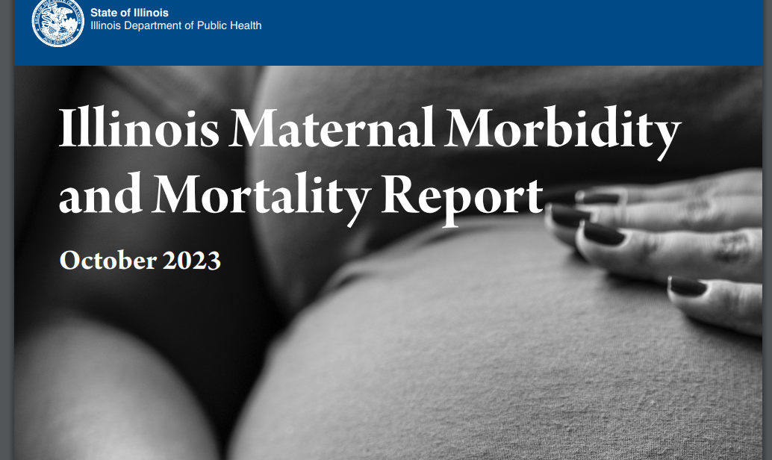
Illinois Maternal Morbidity & Mortality Report ~ 2023
Link:
https://dph.illinois.gov/content/dam/soi/en/web/idph/publications/idph/topics-and-services/life-stages-populations/maternal-child-family-health-services/maternal-health/mmmr/maternal-morbidity-mortality-report2023.pdf

Slide 16

Goal of Report
To describe patterns in:
Maternal morbidity and mortality
Identify opportunities for prevention
Direct recommendations to key partners to prevent the tragedy of maternal mortality

Slide 17
More Data On:
Key Topics:
Mental health
Substance use disorders
Discrimination and racism
Social determinants of health
Community context.

Slide 18

Key Findings:
Chronic Disease During Pregnancy (from 2010 to 2020):
Maternal obesity increased 33%
Maternal hypertension increased 103%
Maternal diabetes increased 68%.

Slide 19
Mental Health Conditions
Substance Use Disorders
Of all live births, 8% had a maternal mental health condition recorded on the delivery hospital record. However, this was above 25% in some counties.
Of all live births, 5% had a maternal substance use disorder recorded on the delivery hospital record. However, this was above 20% in some counties.

Slide 20
Severe Maternal Morbidity
One out of every 115 deliveries had a severe maternal morbidity
Severe bleeding (hemorrhage) is the most common type of severe complication
Black women had a severe maternal morbidity rate more than two times that of White women.

Slide 21
Maternal Mortality
An average of 88 women died while pregnant or within 1 year of pregnancy
1 mother every 4 days died
43% died from a cause related to pregnancy
32% of pregnancy-related deaths due to SUD
> half of pregnancy-related deaths occur > 60 days postpartum
Black women 2x as likely to die from pregnancy-related conditions and 3x as likely to die from pregnancy-related medical conditions as White women
MMRCs determined that 91% of pregnancy-related deaths were potentially preventable

Slide 22

Key Recommendations
Health care providers should know and follow best practices for high-quality maternal health care in the following key areas that are critical for reducing maternal mortality: cardiovascular disease, obesity, mental health conditions, substance use disorder, trauma-informed care, and contraceptive services.
Hospitals and health systems should create protocols and practices to identify and address social determinants of health.
Hospitals and health systems should develop standardized protocols and policies to assure implementation of high-quality delivery of maternal mental health and substance use care.
Community-based organizations should partner with clinical systems to ensure health care providers know about available local social services and case management programs for pregnant and postpartum women.
State agencies should implement plans of safe care for infants exposed to substances during pregnancy, including implementation of a notification and tracking system that is separate from child abuse/neglect reporting systems.

Slide 23
2020 COVID Data & Beyond
2020 COVID Data & Beyond
IDPH acknowledges the need to further study the impact of the pandemic on maternal health outcomes; this will be done in future reports when data is available for 2021 and beyond
Literature Review page 10 of the report

Slide 24
COVID – 19 and Maternal Health
preeclampsia
cesarean section
preterm birth
stillbirth
Related to an increased risk of:

Slide 25
COVID – 19: Changes in Landscape of Healthcare
Nationally, women received fewer prenatal care visits in 2020 than prior to the pandemic
Postpartum visits were reduced
Limit to number of support persons in hospitals
Exacerbation of social determinants of health
Telehealth visits increased

Slide 26
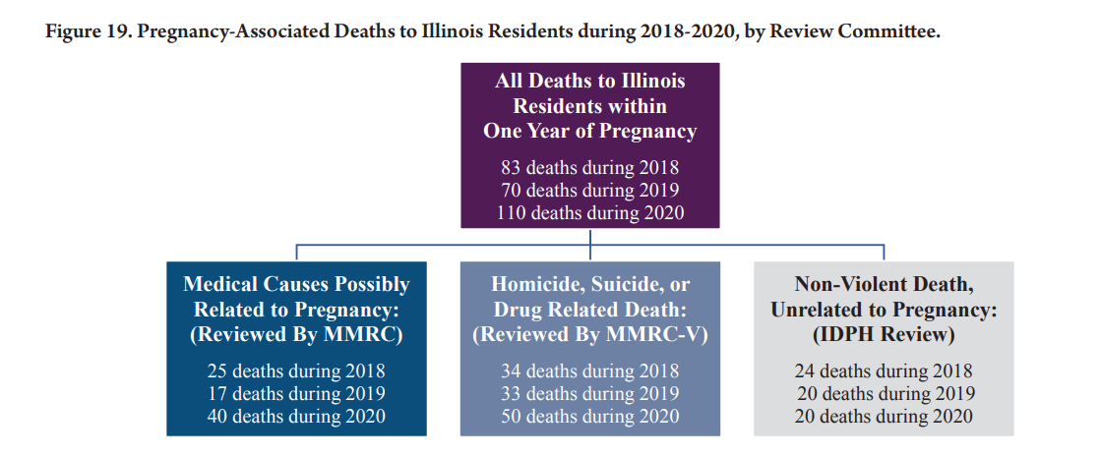
Notes:
Pregnancy-Associated Death = The death of a woman during pregnancy or within one year of the end of pregnancy from any cause.
Pregnancy-Related Death = The death of a woman during pregnancy or within one year of the end of a pregnancy from a pregnancy complication, a chain of events initiated by pregnancy, or the aggravation of an unrelated condition by the physiologic effects of pregnancy.

Slide 27
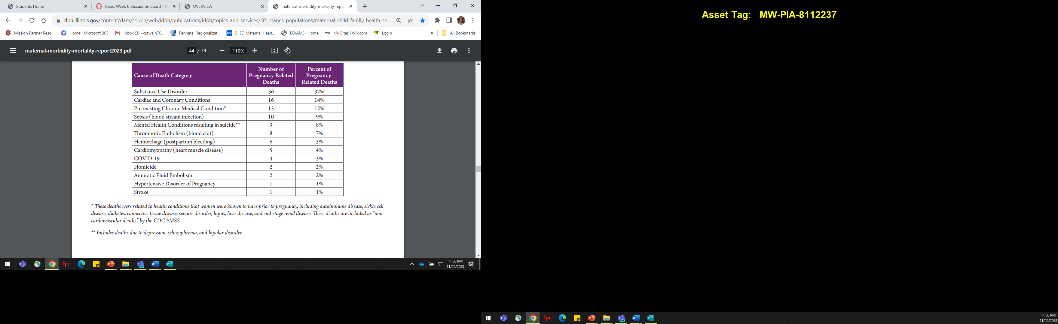
Causes of Pregnancy-Related Deaths:
Pregnancy-Relatedness: The underlying cause of death, which is defined as the event that started the chain of events that led to death.

Slide 28
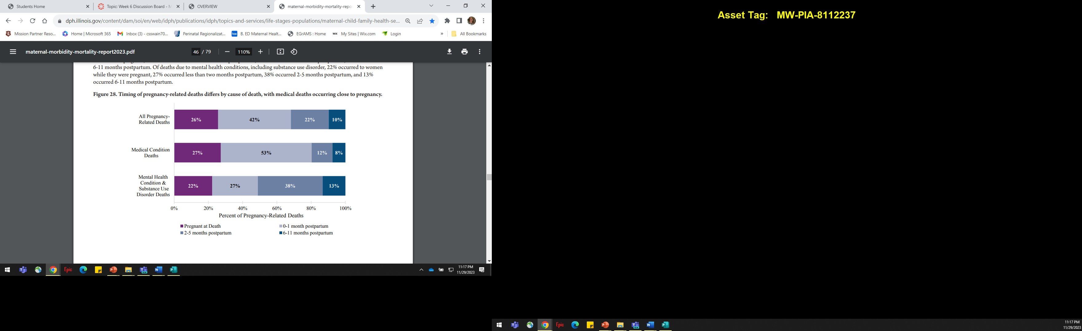
Timing of Pregnancy-Related Deaths

Slide 29
Please Review
Recommendations
Hospitals & Health Systems
Health Care Providers
Health Insurance Plans
State Agencies & Partners
Community-Based Organizations
Resources
Appendix A
Women, Families & Friends
Appendix B
Health Care Providers & Hospitals

Slide 30
IDPH Site Visit Prep

Slide 31

Break
Stretch!!!! Grab a snack!!!!

Slide 32
Telehealth Offering
OSF OnCall
Pregnancy & Postpartum
Support
Kara Roat
Digital Patient Care Manager
OSF OnCall

Slide 33

Workgroups
To join Newborn Workgroup ~ Select Newborn Workgroup Teams Meeting invite
Maternal Workgroup, stay on original invite

Slide 34
SAVE the Date!
RQC ~ 2.29.24
Via Teams
Tentative meeting 5.2.24 or 5.9.24 IN PERSON in Peoria
Waiting room schedules to open

