Slide 1
Gentle Stabilization
Beyond NRP: Delivery Room Care for Preterm Infants

Slide 2
Foundations of Gentle Stabilization
Began at SFMC NICU as part of our “Small Baby Unit” transition
Special area of NICU for 30 week and under infants, focuses on optimizing outcomes for this population.
Areas of focus:
Neurodevelopmental protection is foremost- protecting the preemie’s brain
Positioning, undisturbed sleep, pleasurable experiences versus pain/stress
Gentle respiratory support to minimize lung damage
Avoiding intubation and mechanical ventilation if possible
Encouraging early nutrition and infant’s own mother’s milk as early as possible
Utilizing breastmilk during stressful experiences as well as for feeding
Using donor breastmilk in this population, almost complete elimination of formula
Focus on breastfeeding skills at earlier gestation
Family presence and participation is HUGE
Early skin to skin care, even on first day of life. Goal of minimum 12 hours per week skin to skin
Families are integral part of hands-on care for babies, and their input is valuable to rounds

Slide 3
Foundations of Gentle Stabilization
Many aspects of care that began as “Small Baby” are being generalized into other areas of the NICU
Critically ill term babies, such as congenital heart defects and diaphragmatic hernias
Although “Small Baby Unit” is <30 weeks, many of the principles are now being used in increasing gestations. Most guidelines are being used up to 32 weeks, with a goal of including all NICU babies in the future.
Consultations with our Developmental Care Team (NICU specific PT/OT/Speech) for all admitted infants
The sooner we begin the protective strategies, the better!!
Before, had to await transport team for equipment/NICU staff familiar with techniques
We would love to encourage all nurseries to become familiar with gentle stabilization and incorporate aspects into their care of preterm infants!

Slide 4
Principles of Gentle Stabilization
Minimal Intervention and Patience: Only as much help as the infant truly needs
EXAMPLES: most babies do not need routine oral/nasal bulb suctioning and secretions can be wiped away
Not all preemies need intubation to stabilize respiratory status- often can use Neopuff/ RAM cannula to provide ventilation
Low heart rates generally improve with effective ventilation, not chest compressions.
Oxygen saturations improve gradually over time, do not always need to place infant in high amounts of oxygen to increase them

Slide 5
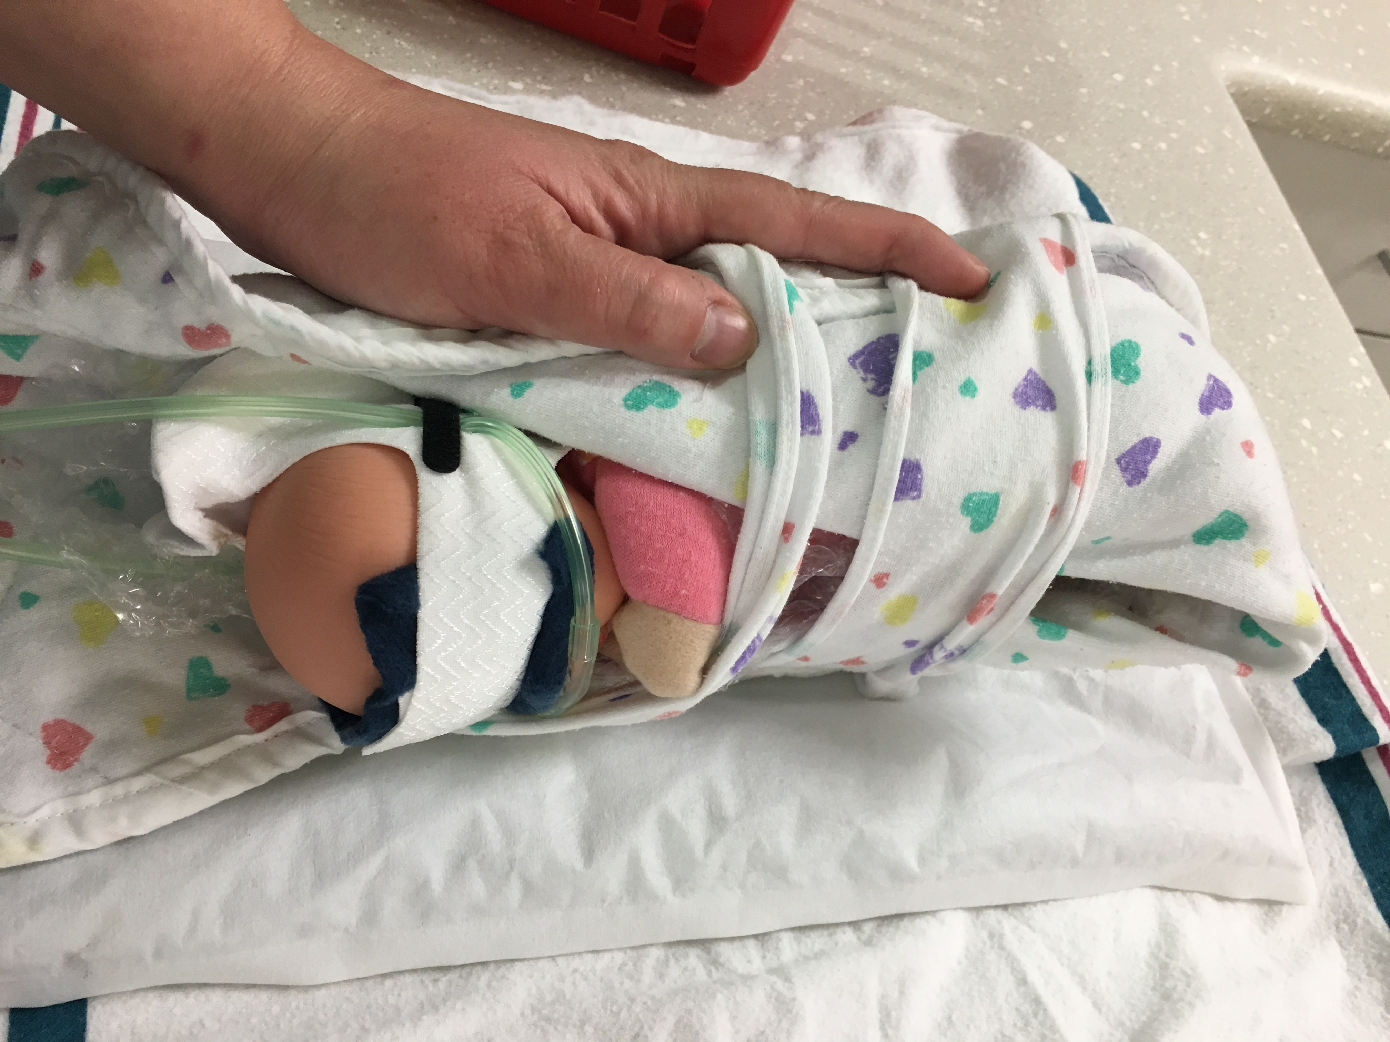
Principles of Gentle Stabilization
Protecting Neurodevelopment: Minimizing stress to the preemie’s brain
Regulation of light and noise as much as possible, covering eyes
Maintaining a flexed position and hands to face. Utilizing a staff member to provide containment.
Maintaining neutral head position (head midline with body)
Placing infant side-lying, rather than supine, helps to minimize stress responses in the micropreemie
Utilizing positioning devices helps maintain these standards and free staff members for other roles

Slide 6
Principles of Gentle Stabilization
Thermoregulation: Avoiding thermal stress for the infant
Using bubble wrap or plastic wrap to prevent evaporative heat loss
Using a chemical mattress to prevent conductive heat loss
Basic principles still apply- remove wet linen, place hat or head covering.
Recommend placing ISC probe in delivery room, can also avoid overheating
Causes tachycardia, tachypnea, higher blood pressures → can result in brain bleeds

Slide 7
Supplies to Gather for Preterm Delivery
Chemical Mattress
Activate close to time of delivery
Consider replacing with a new one close to transport if has been >45-60 min
Bubble Wrap or Plastic Wrap
Place inside of containment device and wrap around infant to prevent heat loss

Slide 8
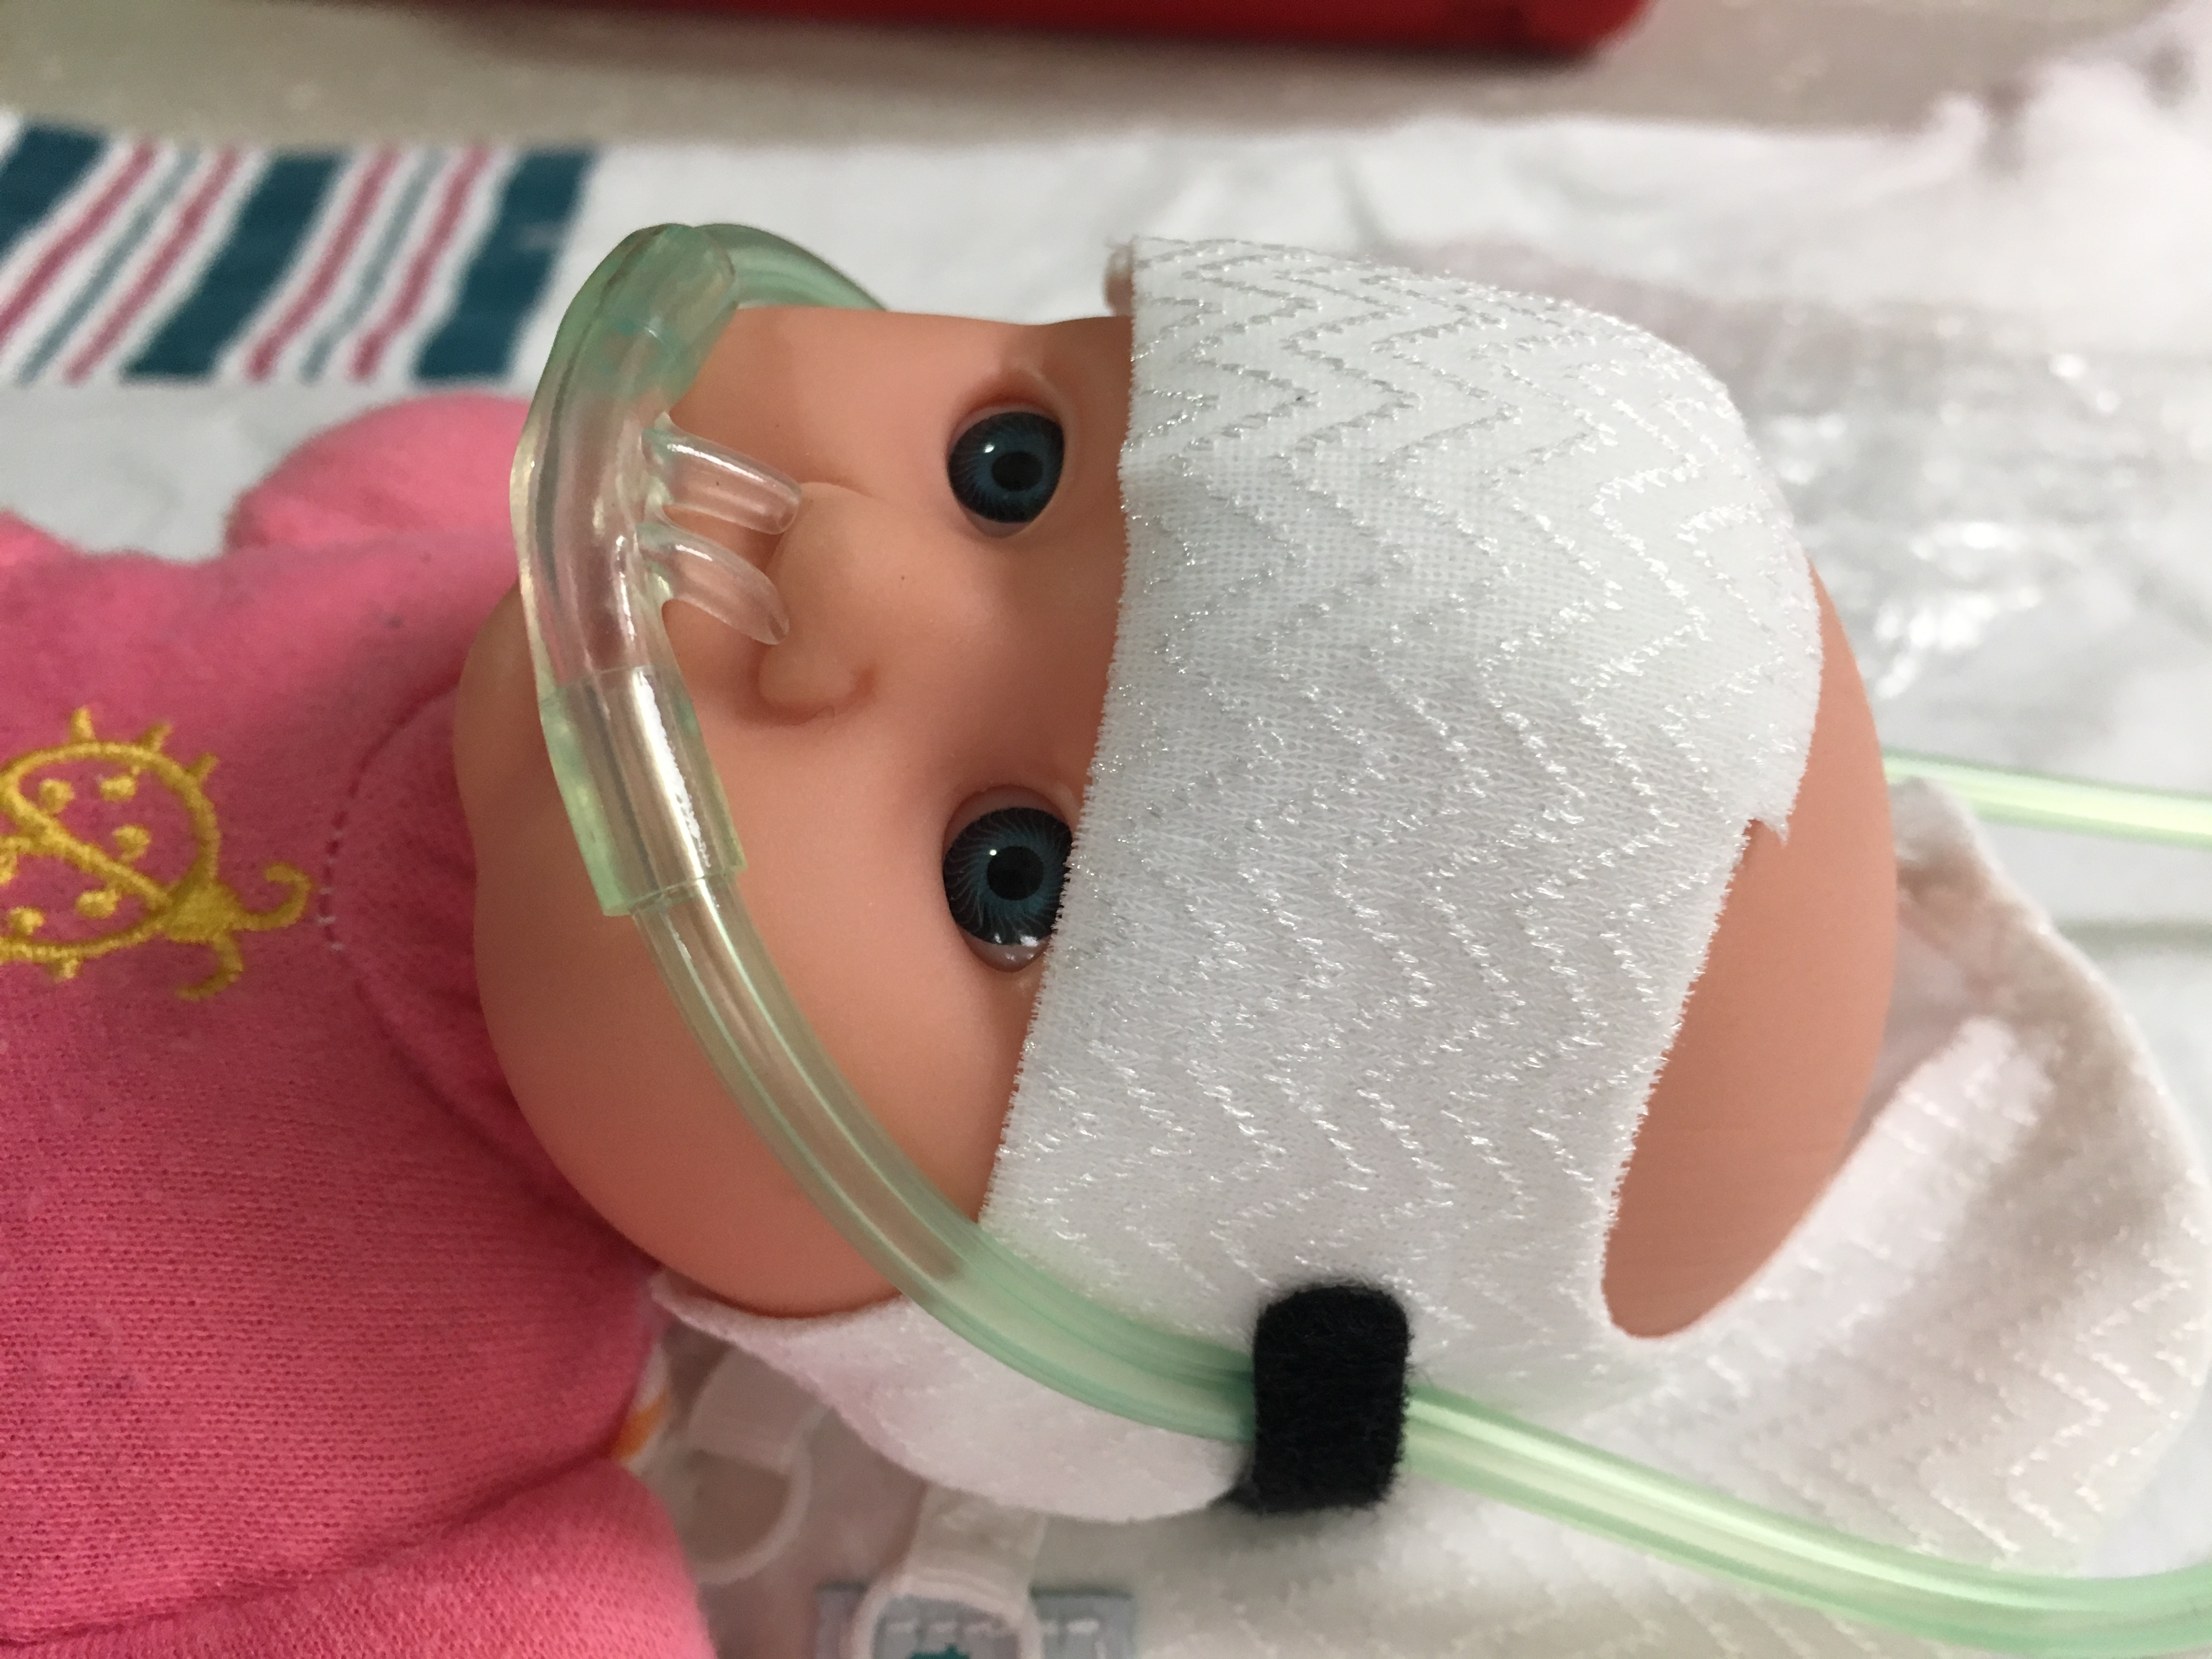
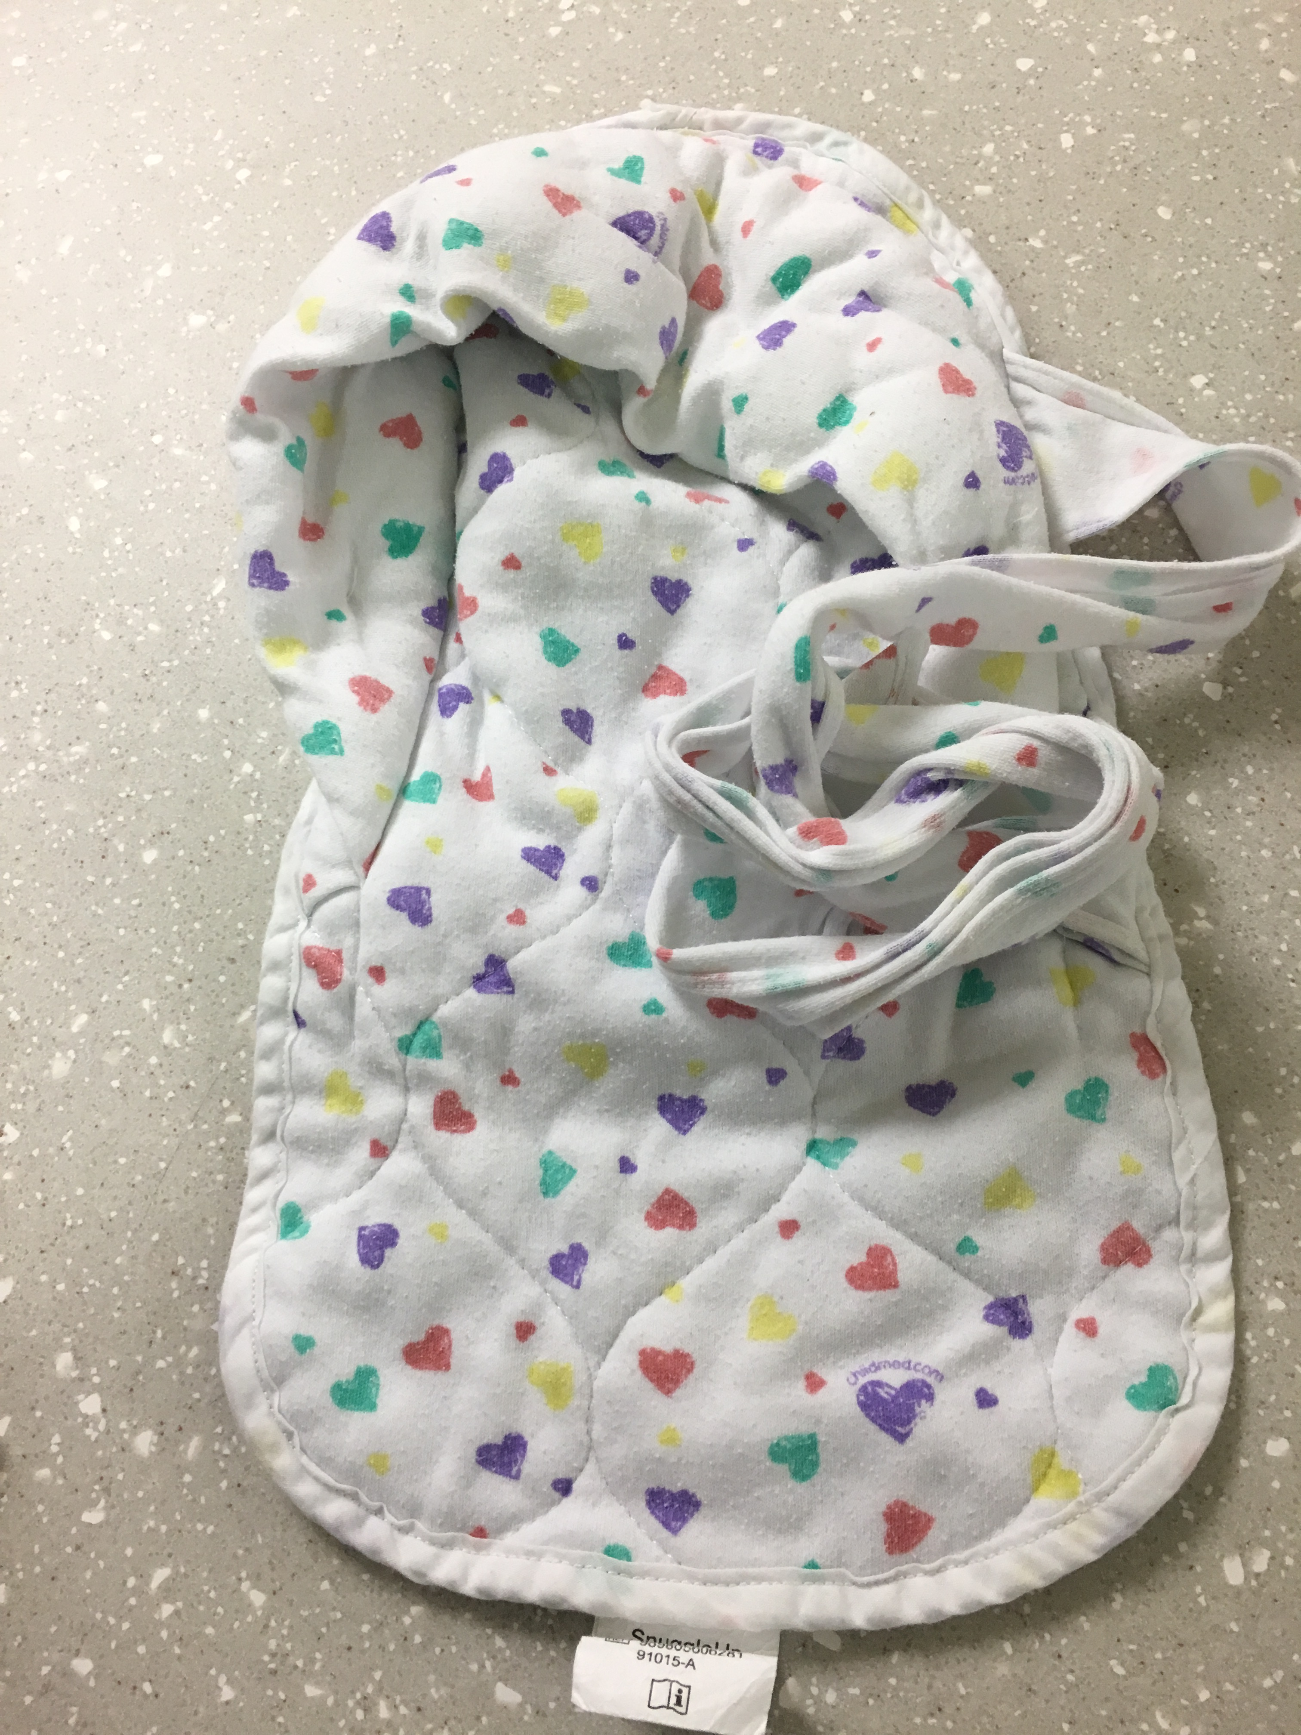
Supplies to Gather for Preterm Delivery
Positioning Devices- Utilize what is available at your facility
Snuggle Up or Blanket Rolls
Keeps infant in a flexed, midline position
Provides infant with containment/boundaries that mimic in-utero environment
Place infant’s hands by face and together, legs flexed and tucked into positioner
This is in addition to hands-on support by a staff member.
Tortle Hat, Bean Bag, Blanket Roll
Prevents infant from being able to turn head out of midline
Reduced risk of brain bleeds

Slide 9
Preparing Equipment for Delivery
We have the developmental supplies ready on the warmer, in addition to the usual resuscitation supplies, such as:
Intubation supplies
Suction
Pulse ox
RAM cannula
Neopuff/mask of appropriate size
And also available, to apply as soon as possible:
“Puppy dog” or limb leads
ISC probe
OG tube

Slide 10
All Developmental Care Pieces Together
This baby is contained and developmentally positioned, shielded from light, has chemical mattress and bubble wrap for thermoregulation
This is “the full package”…
Plus may still be using a hands-on cuddler .

Slide 11
Process of Gentle Stabilization
Assigning roles to team members is vital
Ensures each task in responsibility is covered
Prevents confusion in critical or “high risk, low volume” situations
Assigning team member roles: https://www.youtube.com/watch?v=iFOy06ts8x0&t=1s

Slide 12
Team Members and Responsibilities
Provider: Manage airway and oversee resuscitation
Ensures all equipment is present and functioning prior to birth
Clears secretions by wiping or suctioning
Applies CPAP via mask or RAM cannula
Intubates infant as needed
Works with team to apply developmental devices
Provides direction to other team members and leads decision making
Nurse #1: Assists in resuscitation
Applied pulse oximeter to infant’s right wrist
Auscultates or palpates heart rate
Applies leads and ISC probe as condition allows
Works with team to provide developmental devices

Slide 13
Team Members and Responsibilities
Nurse #2: “The Cuddler”
Provides hands-on containment to infant throughout the resuscitation and care procedures
This may include after the initial delivery room care, such as during line insertion
Respiratory Therapist
Assist provider with intubation supplies, suctioning, etc
Assist with surfactant dosing as needed
Adjust oxygen or Neopuff settings as directed by provider
Other roles: DOCUMENTER if possible, additional RNs to assist with care or assist in beginning transport process (call MedCom, etc)
Micropreemie resuscitations generally have 4-5 staff at SFMC, although we know that is not always possible

Slide 14
The “Cuddler”
As soon as the infant arrives to the warmer for stabilization, one staff member becomes the “cuddler”
Their job is to provide containment and positioning assistance for the infant
Hands to face and midline
Legs flexed
Body midline
Hands on support is vitally important and helps these babies stabilize faster than if they are left without containment

Slide 15
Process of Gentle Stabilization
Delayed Cord Clamping is performed for all preterm and term infants, regardless of route of delivery, if the infant is breathing and moving at delivery.
Concurrent CPAP available and sterile (for use on operative field) for all infants <30 weeks, automatically used for <27 weeks.
Adequate lung inflation helps stabilize heart rate and begin process of improving oxygenation, as well as assist in establishing adequate pulmonary blood flow and increased volume of blood transferred to infant during DCC
DCC without CPAP: https://www.youtube.com/watch?v=LUwNqGQtWcw
DCC with CPAP: https://www.youtube.com/watch?v=fWINoyjXukA

Slide 16
Process of Gentle Stabilization
Stabilization of respiratory status with as little intervention as possible to maintain infant stability
Avoid bulb or deep suctioning if possible
Vagal response → lower HR
Begin with 21% oxygen
Increase oxygen concentration gradually to achieve target saturations
CPAP or PPV to maintain SpO2 or heart rate, as per NRP guidelines
Patience!!
Stabilization of preterm infant with surfactant dosing: https://www.youtube.com/watch?v=cXJKd2RfvaU

Slide 17
Questions?
Simulation!!

