Slide 1
Perinatal Substance Use Disorder
Changing Clinical Approaches in Neonatal Screening and Treatment

Slide 2
Opioid Use IN AMerica
Opioid use in pregnancy has escalated dramatically in recent years, paralleling the epidemic observed in the general population.
In 2012, U.S. health care providers wrote more than 259 million prescriptions for opioids, twice as many as in 1998
Rates of admission to substance use disorder treatment programs for misuse of prescription opioids more than quadrupled between 2002 and 2012
Rates of death associated with opioid analgesics rose nearly 400% between 2000 and 2014
Overdose deaths that involve heroin increased more than 300% in less than 5 years, from just above 3,000 in 2010 to more than 10,500 in 2014
This Photo by Unknown Author is licensed under CC BY-ND

Slide 3
Opioid Use in Pregnancy
In 2007, 22.8% of women who were enrolled in Medicaid programs in 46 states filled an opioid prescription during pregnancy
Antepartum maternal opioid use increased nearly fivefold from 2000 to 2009, based on diagnostic codes
The rising prevalence of opioid use in pregnancy has led to a QUADRUPLED increase in neonatal abstinence syndrome
1.5 cases per 1,000 hospital births in 1999 to 6.0 per 1,000 hospital births in 2013
Associated with $1.5 billion in related annual hospital charges.
States with the highest rates of opioid prescribing also have the highest rates of neonatal abstinence syndrome.

Slide 4
Complications associated with Opioid Use in Pregnancy
Women who use drugs during their pregnancy have higher rates of complications:
Premature rupture of the membranes
Placental abruption
Fetal growth restriction
Stillbirth
National incidence of Neonatal Abstinence Syndrome increases now contributing to 3% of all NICU admissions
Some hospitals, up to 50% of all NICU days are related to NAS
Newborns exposed to drugs in utero have a higher incidence of NICU admission when compared with nonexposed infants, even when corrected for gestational age
Common newborn complications include the following:
Lower birth weights
Prematurity
Seizures
Respiratory complications

Slide 5
Neonatal Abstinence Syndrome
Feeding and Gastrointestinal | Autonomic and Metabolic | Respiratory and Vasomotor | State, Tone, and CNS | Other
Uncoordinated suck | Fever | Tachypnea | Lethargy | Skin excoriation
Weak/poor suck | Temperature Instability | Retractions | Hypotonia | Poor weight gain
Excessive sucking | Mottling | Nasal stuffiness | Hypertonia | Excessive weight gain
Watery/loose stools | Piloerection | Sneezing | Tone regulation difficulty | High pain scores
Vomiting/reflux | Diaphoresis | Yawning | Hyperreflexia
Projectile vomiting | Hypoglycemia | Nasal flaring | Seizure
Hyperphagia |  | Bradycardia | Tremor Jitteriness
Abdominal tenderness |  | Tachycardia | Hyperactivity
 |  |  | High pitched cry
The signs of neonatal abstinence syndrome are many and varied
Mimic other metabolic disorders in the newborn, as well as infection.
Dysfunction in autonomic regulation, state control, and sensory and motor functioning.
Signs can be broadly classified by system

Slide 6
Regional Differences IN Opioid Prescribing and NAS

Slide 7
Regional Differences in NAS- Rural Areas
“Compared with urban peers, rural infants and mothers with opioid-related diagnoses were more likely to be from lower-income families, have public insurance and be transferred to another hospital following delivery.”
Between 2004 and 2013, the percentage of infants with NAS from rural counties increased significantly, going from 12.9% to 21.2%.
The incidence of NAS rose disproportionately in rural regions compared with urban ones.
Rural Areas- Incidence of NAS increased from 1.2 to 7.5 cases per 1000 hospital births
Urban Areas- incidence of NAS increased from 1.4 to 4.8 cases per 1000 Hospital Births
Medscape December 14, 2016

Slide 8
Illinois Perinatal Quality Collaborative Initiative for Mothers and Newborns affected by Opioids (MNO)
STANDARDIZATION IMPROVES OUTCOMES
Studies show care guided by protocol or policy development shortened length of treatment, shortened length of stay, faster weaning from pharmacologic treatment
Hospitals with protocols focused on infant symptoms had shortest length of stay
Separate Obstetrical and Neonatal Teams/Aims
Obstetrical Team Focuses
Universal Screening/SBIRT Implementation
Establishing Protocol/Clinical Checklists
Connecting/Mapping Local Treatment Resources
Educational Resources (Patients, Providers, Staff)
Prevention

Slide 9
Perinatal Substance Use- Screening
Perfect World
Real World
Detecting prenatal drug use would be simple. Every pregnant woman would get tested with an accurate tool and both the mother and baby would receive appropriate therapy.
Drug use would be recognized as a medical issue, and legal entanglements would not flow from positive toxicology results.
Societal resources would be committed to strengthening family bonds and to the well-being of each family member
Approaches to screening vary
Urine toxicology on those “at greatest risk”
Ethically perilous, bias
Universal urine toxicology
Unlawful search and seizure
ACOG specifies explicit consent
Consequences of drug use during pregnancy can go beyond the clinical
May result in child removal, as well as maternal arrest, prosecution and punishment.

Slide 10
Perinatal Substance Use- Universal Screening and SBIRT
Best solution for now…
All women would complete a questionnaire
This would allow their provider to identify and provide services to any women with evidence of substance abuse
Recommended by ACOG, AAP, AMA, CDC
SBIRT
Screening — a healthcare professional assesses a patient for risky substance use behaviors using standardized screening tools. Screening can occur in any healthcare setting
Brief Intervention — a healthcare professional engages a patient showing risky substance use behaviors in a short conversation, providing feedback and advice
Referral to Treatment — a healthcare professional provides a referral to brief therapy or additional treatment to patients who screen in need of additional services

Slide 11
Illinois Perinatal Quality Collaborative Initiative for Mothers and Newborns affected by Opioids (MNO)
Neonatal Focuses
Strengthening Family and Care Team Relationships
Improving Pre-Delivery Planning
Standardizing Identification and Assessment of Substance Exposed Newborns
Family Education
Improving Infant Nutrition and Breastfeeding
Optimizing Non-Pharmacologic Care
Standardized Pharmacologic Care
Coordinating Safe Discharge

Slide 12
Illinois Perinatal Quality Collaborative Initiative for Mothers and Newborns affected by Opioids (MNO)
Strengthen Family and Care Team Relationships
Dispelling myths about addiction
Standardizing language
Reducing bias
Improving Pre-Delivery Planning
Prenatal Consultation for mothers
Maternal treatment recommendations during pregnancy/delivery
Physiology of NAS
Post-birth care expectations
Testing of newborn
Screening protocols
Care and treatment of newborn

Slide 13
Illinois Perinatal Quality Collaborative Initiative for Mothers and Newborns affected by Opioids (MNO)
Standardize Identification and Assessment of Substance Exposed Newborns
Identifying at risk newborns
Evidence based assessment
Finnegan versus Eat, Sleep, Console
Recent research from Yale New Haven Children’s Hospital shows superiority in ESC
Grossman, M. R., MD, Lipshaw, M. J., MD, Osborn, R. R., MD, & Berkwitt, A. K., MD. (2018). A novel approach to assessing infants with neonatal abstinence syndrome. Hospital Pediatrics, 8(1).

Slide 14
Comparing Methods of Assessment
Modified Finnegan Scoring
Eat, Sleep Console Protocol
Likely in place at local institutions
Tool most often used (~95%) in the United States for assessing NAS since its development in mid 1970s
Historical “gold standard,” in research
However, never validated or score cutoffs tested- based on original author’s experience with point at which infants calmed
Basic premise- Infants are scored for a series of 21 clinical signs of withdrawal, every 3-4 hours following a feeding. If the score is consistently 8 or higher, pharmacological intervention may be warranted.
Protocol is spreading nationwide as collaboratives increase
Increasing body of literature is supporting positive outcomes backed by evidence
Basic premise- Infants are physiologically stable if they can eat skillfully, sleep peacefully, and be calmed from crying within 10 minutes.

Slide 15
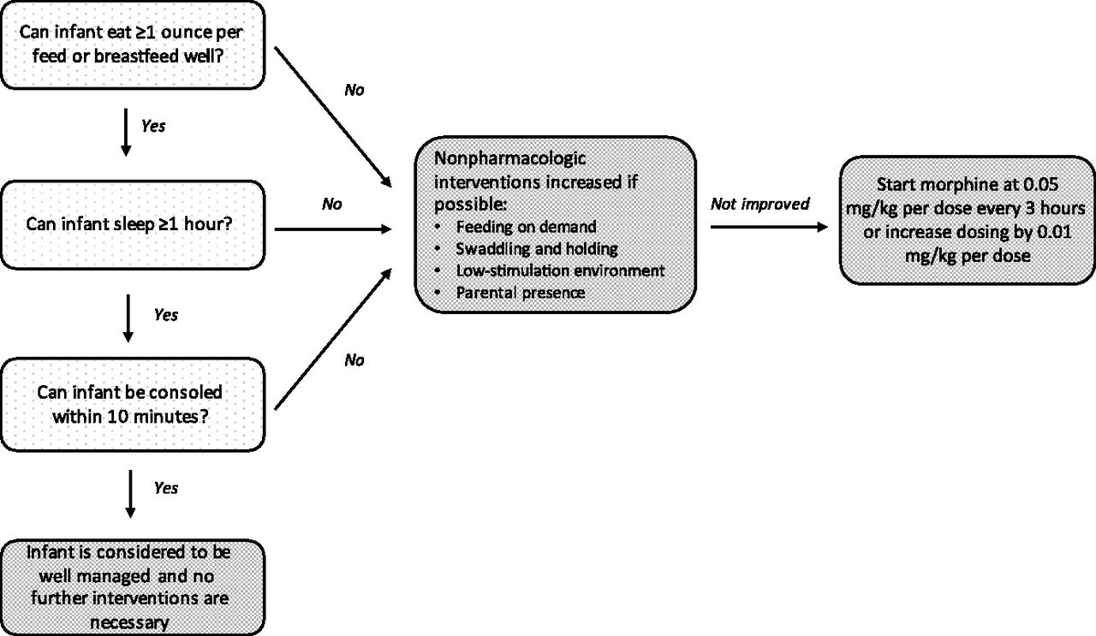
Eat, Sleep, Console Protocol
Simple assessment with concrete terms
Less confusing symptoms, greater interrater reliability
Easy for parents to participate in scoring infant
Family involvement is vital
Use of diary for documentation by parents
Grossman, M. R., MD, Lipshaw, M. J., MD, Osborn, R. R., MD, & Berkwitt, A. K., MD. (2018). A novel approach to assessing infants with neonatal abstinence syndrome. Hospital Pediatrics, 8(1).

Slide 16
ILPQC Infant Bedside Tracking Sheet

Slide 17
Sample Care Diary to Track ESC

Slide 18
Eat Sleep Console Outcomes versus Finnegan ScorINg
Study authors noted:
Vast decrease in number of infants requiring pharmacological treatment (12% vs 62%)
Fewer infants requiring increases in pharmacological treatment (8 times versus 76 times)
Significantly shorted adjusted length of stay
No significant adverse events
No readmissions
Other studies/QI projects have demonstrated “loosening” of Finnegan scoring parameters, with prioritization of feeding success, weight gain, sleep patterns and inconsolability resulted in less pharmacologic need and shorter length of stay

Slide 19
Illinois Perinatal Quality Collaborative Initiative for Mothers and Newborns affected by Opioids (MNO)
Provide Family Education
Developing booklets and pocket cards for easy distribution
Improving Infant Nutrition and Breastfeeding
Emphasis on breastfeeding when safe for infant, as both optimum nutrition and comfort
Encourages hospitals to develop specific protocol with clear, concise guidelines on risk vs benefits of specific situations
Ex. Active abuse at time of delivery versus participant in supervised treatment

Slide 20
Illinois Perinatal Quality Collaborative Initiative for Mothers and Newborns affected by Opioids (MNO)
Optimizing Non-Pharmacological Care
Establishing rooming-in guidelines/physical environment of care
Skin to skin contact
Rocking/swaying/holding
Uninterrupted rest periods
Swaddling/containment
Pacifiers/nursing for comfort
Decreased light and sound
Mother as primary caregiver throughout hospitalization

Slide 21
Illinois Perinatal Quality Collaborative Initiative for Mothers and Newborns affected by Opioids (MNO)
Standardized Approach to Pharmacological Treatment
Protocols decrease length of stay!
Regardless of approach to assessment
Coordinate Safe Discharge
Appropriate observation periods (4-7 days if never medicated, at least 48 hours off medications)
Feeding well, gaining weight
Clearance from Social Services/DCFS
COMMUNICATION with PCP
Developmental follow-up or Early Intervention
For some families, home health visits may be appropriate

Slide 22
Questions??

