Slide 1
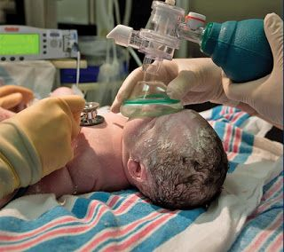
Neonatal Transition and Respiratory Disorders of the Newborn

Slide 2
Newborn Transition

Slide 3
Fetal to Newborn Transition
Transition from “fluid filled fetus” to “air breathing human” requires a series of complex physiological steps.
“The transition from fetus to newborn is the most complex adaptation that occurs in human experience. Lung adaptation requires coordinated clearance of fetal lung fluid, surfactant secretion, and onset of consistent breathing. The cardiovascular response requires striking changes in blood flow, pressures, and pulmonary vasodilation.”
“Abnormalities in adaptation are frequently found following preterm birth or cesarean delivery at term, and many of these infants need delivery room resuscitation to assist in this transition.”
Clinical Perinatology, 2016

Slide 4
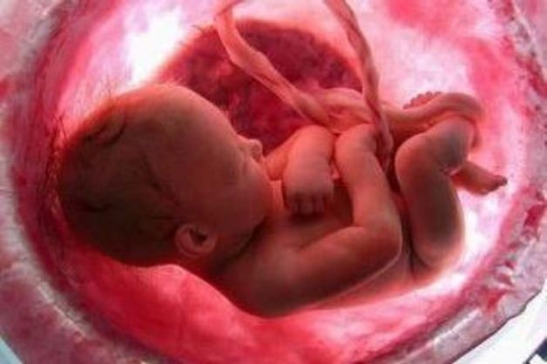
Transition: Major Tasks Prior to Birth
Surfactant Production in Alveoli
Doesn’t typically begin until mid to late 3rd trimester
Surfactant coats the internal walls of the alveoli, which prevents collapse of these sacs during exhalation (atelectasis)
Surfactant is a substance made up of mostly phospholipids and proteins
Reduce the surface tension in the alveoli
Play a role in host defense and controlling the inflammatory process.
Surfactant secretion into the fetal lungs is stimulated by labor!
Alveolar stretch as a result of initiation of ventilation further increases the secretion of surfactant

Slide 5
Transition: Major Tasks Prior to Birth
Reabsorption of Fetal Lung Fluid
During spontaneous labor and immediately after birth, the respiratory epithelium changes from active fluid secretion to active fluid absorption
Related to chloride versus sodium transport
The sodium-mediated active absorption process is believed to be initiated even before labor with regulation by increased cortisol and thyroid hormone levels
During active labor and delivery, fetal lung fluid volumes will decrease leaving only about 35% to be absorbed and cleared from the lungs with breathing
Not “vaginal squeeze”!
Usually done by 2-4 hours of age

Slide 6
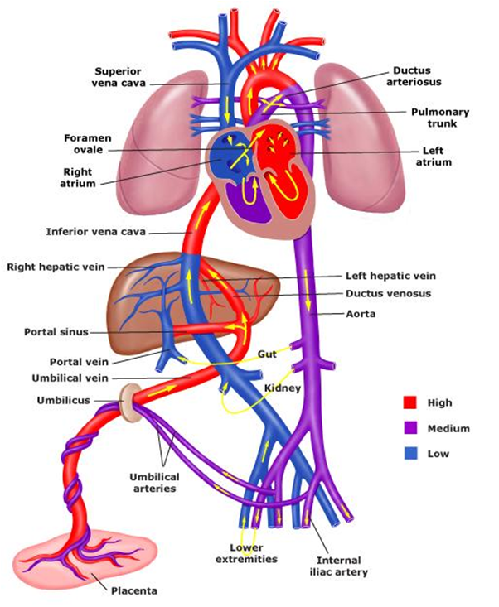
Fetal Circulation
Oxygenated “red” blood from placenta→ umbilical vein → ductus venosus → IVC → RA → most of it flows through the foramen ovale into the left atrium.
Blood then passes into the LV and then to the aorta → perfuses the heart muscle itself, the brain and arms → back to RA through the SVC and goes to the RV.

Slide 7
Fetal Circulation
“Purple blood” is pumped from the RV into the pulmonary artery.
Tiny amount continues on to the lungs (due to increased pulmonary vascular resistance- “high blood pressure” in lungs).
Most of this blood is shunted through the ductus arteriosus to the descending aorta.
This blood then enters the umbilical arteries and flows into the placenta.

Slide 8
What Happens At birth?? First Breath
Pulmonary vascular resistance (“lung blood pressure”) DROPS, those blood vessels relax, resulting in oxygenated blood flowing into the lungs
This is caused by a combination of increased oxygen exposure as well as getting the alveoli open with first breaths.
Surfactant secretion is triggered by alveolar expansion
As lungs open, surfactant rushes in!
Normal newborns inflate their lungs at birth by generating large negative pressure breaths, which pull the lung fluid from the airways into the distal airspaces
Maintain functional residual capacity, the “leftover air” following exhalation, to prevent alveolar collapse
Like “PEEP”

Slide 9
What Happens At birth?? Clamped UmbilicaL COrd
The low-resistance vascular bed of the placenta is disconnected from the newborn’s circulation.
Results in HIGHER systemic vascular resistance (“body blood pressure”) in order to perfuse vital organs.
The pressure within the left atrium increases due to increased systemic vascular resistance + more blood coming back from lungs.
With the left atrial pressure being greater than the right atrial pressure, the flap across the foramen ovale closes.

Slide 10
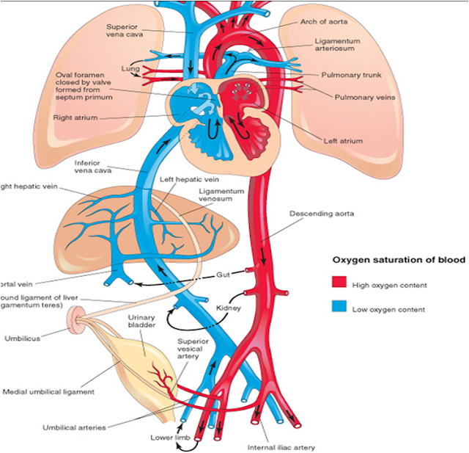
Circulation After Birth
Most term infants have a reversal of flow across the ductus arteriosus with left-to-right flow occurring within 10 minutes after birth, resulting in greater pulmonary blood flow.
Increased pulmonary blood flow/ less flow across DA + oxygenation → closure of ductus arteriosus
Full closure of ductus arteriosus varies, usually 24-48 hours
Mode of delivery (longer for c-section)
Sex (longer for females)
Circulation is then similar in physiology to adult

Slide 11
Oxygen saturations At birth
Fetus is normally “hypoxemic” compared to newborn
Saturations would vary from 30s-50s-70s depending on where in circulation measured
BEST oxygen saturations would be from right upper extremity- preductal
Expectation is GRADUAL rise to “normal” over first 10 minutes of life
WHY is this OK??
Fetal hemoglobin!
“Holds on to” oxygen differently than adult hemoglobin
Takes about 6 weeks for infant to replace all fetal hemoglobin with adult hemoglobin

Slide 12
What if Something Goes Wrong?? Signs of Newborn Respiratory Distress
Tachypnea
Normal 40-60 breaths/min, rates may be higher (>60) in the first hour after birth
Retractions- result of abnormal accessory muscle use to ventilate
The neonatal chest is very compliant so substernal, subcostal, and even intercostal retractions may be noted in infants with only minor respiratory distress.
Increasing intensity of retractions indicates worsening respiratory distress.
Grunting – attempt to increase functional residual capacity and stabilize alveoli by partially closing the glottis
Nasal flaring- attempt to widen airways
Cyanosis – best observed in oral mucosa, acrocyanosis can persist for 24-48 hours
https://www.youtube.com/watch?v=6xQ5VmLfAMg

Slide 13
What If Something Goes Wrong??
NRP and the AAP tell us approximately 10% of newborns need assistance at birth/resuscitation
~1% will require extensive measures (intubation, cardiac compressions, medications)
The 90%: “I’m fine, you guys!!”
Evaluation of infant at birth- crying and breathing? Good tone? Term-ish?
While skin to skin with mother, dry and stimulate infant, clear secretions IF NEEDED
Continued evaluation throughout first minutes/hours of life

Slide 14
What If Something Goes Wrong??
The 9%: “Can I get a little help over here??”
If apnea, ineffective respirations or heart rate <100 bpm
Position and clear airway if needed
Begin positive pressure ventilation at 40-60 breaths per minute
“BREATHE-2-3”
Place pulse oximeter
BEST INDICATOR of effective ventilation is rising heart rate
If not improving in 15 seconds, consider corrective actions
MR. SOPA

Slide 15
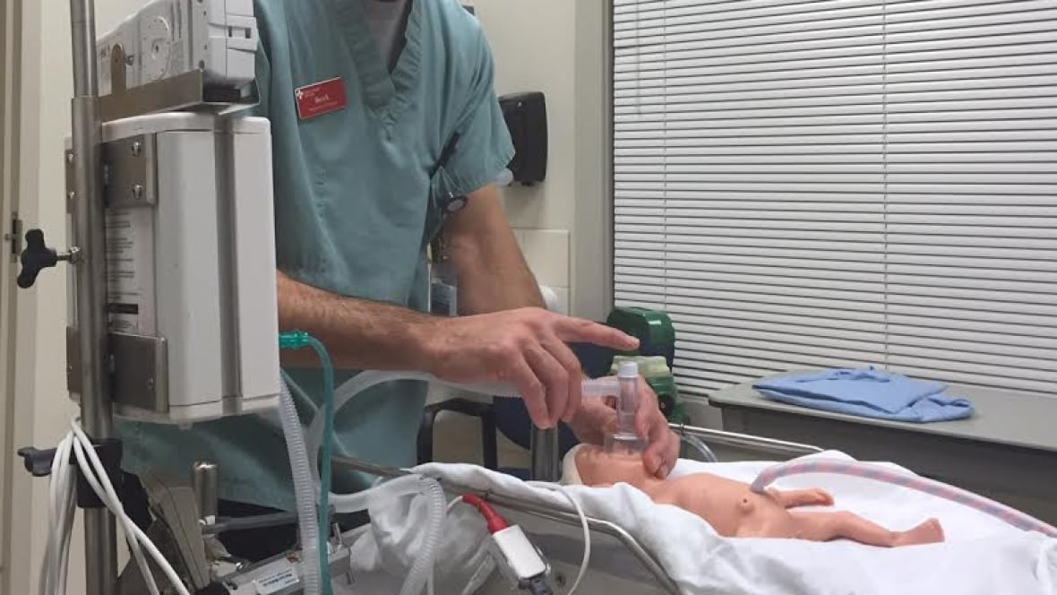
Helpful Hints for Positive pressure Ventilation
Can always begin with 21% FiO2- place pulse oximeter to guide adding oxygen if necessary.
Inflating the alveoli is super important- look for chest rise as an indicator that you are inflating them!
Think of MR. SOPA in pairs, and give each pair time to work (~8 breaths)
Mask/reposition head
Suction mouth/nares and open mouth
Increase pressure- NOT THE ONE IN YOUR HAND!
If none of those work, consider intubation…
Don’t be afraid to give a “long” breath!
I-time is very important when starting with closed alveoli!

Slide 16
What If Something Goes Wrong??
The 9%: “Can I get a little help over here??”
If labored breathing/grunting/retractions:
Position and clear airway
Place pulse oximeter
Consider CPAP with mask or RAM cannula
Begin with 21% oxygen, adjust as needed
Just getting the alveoli open can often improve saturations!
Common in preterm, c-section deliveries, IDMs, difficult birth

Slide 17
What If Something Goes Wrong??
The 9%: “Can I get a little help over here??”
If persistently cyanotic/ low saturations for age:
Position and clear airway
Place pulse oximeter
Don’t just rely on eyes- very hard to judge exact numbers on sight!
Give free-flow oxygen via mask
ONLY TIME you have to start with MORE than 21%- but DOESN’T have to be 100%
“Start low, go slow”: 30-35% to begin, give time to work
Gradually increase if SpO2 doesn’t fall within range- don’t have to aim for 90s.
Consider CPAP if free-flow doesn’t improve sats, sometimes just need the inflation!

Slide 18
What If Something Goes Wrong??
The 1%: “Houston, we have a problem…”
Heart rate not improving or breathing beginning with effective PPV- meaning all MR.SOPA steps have been tried and/or good chest rise is noted
Consider intubation if qualified provider available
Remember to limit attempts to ~20 seconds, provide PPV in between
Some settings utilizing LMAs as airway option
ETT sizes
Depth of insertion

Slide 19
What If Something Goes Wrong??
The 1%: “Houston, we have a problem…”
RARE to get here
Usually only if fetal conditions were incredibly poor
Heart rate <60 AFTER effective ventilation, preferably through ETT
Compressions coordinating with PPV, rate of 90 bpm to 30 breaths
“1 and 2 and 3 and breathe”
Intubate if not done
Provide 100% FiO2
Heart rate remains <60 despite compressions
Epinephine- IV preferred (0.1-0.3ml/kg), ETT possible (0.5-1ml/kg)
“Do no math in a code!”

Slide 20
Characteristics of A Resuscitation
Always be prepared!!
Supplies readily available at every delivery
Team member JUST for baby
Know process for obtaining additional assistance
Know risk factors
Fetal intolerance of labor, gestation, route of delivery and why, maternal complications, amniotic fluid
Teamwork
Define roles prior to birth, if possible
Stay as calm as possible- you know what to do!
DEBRIEF!!

Slide 21
Newborn Respiratory Disorders
Common Conditions in the Nursery

Slide 22
This Baby is in distress… Now What?!?!?
Two components of respiratory support to think about… FLOW/PRESSURE and OXYGEN.
FLOW or PRESSURE: This is how hard we are delivering air to the alveoli to hold them open.
If on CPAP, this is your PEEP
If on a nasal cannula (of any sort), this is your LITER FLOW
For MOST NEWBORNS, this is where the most help comes from!
Eases work of breathing, slows tachypnea, improved oxygen requirements
OXYGEN CONCENTRATION: This is the percentage of oxygen we are giving in the air pressure we are using to hold the alveoli open
Controlled by your blender, can be anywhere from room air (21%) to 100%.
This improves desaturations but WILL NOT change your work of breathing.

Slide 23
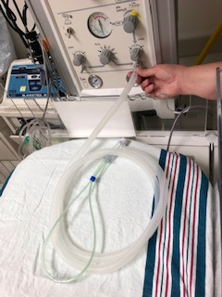
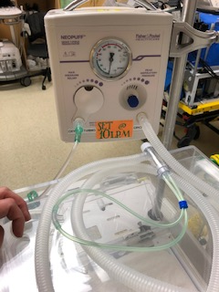
Respiratory Support Options In Most Nurseries
CPAP via RAM cannula- using the Neopuff
Short term support (<6 hours)- IL statute for Level 2 nurseries

Slide 24
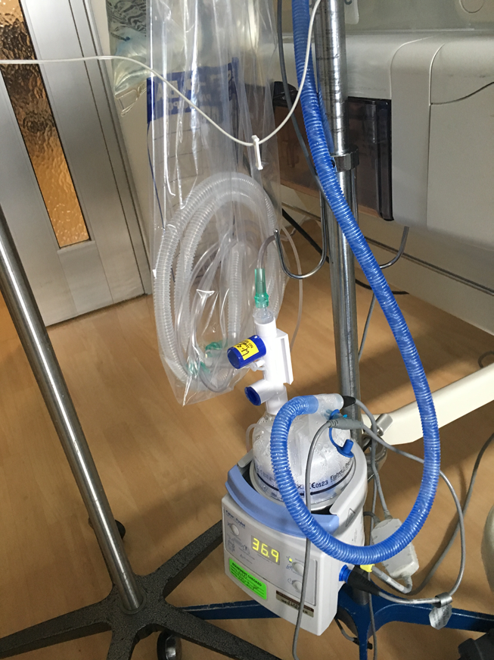
Respiratory Support Options in Most Nurseries
Heated High Flow Nasal Cannula vs.“Low Flow” Nasal Cannula- difference isn’t flow!
It’s heat and humidity.
Can keep up to 2LPM, depending on comfort level of staff and providers
Should always be attached to a blender, to control oxygen percentage

Slide 25
Respiratory Distress Syndrome (RDS)
Affects approximately 2% of neonates
Premature and low birth weight infants are at the highest risk, affects 15-30% of 32-36 weekers, increased with lower gestational age
Infants of diabetic mothers
No antenatal steroids
Male sex
No labor prior to delivery
Pathophysiology
Impaired or delayed surfactant synthesis and secretion
Prematurity #1 cause
Dynamic process that depends on multiple factors
Surfactant may also be inactivated by sepsis, aspiration, or pneumonia
In uncomplicated case, peak severity of symptoms occurs at 2-3 days with recovery beginning by 72 hours
Complicated course may go on for days, weeks or months and will eventually be considered CLD/BPD.

Slide 26
RespiratorY Distress Syndrome (RDS)
Clinical presentation
Develop rapid labored breathing shortly after birth (usually within 6 hours)
BUT WE CAN CHANGE THIS!
Grunting, retractions, nasal flaring, cyanosis and increased oxygen requirement
Progressive worsening of symptoms
Diagnostic chest x-ray – ground glass, homogenous (looks same throughout), air bronchograms (can see airways)

Slide 27
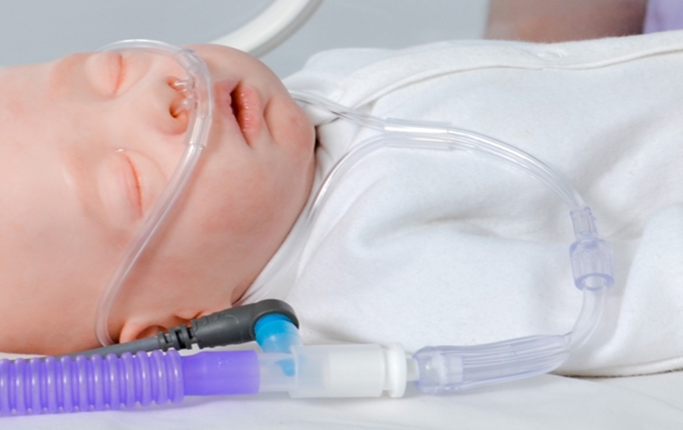
Treatment of RDS
Prompt treatment will decrease complications associated with RDS
Supplemental oxygen- maintain SpO2 88-93% in preterm infants
Infants with RDS need positive pressure to assist in keeping alveoli open
CPAP or PPV via Neopuff at delivery, can use RAM cannula
May transition to Heated High Flow Nasal Cannula
Provides “CPAP effect” with warm, humidified air or oxygen
In earlier gestations, may require ventilator support
.

Slide 28
Treatment of RDS Surfactant Therapy
Considered when oxygen requirement is >30% with clinical symptoms/ CXR findings
Requires temporary intubation. Will use Neopuff to provide ventilation throughout procedure
Very tiny catheter is placed down ETT once intubated
Room temperature surfactant is given in two halves
Infant can be rolled from side to side to assure each lung receives equal amount
Typically helps almost immediately, can rapidly wean oxygen
Improves pulmonary compliance
Can need to lower pressures being used on Neopuff
Infants often remain somewhat tachypneic, some retractions still noted
Oxygen requirement is primary indicator of success

Slide 29
Transient Tachypnea of the Newborn (TTN)
Temporary condition that results from pulmonary edema secondary to inadequate or delayed clearance of fetal lung fluid
Symptoms typically resolve completely by 48-72 hours
Can be difficult to distinguish from other causes of respiratory distress
Risk factors include premature or elective cesarean delivery without labor, large birth weight, IDM, twin pregnancy, male
Prevention of TTN – delaying elective c-section until 39-40 weeks or until the onset of spontaneous labor, avoiding elective inductions.

Slide 30
Transient Tachypnea of the NeWborn (TTN)
Clinical presentation
Symptoms of respiratory distress very early after birth, with tachypnea being the most consistent finding
May also have increased work of breathing, grunting, nasal flaring and retractions, oxygen requirement usually less than 40%
Rapid continuous improvement
CXR – perihilar streaking, fluid in the “fissure”, minor pleural effusions
Treatment
If resolved in <6 hours and no oxygen requirement, OBSERVE
Supportive- High flow nasal cannula or hood (in some nurseries), prone positioning
Antibiotics – 36 hour rule out

Slide 31
Congenital Pneumonia
Postnatal pneumonia typically presents in the first 24 hours of life
Maternal fever/chorioamnionitis and prolonged ROM are major risk factors
If the fetus aspirates infected fluid prior to delivery, organisms that reach the distal airways or alveoli may need to cross only 2 cell layers to enter the bloodstream. Typically present at birth and symptoms are more pulmonary than systemic.
May also be acquired by the aspiration of bacteria colonizing the birth canal
Most common bacterial organism is Group B strep
CXR usually without a focal finding or specific consolidation, often very similar to RDS films

Slide 32
Congenital Pneumonia
Clinical presentation may not be specific
There should always be a high index of suspicion
Respiratory distress with tachypnea and retractions
Temperature instability, lethargy, apnea, tachycardia, metabolic acidosis, abdominal distention, poor feeding and neurologic depression
Treatment
Supportive respiratory management- whatever the baby needs to oxygenate and ventilate- room air to ECMO
Ampicillin and Gentamicin or cephalosporin (better lung penetration), treatment course varies but typically 5-7 days

Slide 33
Pneumothorax
A pneumothorax is the presence of air in the cavity between the lungs and the chest wall, causing collapse of the lung.
Symptoms:
Respiratory distress (grunting, retractions, tachypnea)
Oxygen requirement/desaturations
Positive transillumination (chest lights up when flashlight/transilluminator applied) or visible on CXR
Diminished lung sounds on affected side
Tension- causing a shift of the heart/central blood vessels away from the pneumothorax
Causes hemodynamic instability (hypotension, bradycardia) in addition to respiratory distress
Muffled/shifted heart sounds
Risk factors: RDS, meconium aspiration, required PPV or respiratory support, male sex, first day of life (higher risk of spontaneous pneumo on 1st day of life than any other time in life!)

Slide 34
Images of Pneumothoraces
Large pneumothorax on right
can clearly see lung edge away from chest wall, and dark air collection between lung and chest
More subtle right pneumothorax along lower border

Slide 35
Pneumothorax Treatment
Small, stable pneumothorax
Can observe infant for need for further treatment
Monitor for continued respiratory distress, worsening oxygen requirement
Helps to keep infant calm→ crying can worsen tear in lung, causing larger pneumo
Many pneumos do not end up needing treatment
Must have a plan in place for immediate intervention if pneumothorax worsens

Slide 36
Pneumothorax Treatment
Can perform needle aspiration
Site prepped with chloraprep, infant given fentanyl or morphine for sedation if time/condition permits
20-22g angiocatheter is inserted to 4th intercostal space, mid axillary line
Needle is withdrawn and catheter is attached to a stopcock and large (10-30ml) syringe
Air is withdrawn and amount documented
Follow-up CXR performed to assess resolution of pneumothorax
Used for small pneumothorax not likely to reoccur, or as an emergent, lifesaving technique if time does not permit chest tube insertion
Some providers will just place chest tube emergently rather than do two separate procedures

Slide 37
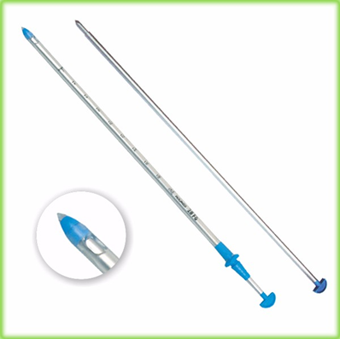
Pneumothorax Treatment Chest Tube Placement
Chest Tube Placement: Considered if
Pneumothorax is large or worsening
Baby is significantly symptomatic
To stabilize infant for transport/prevent reoccurrence on transfer
Fuhrman advantages over trocar chest tube
No cutting or suturing
More flexible -> improved comfort
Smaller size
Less scarring, improved comfort
Fuhrman
Trocar

Slide 38
Persistent Pulmonary Hypertension of the Newborn (PPHN)
Approximately 1/500 infants
Previously known as PFC (persistent fetal circulation)
Failure of completion of the normal transition of fetus to newborn
Delayed closure of fetal shunts
Continued fetal physiology with high pulmonary vascular resistance and low systemic vascular resistance
Can’t get blood into lungs to oxygenate

Slide 39
Persistent Pulmonary Hypertension of the Newborn(PPHN)
Commonly occurs in term and near-term infants
Emerging evidence of increased occurrence in premature infants
Accompanies other lung pathologies or conditions
Congenital diaphragmatic hernia
Meconium aspiration syndrome
RDS
TTN
Pneumonia
Asphyxia/acidosis
Congenital cardiac defects

Slide 40
Persistent Pulmonary Hypertension of the Newborn (PPHN)
Symptoms/Signs:
Hypoxemia, especially with differential in SpO2 between right hand and foot
Accompanying cyanosis
Respiratory distress signs (grunting/retractions/nasal flaring/tachypnea)
Particularly clear CXR
Hypotension
Diagnosis
ECHO is gold standard for diagnosis

Slide 41
Treatment of PPHN
Oxygen: a potent pulmonary vasodilator- target SpO2 95% or greater
Sedation: Calm infant allows PVR to fall more efficiently, crying can halt or reverse progress
Respiratory Support: May be as non-invasive as HFNC, but often require ventilation
Not unusual to require escalation to high-frequency ventilation or even ECMO
Inhaled Nitric Oxide: Achieves potent and selective pulmonary vasodilation without decreasing systemic vascular tone
iNO reduces V/Q mismatch by entering only ventilated alveoli and redirecting pulmonary blood by dilating adjacent pulmonary arterioles
Other pharmacologic management: Sildenafil, inotropic agents to support systemic blood pressure

Slide 42
Meconium Aspiration Syndrome (MAS)
Fetus may pass meconium prior to birth, in response to temporary episode of hypoxemia/acidosis in utero → decreased sphincter tone
More common in late term (40-42 week) or post-term (>42 week) gestations, or accompanying intrauterine growth restriction
Placental insufficiency which predisposes infant to hypoxemia or acidosis
Meconium stained amniotic fluid occurs in ~15% of deliveries
Only about 10% of THOSE acquire MAS

Slide 43
Meconium Aspiration Syndrome (MAS)
Once meconium is present in the amniotic fluid, it can potentially be aspirated into the lungs prior to birth, during delivery, or immediately following birth
NRP NO LONGER RECOMMENDS any variation in the treatment of meconium-stained infants versus those with clear amniotic fluid
Proceed with normal steps of resuscitation if infant is not vigorous and crying
Thick, sticky meconium causes a chemical pneumonitis
Sterile, so not bacterial pneumonia, but does decrease lung’s own immune defenses
Debate on role of antibiotics in MAS

Slide 44
Meconium Aspiration Syndrome (MAS)
Patchy, heterogeneous CXR
Mixed areas of atelectasis and hyperinflation due to meconium blocking airways or trapping air in alveoli
Symptoms
History of meconium staining at birth
Respiratory distress symptoms
Often has symptoms of PPHN

Slide 45
Treatment of Meconium Aspiration Syndrome (MAS)
Supportive respiratory care
Often have difficulty with ventilation and oxygenation due to varying lung pathology
Frequently may require ventilation/ high frequency ventilation, occasionally ECMO
Sedation and permissive oxygenation
Due to higher risk of PPHN
Antibiotics… some treat for 5-7 days
Surfactant dosing
Due to inactivation of natural surfactant

Slide 46
Questions??

