Slide 1
Late Preterm and Level II Care
AKA… WHAT Do You Want ME to Do With This Kid?

Slide 2
Late Preterm Infants
Generally means born 34-36 6/7 weeks
Prone to issues not commonly seen in term infants, even when “well”
Apnea and bradycardia
Difficulty with thermoregulation
Feeding dyscoordination requiring OG/NG feedings or IV support
Hypoglycemia
Hyperbilirubinemia
Often end up with a 1-3 week stay in Level 2 nurseries to achieve stability with temperature and practice with feedings
These are those “feeder/growers” we are talking about!

Slide 3
Apnea
Apnea, by definition, is a pause in breathing lasting 20 seconds or more.
In preterm infants, it is related to an immature respiratory center in the brain. This causes a disturbance of respiratory control during REM sleep.
Loss of upper airway tone, pharyngeal collapse, airway obstruction
This causes periodic breathing (breathe, pause, breathe, pause). If the pauses last 20 seconds, it is apnea of prematurity.

Slide 4
Apnea of Prematurity
Apnea of prematurity is most common in infants <30 weeks, but can be seen even in late preterm infants
Infants may exhibit:
Cyanosis, especially around lips/oral mucosa
Bradycardia (HR <80bpm)
Oxygen desaturation
Reflex tachypnea (fast breathing after the apnea resolves)
Apnea or bradycardia can sometimes worsen during tube feedings, as infants may have less respiratory reserve as their stomach fills, or as gastroesophageal reflux occurs

Slide 5
Bradycardia in the Newborn
Is defined as a heart rate <80 bpm
Often is a result of apnea event or periodic breathing in a preterm infant- hypoxia causes bradycardia
Can result from gastroesophageal reflux, regurgitation or uncoordinated feeding pattern in an infant learning to bottle feed- vagal stimulation
Occasional infant who just has “low resting heart rate”- runs 100-110s even when awake, drifts below 80 when calm or sleeping
Hypothermic newborns will also become bradycardic
Rare causes include congenital heart block, tension pneumothorax, neurological abnormalities

Slide 6
When the Alarm Sounds
Visually assess infant and cardiorespiratory monitor
Cyanosis? Pallor?
Respiratory pattern- shallow breaths? No breaths? Periodic breathing?
Activity level
What is occurring- feeding? Sleeping? Held?
Loose leads? Pulse oximeter correlating?
Give infant a chance to self-correct
Brief amount of time, may have “fixed it” by the time you arrive at bedside
Still needs documentation

Slide 7
When the Alarm Sounds
Intervene to stimulate breathing
Gentle stimulation- pat back, rub soles of feet
Moderate stimulation- repositioning, more firm touch to rub back
Vigorous stimulation- very firm touch to encourage respirations
Administer supplemental oxygen if needed
Blow-by if in room air
Turn up the percentage of oxygen if already on HFNC
If it isn’t working…
Take your own deep breath!
Provide bag/mask respirations for infant until breathing begins
Call for assistance

Slide 8
Treatment of Apnea of Prematurity
Clear documentation of spells, to see association with sleep/feeds, etc
Document on the Apnea/Bradycardia flowsheet
Caffeine citrate
Can be given IV or PO
20mg/kg loading dose (once)
10mg/kg/day given each morning, adjusted to the infant’s weight as they grow
High flow nasal cannula
Compensates for the lack of upper airway tone

Slide 9
Thermoregulation Practices for Preemies
Preterm infants often need assistance with thermoregulation
Why Keep in Isolette?
Energy expenditure when learning feedings= weight loss, poor feeding
Hypoglycemia
Apnea/bradycardia/desats
Once infant can PO feed successfully and begin to gain weight, will EASILY wean to open crib!

Slide 10
Thermoregulation Practices for Preemies
ISC (skin probes)
Infant unclothed except diaper
Used when infant cannot be swaddled (close observation for seizure activity, abdominal exam, respiratory status, etc)
When under phototherapy
When infant is displaying temperature instability
During times of temperature swings (during initial bath)

Slide 11
Thermoregulation Practices for Preemies
Air Controlled Isolette
Infants that can be dressed and swaddled (sleeper and one blanket)
Generally set temperature at 32-33C to start , or close to infant’s ISC “actual” temperature
Assess infant’s axillary temperature q3hrs, wean by 0.5C as tolerated to a minimum of 26C

Slide 12
Weaning From Isolette to Open Crib
Tolerating feedings at/near goal
Minimal apnea/bradycardia episodes, stable oxygen requirement
Consistent weight gain (questionable in this setting)
Maintaining temp at 97.7 or higher on air control at 28C (or lower)
Transition infant to onesie/sleeper and place in sleep sack or swaddled X2 blankets
Frequent temp checks once transitioned
Avoid bathing in next 18-24 hours after being placed in open crib

Slide 13
IV Therapy
Most Level 2 infants will have an IV for some period of time, if receiving a septic evaluation or preterm enough to be unlikely to take enough PO to maintain their blood glucose.
Starting IV fluids are usually D10W at 70ml/kg/day
Example for a 2kg infant: 2kg x70ml= 140mls
140mls/24 hours in the day is 5.8ml/hr
We adjust IV fluids daily based on electrolyte results in earlier preterm infants

Slide 14
Starting Peripheral IVs in Newborns
TAKE YOUR TIME to assess for the best site… look at hands, arms, antecubitals, feet, calves, and scalp.
Scalp- always make sure to palpate for a pulse first, avoiding temporal area due to arteries.
Always point downward towards heart- stand at baby’s head!
Unlike adults, this is a visual assessment, rarely can you feel a vein- that doesn’t mean you can’t access it.
Consider using a transilluminator to assist in locating veins.

Slide 15
Starting Peripheral IVs in Newborns
Consider a tourniquet for extremities, but not always necessary. Can cut down an adult tourniquet to both shorter and narrower if needed.
Have all supplies ready ahead of time- tegaderm (may need to cut in half), tape, cotton ball, stabilization device (if using).
SWADDLE the baby, with only the part you need unrestrained.
Utilize a second person, if possible, for administering sucrose or breastmilk, containing infant, and helping infant to suck on pacifier or gloved finger.

Slide 16
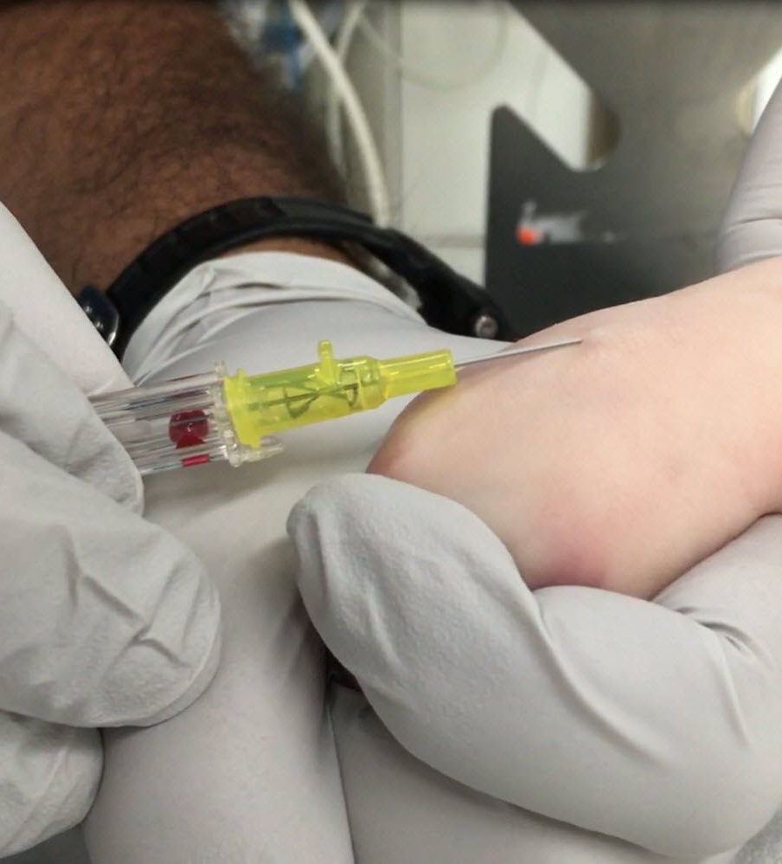
I’m Ready to Stick!
PREP THOROUGHLY and ALLOW TO DRY COMPLETELY.
Chlorhexadine is fine if >27 weeks gestation, betadine or alcohol if <27 weeks
Insert needle into chosen vein, sliding in slowly and watching for a flash.
Typically almost flat to skin, very shallow angle!
Hold skin taut to stabilize the vein- above and below with fingers of non-dominant hand making a “C”
May have to pull needle out of catheter to watch for slow return of blood.
If none present, reseat needle fully and advance carefully, stopping to check periodically for a flash.
Often helpful to place tegaderm over catheter once flash is obtained, prior to flushing.
So they don’t dislodge it by wiggling while you flush!

Slide 17
Securement and Assessment
Place tegaderm over insertion site. May use tape over tegaderm to further secure catheter, often “chevron” around hub of tubing.
Utilize cotton ball or small gauze to prevent hub from creating pressure sore.
May also use cotton ball inside hand if taping circumferentially.
MAKE SURE insertion site is visible- not wrapped under Coban or gauze.
Visualize site every 30 minutes- don’t “swaddle in” IV extremity.
Some facilities prefer armboards, can also use folded diaper, “soft nets” to support extremity.

Slide 18
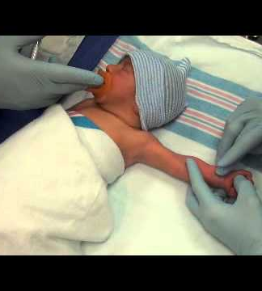
Venipuncture and Heelsticks
Venipuncture, especially for cultures, requires careful preparation.
Same guidelines as IV starts- clean for at least 30 seconds, allow to dry for a whole minute.
Contaminated cultures are a leading cause of prolonged antibiotic use in newborns
Utilize a butterfly with syringe on end, not vacutainer
Pull plunger back slightly prior to attaching to butterfly tubing
Helpful to use a “friend” to pull back on syringe once blood is flowing
Similar technique to IV starts
Shallow angle, slow advancement

Slide 19
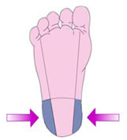
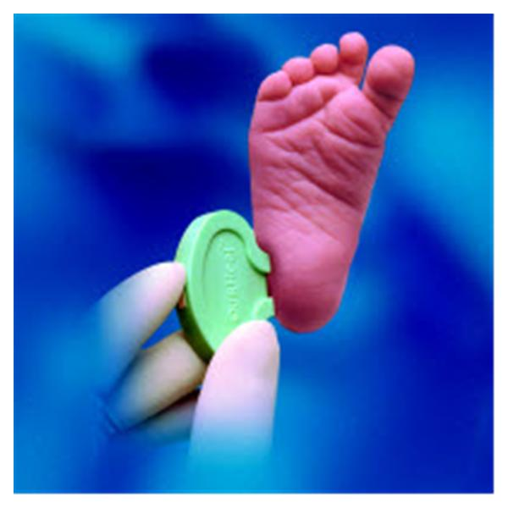
Venipuncture and Heelsticks
Successful heelsticks are dependent on great capillary blood flow- WARMTH and POSITION are critical
Place heel warmer several minutes prior to stick
Consider two- one on foot, one on calf, can leave one on calf throughout procedure
Calm, swaddled baby or place skin-to-skin with mother
Containment, sucrose or breastmilk and sucking all help!
Prep site thoroughly and allow to dry completely
Hold lancet firmly against heel and depress button

Slide 20
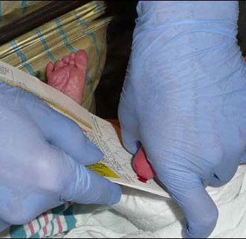
Venipuncture and Heelsticks
With non-dominant hand cupping foot, thumb pointing downward, flex foot lightly against shin, don’t squeeze excessively
Allow time for capillary refill to occur
Gravity is your friend, position baby to allow blood to flow “downward” if possible
Try to avoid “scraping” or “scooping” if possible, allow drops to fall freely
Prevents hemolysis and clotting

Slide 21
Early Feedings
For earlier preterm babies (32-33 weeks) or babies with respiratory distress first feeds may be “priming” feeds
Preferably breastmilk
Up to 20ml/kg/day
Purpose is to activate gut enzymes, prevent atrophy of the villi, prepare the intestines for larger amounts of food
This is “free food”, we don’t count it towards the baby’s fluid goal or calorie goal.
“Colostrum therapy”- offering up to 2mls of mother’s milk via swab or syringe to allow tastes in an infant otherwise unable to feed.

Slide 22
Feeding Schedules
When those infants are ready for more nutrition, they can be placed on a “feeding schedule”
Labeled by alphabet letter in the NICU, divided by gestation/weight
Most common one used in this setting is “D”
Advances feeding volume every few feedings
Typically begin with plain expressed breastmilk, then consider adding more calories with HMF (human milk fortifier) when mothers are able to pump higher volumes
These feedings may be by OG or NG tube, or by mouth
Also incorporate opportunities for breastfeeding directly

Slide 23
Feeding Schedules
Multiply rate factor (third column) by the weight in kilograms, to get the volume of each feeding.
Example: 2kg baby- first three feedings 8mls, second three feedings 11mls, third three feedings 14mls

Slide 24
Inserting a Feeding Tube
Measure from tragus of ear, to center of upper lip, to xyphoid process and add 1cm.
Mark cm with tape, then tape to face to secure
Can insert orally or nasally
Oral only until >1500gm due to small size of nares
Oral can impede bottle or breast feeding, nasal can impede respirations
Check placement with air bolus and aspiration of gastric contents.
Remove clean with sterile water weekly, replace monthly or as per manufacturer guidelines

Slide 25
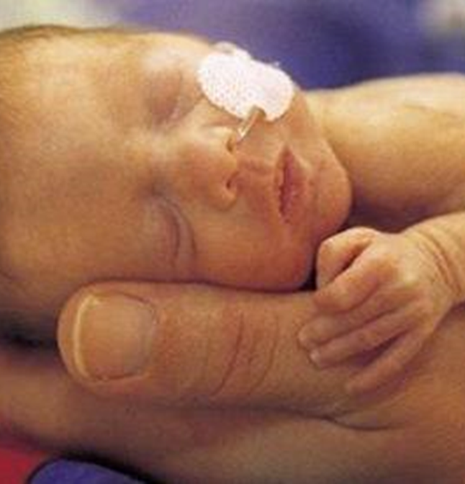
Giving Tube Feeds
Prior to each feeding, check tube placement with air bolus and pull back slightly to view gastric contents
Current NICU protocol says not to check volume of aspirates in the absence of an abnormal examination
Soft, rounded belly, active bowel sounds, stooling at least once daily, minimal emesis
Can be given by gravity, hanging syringe from top of isolette or crib, or being held by nurse/parent
If infant is having feeding intolerance, may be administered by syringe pump to control rate (usually over 30-60 minutes)

Slide 26
Giving Tube Feeds
Flush tube with 1-3ml sterile water when completed
Feeding tubes need to be removed and cleaned with water every 7 days
Extension tubing (used if giving by syringe pump) needs to be replaced every 8 hours.
Use a cotton swab to allow infant to taste drops of milk during tube feedings, or place drops on infant’s upper lip to allow them to smell milk
Offer pacifier during tube feedings, to associate pleasurable sucking with stomach becoming full

Slide 27
Breast and Bottle Feeding
Oral feedings may begin when respiratory status is stable and infant is showing cues
Can orally feed while on nasal cannula as long as respiratory rate is <60
Early in the process, infant will likely not be able to take full bottles, or nipple at every feeding time
Limit bottle feeding attempts to 20 minutes
Prevents excessive energy expenditure
Less likely with breastfeeding, no stringent time frame

Slide 28
Feeding Readiness Criteria: OFFER FEEDS IF…
Autonomic | Motor | State | Attention/Interaction
Steady breathing, heart rate, oxygen saturation when held | Rooting Hands to mouth | Woke on own: Quiet alert | Engaging in care: shifts gaze toward caregiver
Breathing <60 breaths/min with care | Sucking on hands and/or pacifier | Overall wakes 50% of caregiving times and stays awake 10+ minutes | Energy observed
Breathing <60 breaths/min and O2 sats in desired range with NNS | Active tucking of arms and legs

Slide 29
Feeding Readiness Criteria: DON’T OFFER FEEDS If…
Autonomic | Motor | State | Attention/Interaction
Breathing > 60 breaths per minute | No rooting to accept the pacifier | Briefly wakes with care | Eyes do not open
Bradycardia with caregiving | No hands to mouth | Drowsy | Low energy
Desaturation with caregiving | Slight or minimal active tucking of arms and legs | Sleeping throughout care

Slide 30
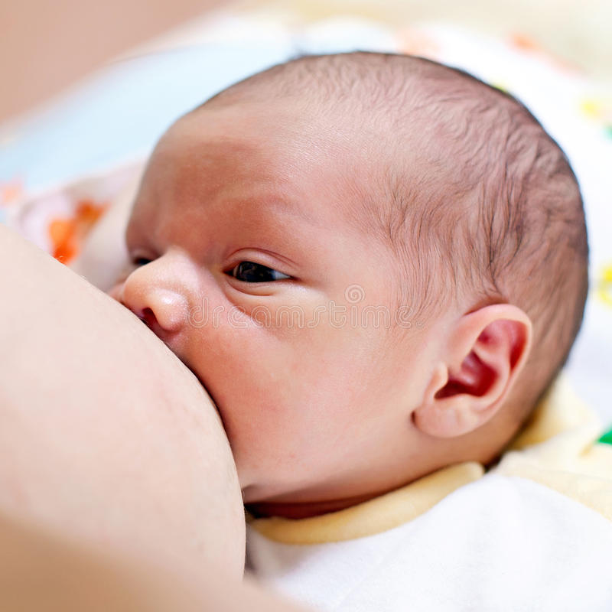
Supporting Breastfeeding
Skin to skin holding and nuzzling at breast to lay a foundation
Utilize lactation consultation
Establish early feedings at breast if breast feeding is mom’s goal
Supplement following breast feeding with tube feedings
Preemies not expected to breast and bottle at same feeding experience!
NICU Guidelines: 10 minutes latched and actively feeding= no supplement
5-10 minutes latched and actively feeding= ½ supplement
<5 minutes latched and actively feeding= full supplement

Slide 31
Signs of Completion of Feeding
Baby no longer rooting or eagerly sucking
Pauses exceed sucking bursts
Decreased energy in body, no longer maintaining hands to face
Increased loss of milk from mouth
Decreased coordination

Slide 32
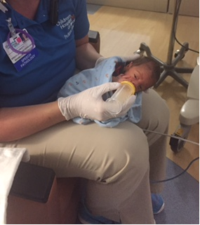
Feeding Position: Elevated Side-lying
Head in midline
Ear, shoulder, hip toward ceiling
Postural support to arms and body
Bottle held horizontal
Rationale
Slows flow
Improves airway protection and breathing
Fewer signs of behavioral stress
Optimizes energy, safety and overall performance

Slide 33
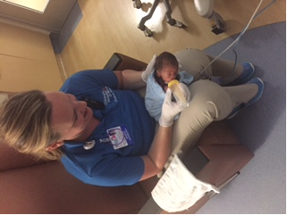
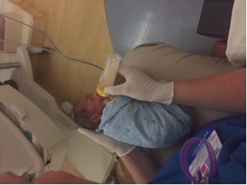
Side-lying Positioning
C.Meyer, T. DeWolfe, CHOI NICU Therapy 2017

Slide 34
Questions??

