Slide 1
Illinois Congenital Syphilis Elimination Strategy Comes to You
The What, Why, How and When
of Congenital Syphilis Testing, Prevention, and Treatment During Pregnancy

Slide 2
Preventing Congenital Syphilis (CS)
What is congenital syphilis?
What is the law in Illinois?
Why is Third Trimester Testing critical?/Why work so hard to find cases?
How much of a problem is congenital syphilis?
How is syphilis diagnosed and treated during pregnancy?
When should testing be done?
We find a positive syphilis test in pregnancy. What next?

Slide 3
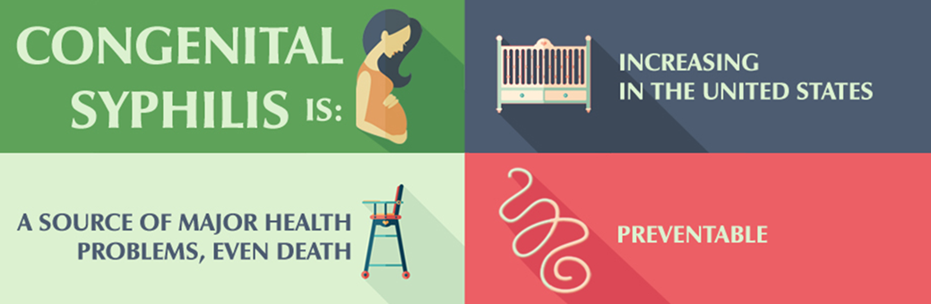

What is Congenital Syphilis?
A preventable and treatable infection acquired by the fetus during pregnancy, transmitted from a pregnant person infected with syphilis
A disease that causes significant morbidity and mortality
  25% untreated pregnancies with syphilis result in pregnancy loss or other adverse outcomes
    Including neonatal death, prematurity, low birth weight, neonatal illness, and lifetime morbidity such as developmental delay and hearing loss.

Slide 4
Syphilis Testing during Pregnancy:
What is the Law in Illinois?
For all pregnancies in IL, both first visit and third-trimester syphilis testing are required. 410 ILCS 320/1
There are documented disparities and poor adherence with IL mandate.¹
1. Clement AC, Fay KE, Yee LM. Disparities in state-mandated third-trimester testing for syphilis. Am J Obstet Gynecol MFM. 2022 May;4(3):100595. doi: 10.1016/j.ajogmf.2022.100595. Epub 2022 Feb 15. PMID: 35176505; PMCID: PMC9081215.

Slide 5


Why is Third Trimester Testing Critical?
Why work so hard to find CS cases?
Congenital Syphilis is a preventable, detectable, and treatable disease -- during pregnancy!
Early third trimester testing allows plenty of time for effective treatment of both the pregnant person and the fetus
Syphilis can acquired throughout pregnancy and have no symptoms!
  Congenital Syphilis may be missed at birth
Syphilis cases and CS cases are on the rise in IL and US

Slide 6

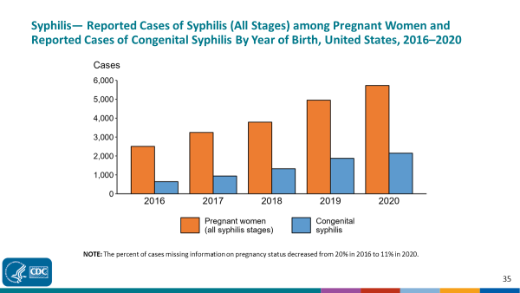
As Pregnancy-associated Syphilis Rises in USA, Congenital Syphilis Follows

Slide 7
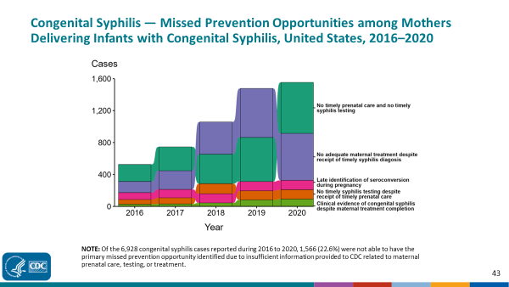
The majority of CS cases are preventable by testing and treating women who are already engaged in prenatal care.

Slide 8
How much of a problem is syphilis?
Increasing Syphilis Seroprevalence in Illinois and US
In 2013, primary and secondary cases of syphilis in Illinois were 6.2 cases per 100,000 population.
As of 2017, primary and secondary cases of syphilis in Illinois rose to 9.6 per 100,000 population, making Illinois was the 10th state with the highest number of primary and secondary syphilis cases.
Chicago rate: 30.2 per 100,000.

Slide 9
IL Congenital Syphilis Prevention Cascade
Step 1: Universal testing for syphilis at initial prenatal visit
Treatment for positive cases
Step 2: Universal third trimester syphilis testing
Treatment for positive cases
Step 3: Testing at delivery in areas of high seroprevalence or for persons with increased risk
Partner testing and treatment
Partner testing and treatment
Negative test
Negative test
Modified from: Park E, Yip J, Harville E, Nelson M, Giarratano G, Buekens P, Wagman J. Gaps in the congenital syphilis prevention cascade: qualitative findings from Kern County, California. BMC Infect Dis. 2022 Feb 5;22(1):129. doi: 10.1186/s12879-022-07100-3. PMID: 35123425; PMCID: PMC8818245.

Slide 10

IL Universal Strategy vs. CDC Recommendations
*Step 1: Universal testing for syphilis at initial prenatal visit
Step 2: Universal third trimester syphilis testing
Step 1: Universal Testing for syphilis at initial prenatal visit
Negative test
Negative test
Step 2 and 3: Testing at 28 weeks and delivery for persons in high seroprevalence areas or have identified increased risk(s) of syphilis
Step 3: In areas
of high risk or for persons with increased risk, test at delivery
Negative test

Slide 11
CDC’s High Risk Groups for Acquiring Syphilis During Pregnancy
Sex with multiple partners
Drug use
Transactional sex
Late prenatal care
Incarceration of pregnant person or partner
Unstable housing
STI Treatment Guideline, 2021, CDC

Slide 12
Transmission Risk By Syphilis Stages
Primary and Secondary Syphilis: Highest risk of transmission from partner to pregnant person and from pregnant person to fetus
    Usually transplacental acquisition, rarely acquired during delivery
    Primary disease: painless chancre at site of inoculation
    Secondary syphilis: disseminated disease classically identified by rash or mucous membrane lesions in mouth, vagina or anus.
    Signs of primary or secondary syphilis can easily be missed.
Latent syphilis in the mother can also result in congenital syphilis
  Pregnant person often shows no clinical signs or symptoms

Slide 13
Treatment of Syphilis during Pregnancy
& Optimal Timing of Detection and Treatment
Parenteral penicillin IM or IV) is the only drug appropriate for any stages of syphilis during pregnancy.
  If Penicillin (PCN) allergy listed, obtain Allergy Consult.
Early treatment is optimal
Syphilis detected in 3rd trimester: Is there time to treat or prevent congenital syphilis? Yes!
  Treatment in pregnancy is most likely to be effective in preventing transmission and in treating an infected fetus if appropriate treatment is initiated 30 or more days prior to delivery.
  Ideal window for third trimester testing is 28-34 weeks, although later testing, even at delivery, can be beneficial.

Slide 14
Syphilis tests in a pregnant person look positive
What’s next?

Slide 15
“Reverse” Syphilis Testing Interpretation During Pregnancy:
More at Risk → More Scrutiny (derived from CDC STI Guidelines 2021)
1. Treponemal Ab (EIA or CIA) | 2. Reflex RPR or VDRL | 3. Reflex to 2nd treponemal test | Interpretation and Actions
Negative | Not performed | Not performed | No evidence of syphilis. No treatment.
Positive | Positive | Not performed | Syphilis is confirmed. Treat with parenteral PCN according to stage of maternal syphilis. Test and treat partner. Treat for syphilis with one possible exception: there is documented prior treatment of syphilis with reduction in RPR titers and the RPR has remained low and stable (termed serofast). In these patients, if no ongoing risk of syphilis, might withhold treatment. Specialist consultation is recommended.
Positive | Negative | Positive | Syphilis is confirmed– either current or in the past. If no history of treatment of syphilis in the past, treat for appropriate stage of syphilis. If unknown stage, treat with 3 weekly Benzathine PCN shots. Test and treat partner(s). If well-documented history of syphilis and adequate treatment and no ongoing risk, no further treatment is necessary.
Positive | Negative | Negative | If low seroprevalence region, low behavior risk and no history of treated syphilis, the treponemal ab is likely false positive, but examine patient for primary or secondary syphilis AND test & examine partner(s) for syphilis AND repeat mother’s tests in 4 weeks. If test 2 and 3 remain negative, no treatment is indicated. If, +/-/- but additional follow-up is uncertain, treat with 1 dose of Benzathine PCN G IM.

Slide 16
Linkage to Care
Must Follow
Maternal Syphilis Detection
Maternal Syphilis Detected.
Initiate PCN Treatment.
Notify IDPH.
Partner testing and treatment
If penicillin allergy listed,
obtain urgent Allergy Consult
to ensure PCN administration
Arrange Postpartum Follow-up of RPRs for 1-2 years
Notify neonatal team at or ahead of delivery of :
Maternal syphilis history, treatment (doses, route, and dates) , and serial RPRs

Slide 17
Your Detecting Maternal Syphilis & Documenting Syphilis Treatment During Pregnancy Matters!
All infants do not automatically get checked for syphilis at birth.
However, any infant with a mother with syphilis during pregnancy should get syphilis testing.
  These infants will be placed into one of 3 risk groups: high risk, intermediate risk and very low/no risk – depending upon infant’s exam, RPR titer and the diagnosis you made and treatment you gave during the pregnancy.
    Those infants with high or intermediate risk will get a lumbar puncture and PCN treatment.
    Those infants with normal exams, low RPRs, and whose mothers began appropriate treatment at or before 30 days prior to delivery are usually not treated and do not get LP.

Slide 18
Systemic Changes to Promote
Effective Third Trimester Syphilis Testing
Ensure your hospital follows the reverse syphilis testing algorithm with reflex testing.
Review what other activities or services happen at 28-34 weeks gestation such as HIV third trimester testing and switching to q2 week visits. Bundle these activities (via computer decision support) with syphilis third trimester testing.
Create a pathway for partner testing and treatment.

Slide 19
Conclusions
Congenital Syphilis is detectable, preventable, and treatable DURING PREGNANCY.
Third Trimester Testing for maternal syphilis is the LAW in IL.
Ideally, third trimester syphilis testing takes place between 28-34 weeks gestation in order to allow for effective treatment of pregnant person and fetus, but testing beyond 34 weeks, even at delivery, is still beneficial for the health of baby and parents.
Detection of syphilis during pregnancy demands multiple ACTIONS
  Perform thorough history and exam to determine stage of disease
  Treat with Penicillin urgently, according to stage of disease
  Test and treat partner(s)
  Arrange linkage to care for maternal postpartum syphilis monitoring, for partner, and for neonate.
  Let’s Do This!

Slide 20
FOR IMMEDIATE RELEASE: CONTACT:
  November 2, 2023 Michael.Claffey@illinois.gov James.Leach@illinois.gov
IDPH Launches New Provider Phone Line in Response to Alarming Increase in Babies Born with Congenital Syphilis
CHICAGO – Acting to address a sharp increase in congenital syphilis cases among newborns, the Illinois Department of Public Health (IDPH) is urging healthcare providers to conduct more testing for the sexually transmitted infection in advance of birth and is launching a new phone line to provide clinical consultation for providers who treat pregnant patients and newborns.
The service called the Perinatal Syphilis Warmline (at 1-800-439-4079) comes in response to an almost tripling in the number of congenital syphilis cases in Illinois since 2021. There were 29 cases in the state in 2020, 50 cases in 2021 and 84 cases in 2022. Calls will be answered within a day. “The best way to protect Illinois’s babies from congenital syphilis is for pregnant people to get tested and treated for sexually transmitted infections before birth,” said IDPH Director Dr. Sameer Vohra. “These rising rates of congenital syphilis are alarming, and IDPH is responding with new education tools and support services to help providers who care for those who are pregnant and their newborns.”
Congenital syphilis cases have been surging in recent years both nationally and in Illinois. Since 2000, national data shows an increase in syphilis of 459%. Specifically for pregnant people and their infants, congenital syphilis has increased 203% since 2017.
Syphilis is an infection caused by the bacteria Treponema pallidum and is spread through sexual contact. Congenital syphilis occurs when a pregnant person with untreated syphilis passes the infection to their infant during pregnancy. It can cause permanent damage or death to an infant. Before birth, syphilis can cause a miscarriage, premature delivery, or low birth weight. Up to 40% of babies with congenital syphilis may be stillborn or die from the infection. A baby with a syphilis infection may not have signs or symptoms of the infection at the time of birth. But if untreated, the baby may develop serious complications such as cataracts, deafness, or seizures and, it could also lead to death in infancy or childhood.

Slide 22
Health care providers are required by Illinois law (410 ILCS 320/1) to screen all pregnant women for syphilis infection during the first prenatal visit and during the third trimester. - In the event any blood tests shall show a positive or inconclusive result an additional test or tests shall be performed
1) Initial SYPHILIS screening:
Total # delivered women who presented without ANY documented syphilis screening test prior to labor and delivery
1. Total # women missed, not screened (either before delivery or immediately postpartum) Of the total untested, delivering women, total women not screened.
2. Total # women screened Total number of untested, delivering women who were screened for SYPHILIS
a.# any reactive results |  | b.# negative results
B. Total # of multiple births and infants received through transports From missed women only, total number of multiple births. Add the number of infants received through transports.
2) Repeat 3rd Trimester SYPHILIS screening:
A. Total # delivered women who presented without documented SYPHLIIS screen after 28 weeks (27w6d) in the pregnancy The number of delivered women who presented to L&D with documentation of SYPHILIS screening in pregnancy, but without a screen performed after 27 weeks and prior to delivery.
B. Total # women missed, not screened prior to discharge Of the total delivering women not repeat screened after 27 weeks, total women not screened.
2. Total # women SYPHILIS screened Total number delivering women not repeat screened after 27 weeks, who were screened for SYPHILIS
a.# any reactive results |  | b.# negative results

Slide 23
